Slide 1
Lidar in New mexico
Shawn L. Penman, PhD, CFM, GISP

Slide 2
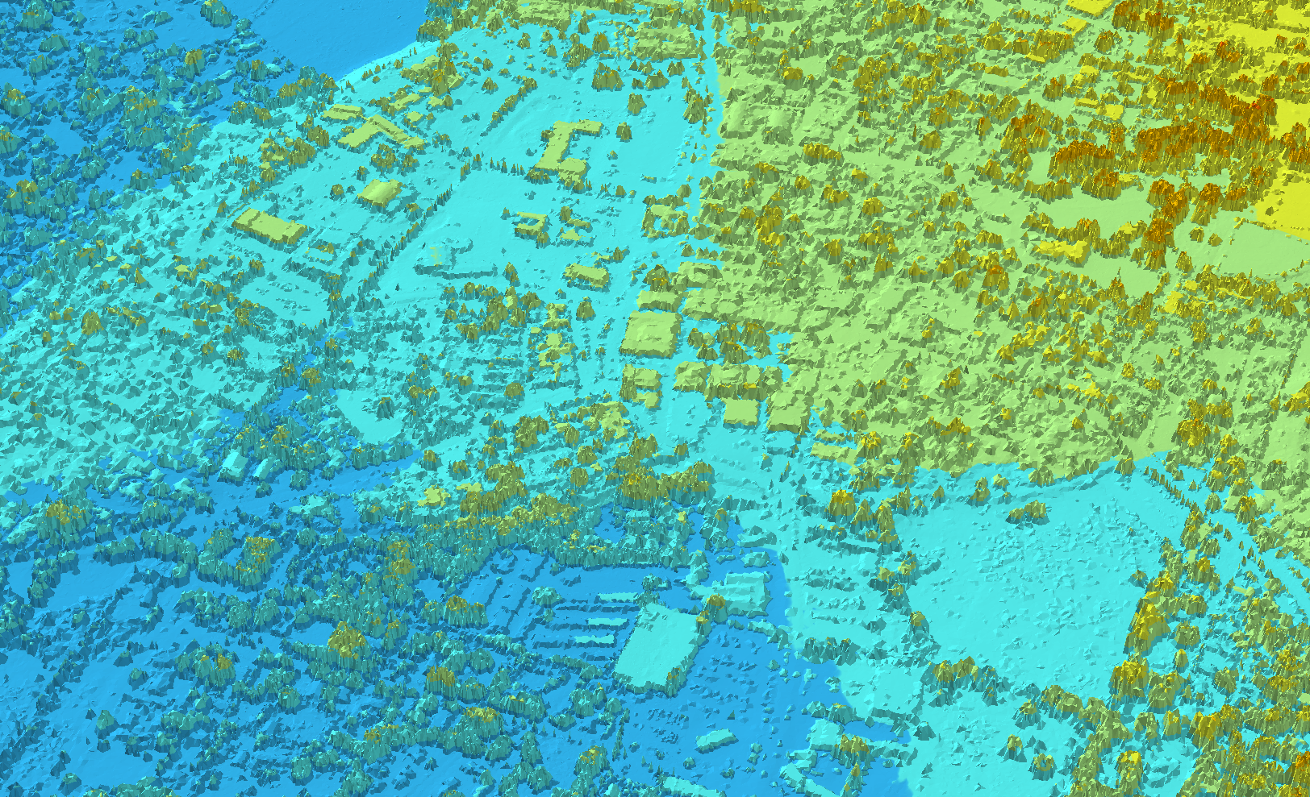

Slide 3
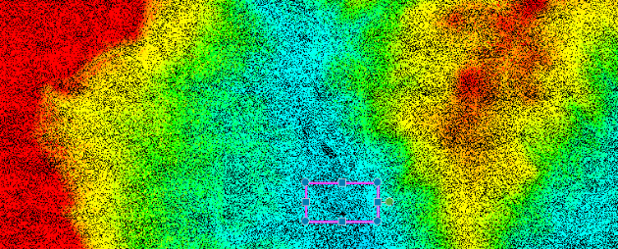
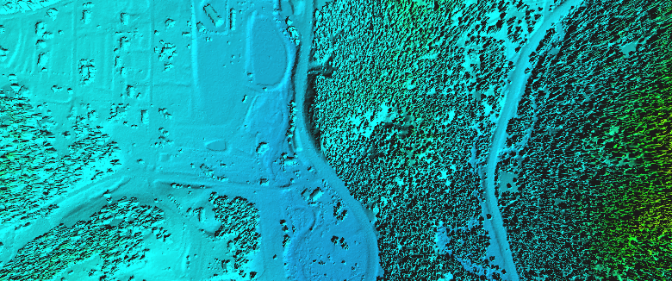
Basic Lidar Products
Lidar Point Cloud, Colored by Elevation
La Cueva Area (Valles Caldera Project, 2010)
Surface Model
Side-View Profile

Slide 4
USGS Quality Levels
Quality Levels | Data Source | Horizontal Resolution | Vertical Accuracy
 |  | Point Density | RMSEz in Open Terrain | Equivalent Contour Accuracy
QL 1 | LiDAR | 8 points/m² | 9.25 cm | 1 foot
QL 2 | LiDAR | 2 points/m² | 9.25 cm | 1 foot
QL 3 | LiDAR | 1 – 0.25 points/m² | ≤18.5 cm | 2 feet
QL 4 | Imagery/ LiDAR | 1 – 0.04 points/m² | 46.3 – 139 cm | 5 – 15 feet
QL 5 | Imagery/ IFSAR | 0.04 points/m² | 92.7 – 185 cm | 10 – 20 feet

Slide 5
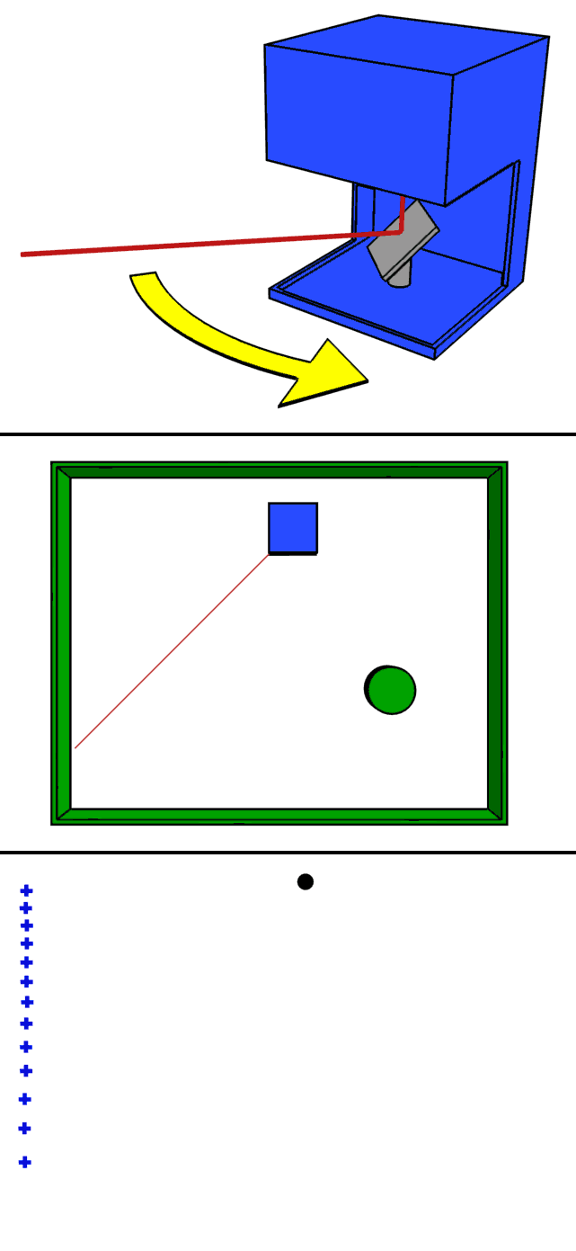
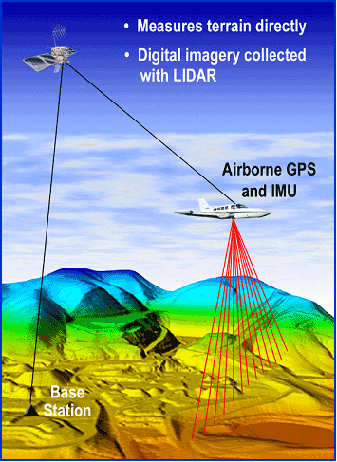
What is lidar?
lidar: light detection and ranging
sometimes called 3D laser scanning
or laser elevation profiling
Lidar measures distances to the Earth using laser pulses
Processed pulses give precise 3D info about surface shape and features

Slide 6
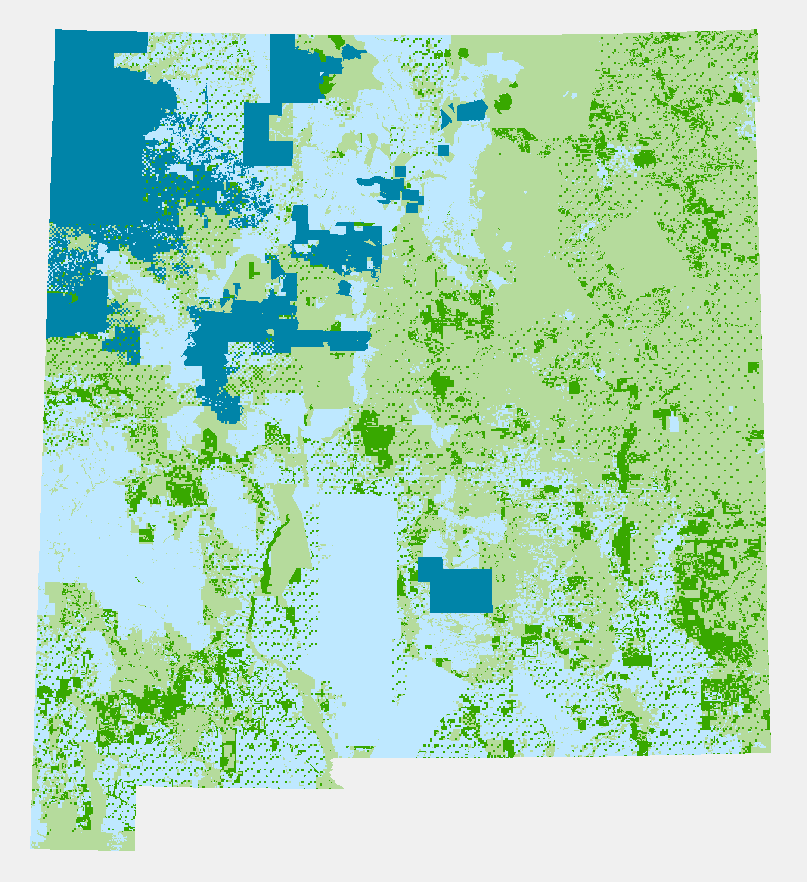
Land ownership
Federal 34%
Tribal 11%
State 12%
Private 44%
Notes:
M
Fed 34%
Tribal 11%
State 12%
Private 44%

Slide 7
NM Lidar

Slide 8
Lidar Returns
Forest Resource Assessment Nepal
Notes:
lidar: light detection and ranging
sometimes called 3D laser scanning
or laser elevation profiling
Lidar measures distances to the Earth using laser pulses
Processed pulses give precise 3D info about surface shape and features

Slide 9
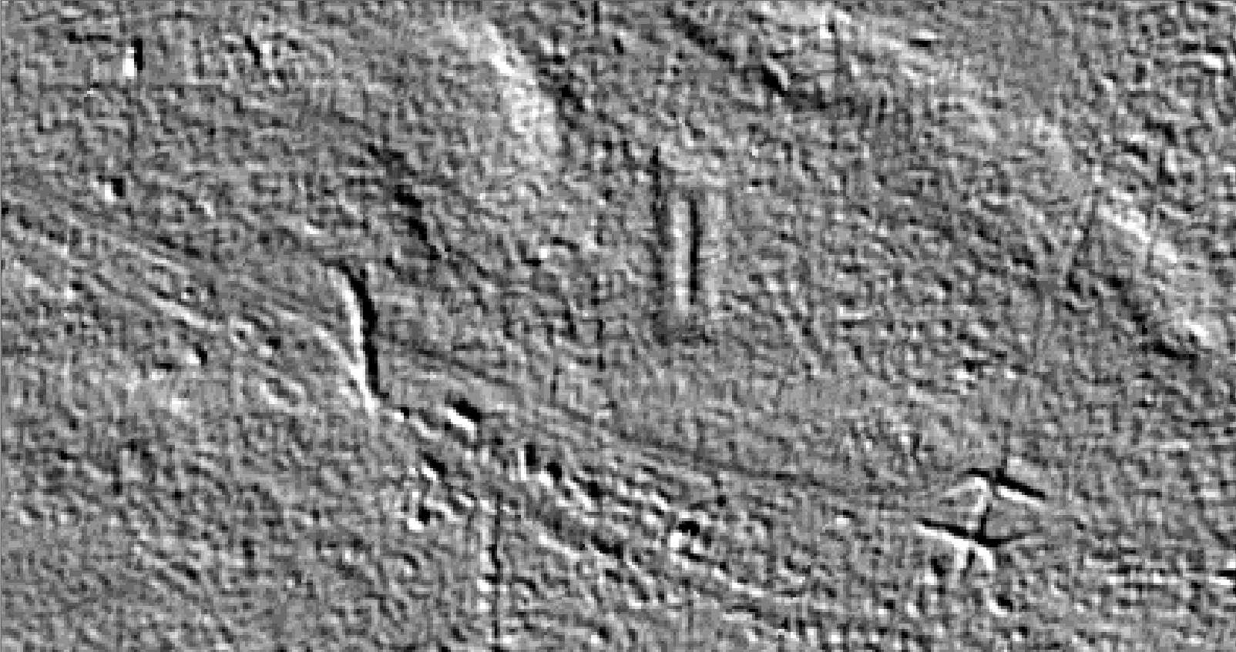
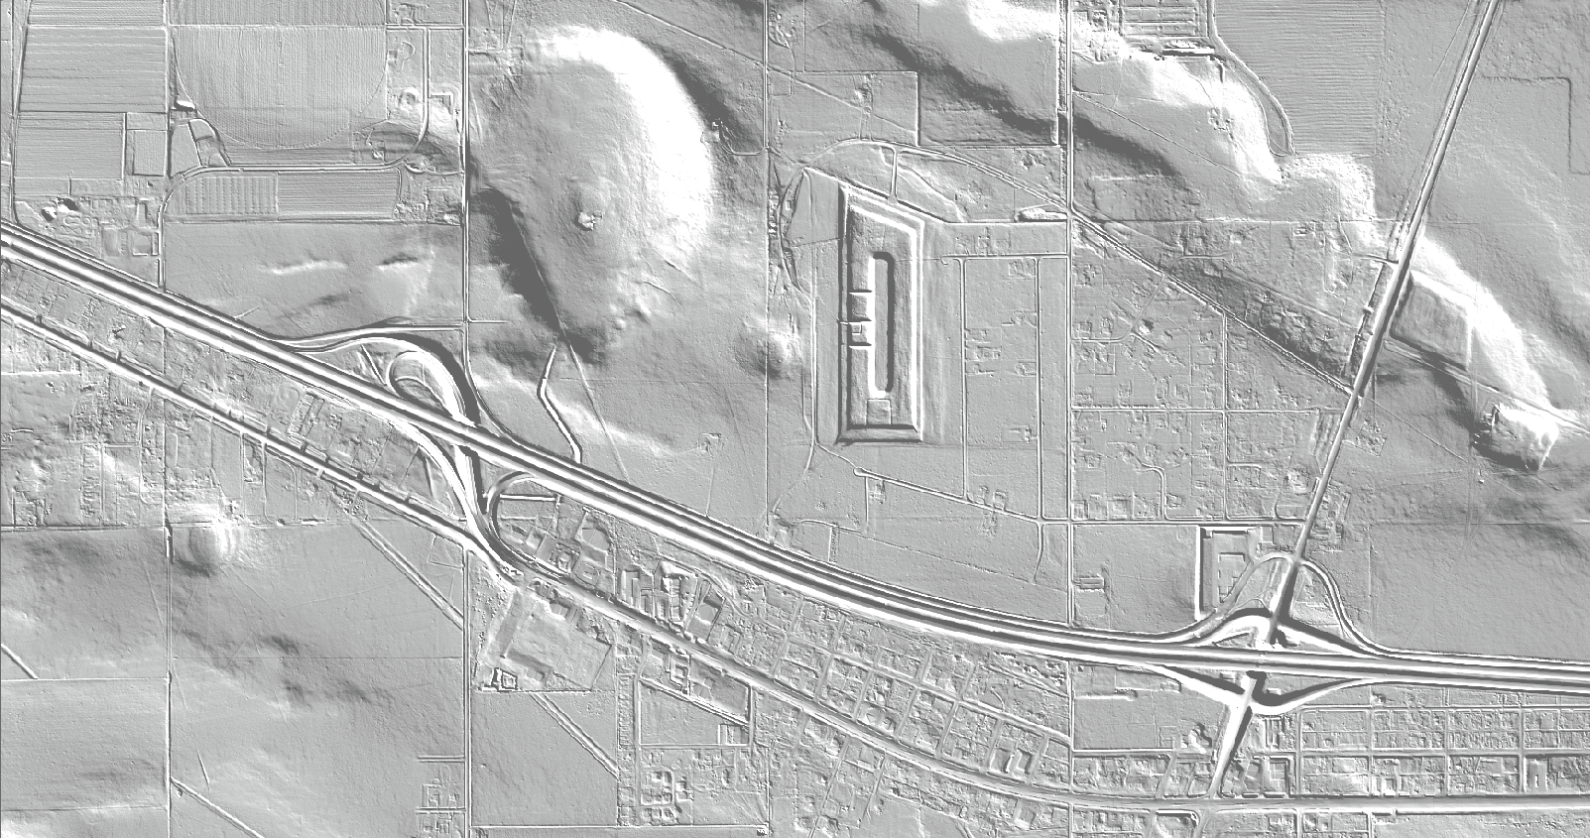
Current 10 Meter DEM vs USGS QL2 Lidar

Slide 10
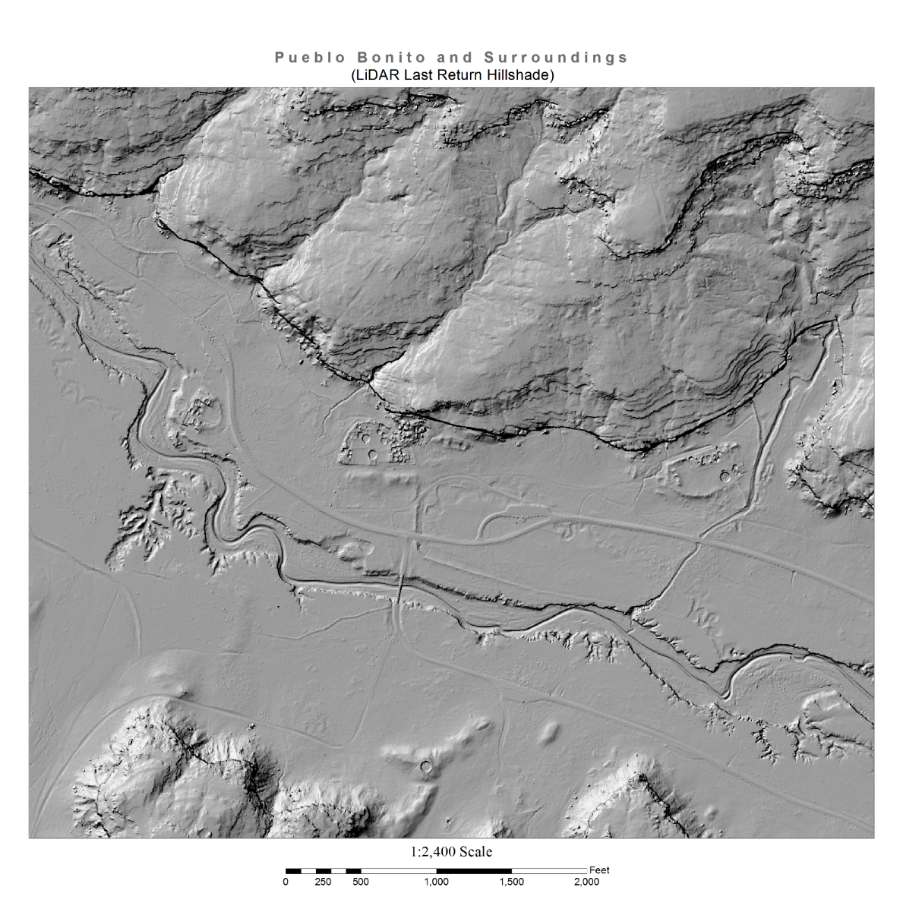
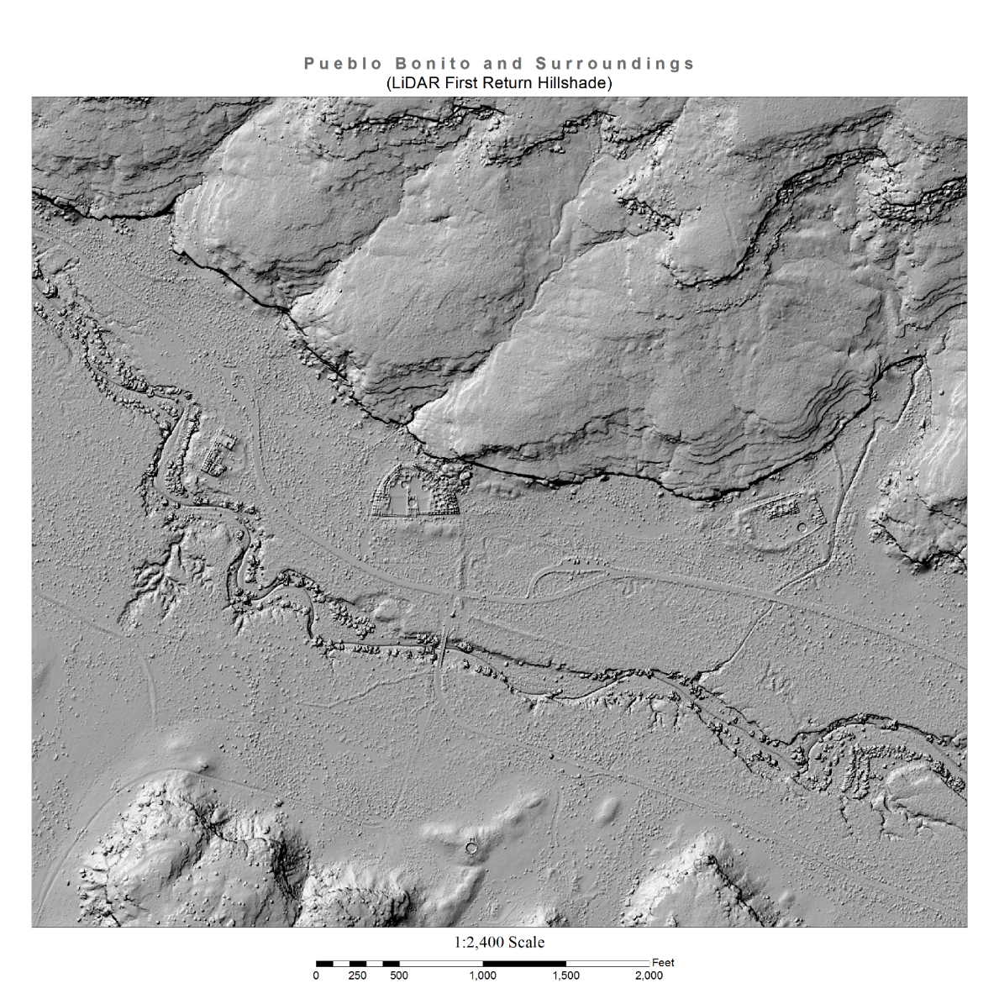
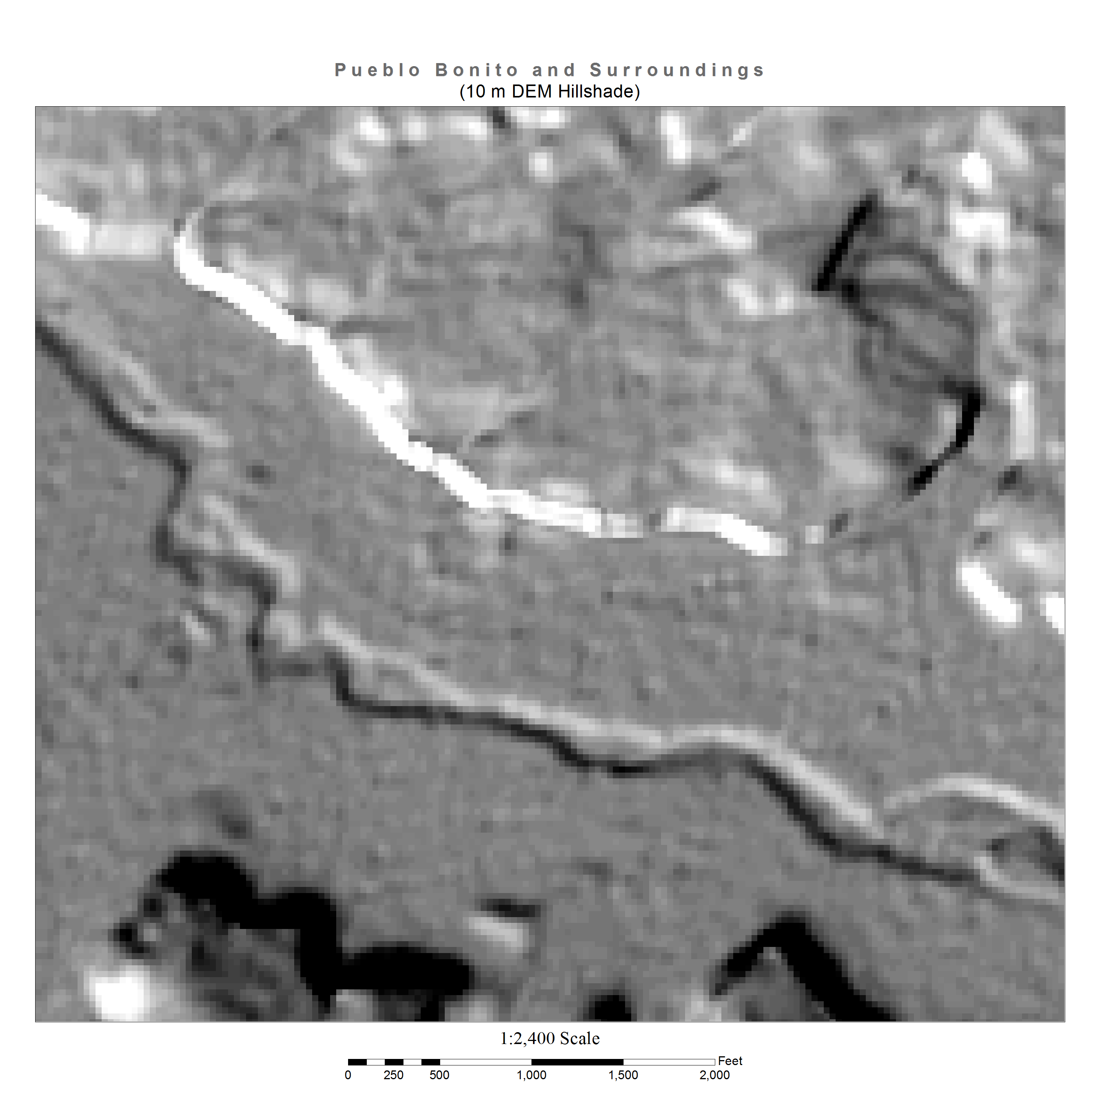
Lidar for fun

Slide 11
Lidar Products
Delivered Elevation Products
DEM
Classified LAS Files
Break lines
Intensity Image
EDAC Produced
Elevation Products
DSM
DTM
Hillshade
Contours
Slope
Aspect

Slide 12
Lidar Products
EDAC Feature Extraction
Building Footprints
Impervious Surface
Streams
Acequias
Levees
Vegetation
Roads
Utilities
Sinkholes
Playas (ephemeral lakes)
Defensible Space
Reduced Fuel Zone
Overall Perimeter
Defensible Space & Reduced Fuel Zone
Notes:
Defensible Space:
We used the developed building/structure and canopy layers to create a WUI defensible-space perimeter for each structure.
Defensible space of up to 30 feet is the area where vegetation should be kept to a minimum, sometimes termed the “low, lean, and green” zone.
Reduced Fuel Zone:
A perimeter representing the reduced-fuel zone; this zone of up to 100 feet from a structure is the area where vegetation should be trimmed and
maintained to preserve horizontal and vertical separations between the structure and the fuel (vegetation). This was used as a mask to create a
separate WUI canopy raster layer to highlight all vegetation and vegetation heights within the WUI defensible-space perimeters.
Over all Perimeter:
A layer combining the Rio Hondo Defensible Space data, and the Reduced Fuel Zone data.
This gives the user a simpler way of identifying areas that may require fuel thinning treatments.

Slide 13
Rio hondo products

Slide 14
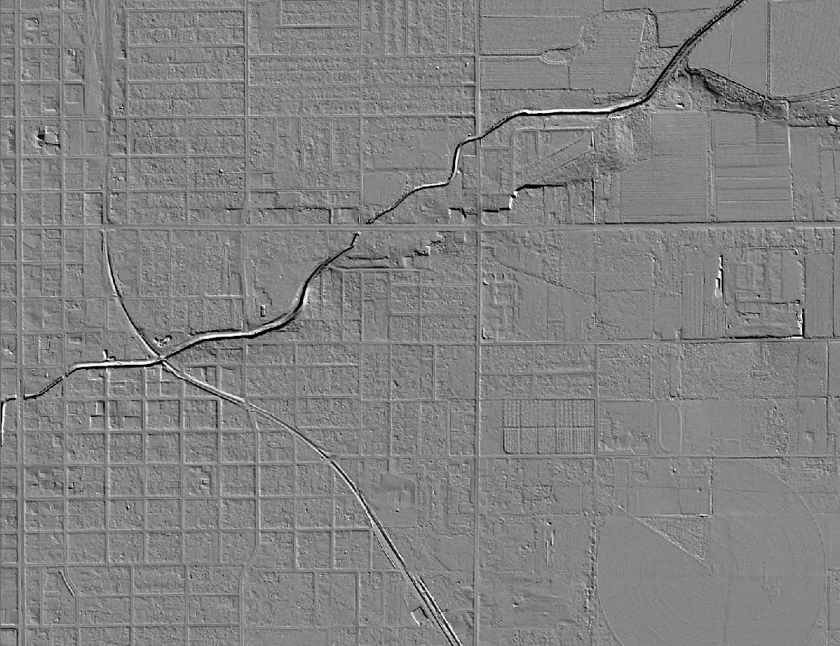
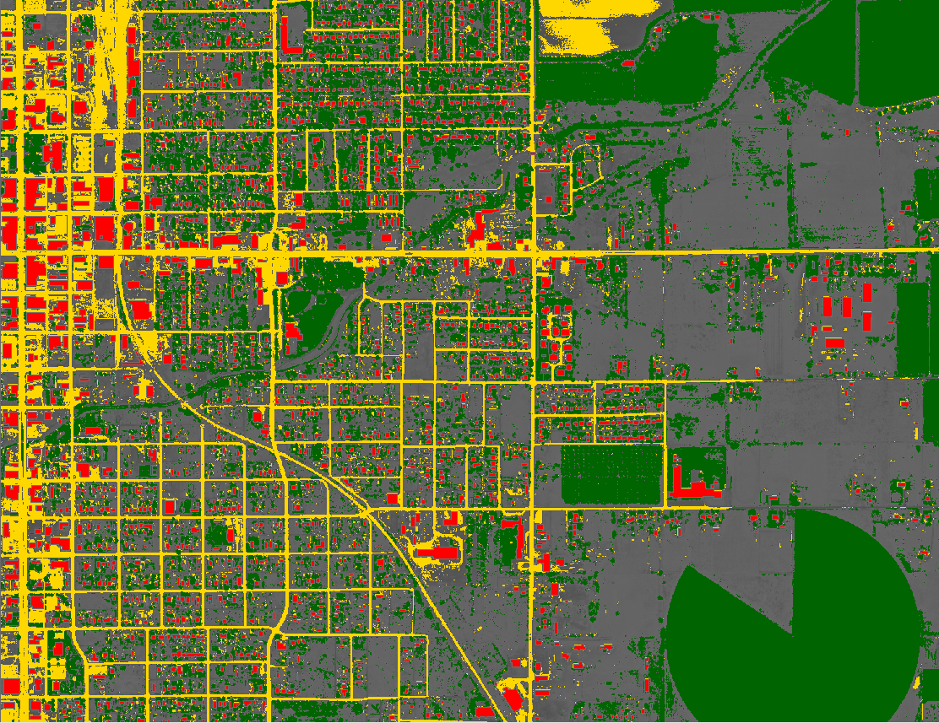
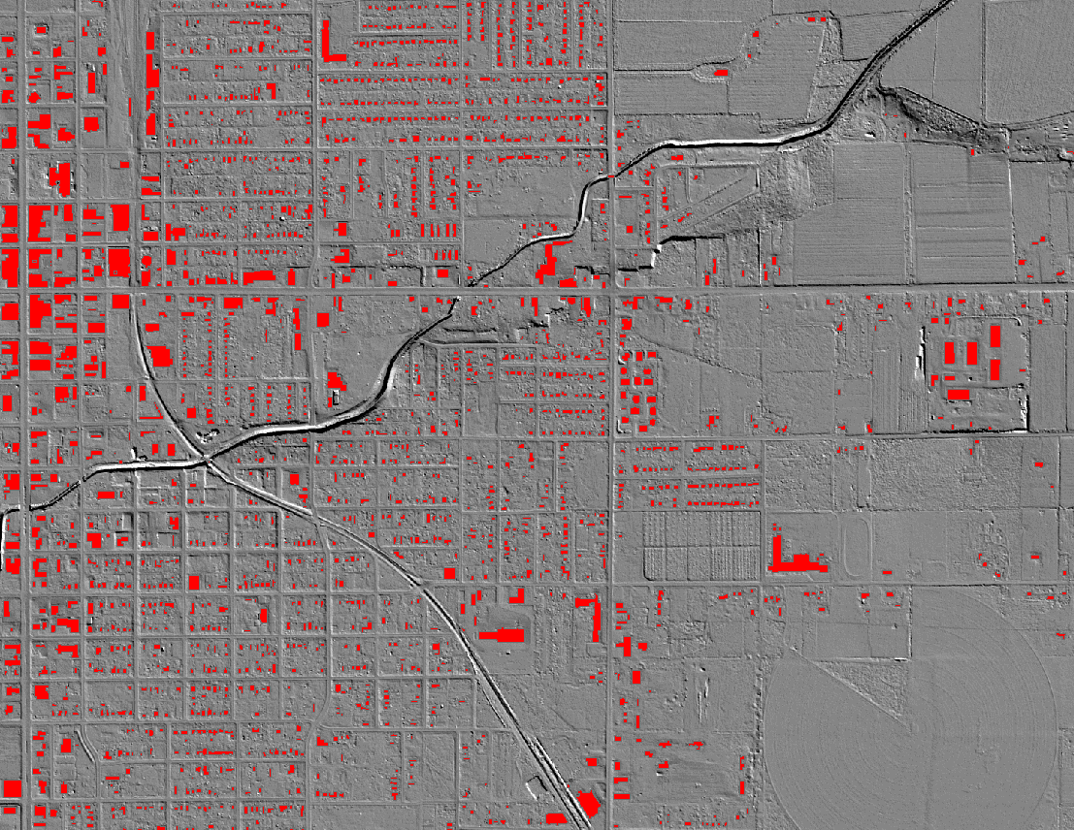
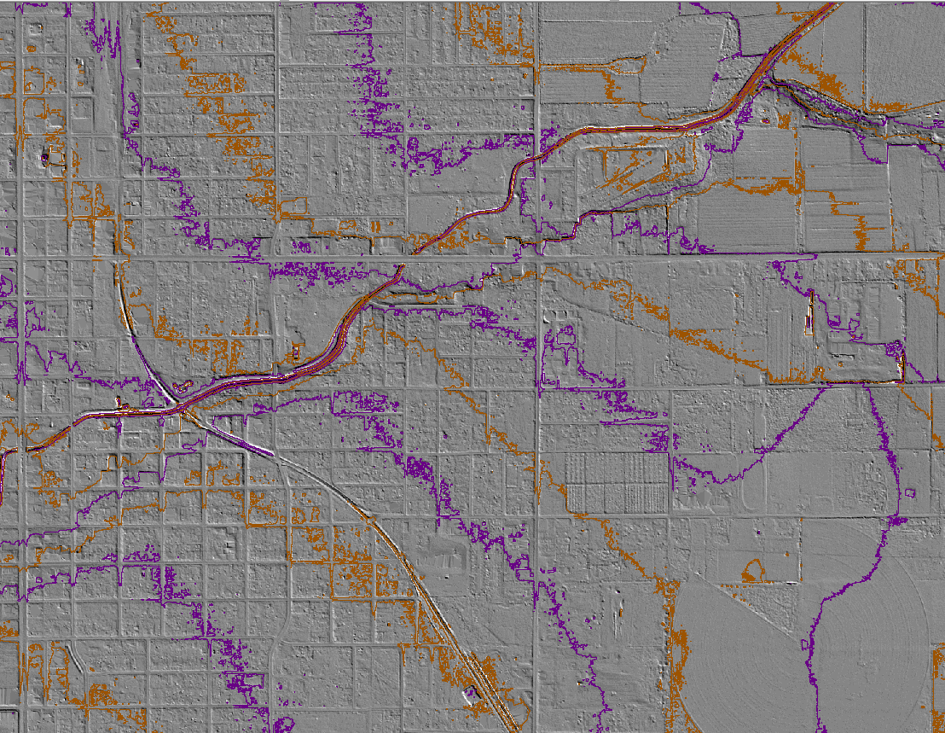
Notes:
1. 1:24k quad map
2. 10m USGS - NED shaded relief
3. Lidar bare earth shaded relief
4. 5 & 10 ft contours
5. building footprints
6. vegetation canopy and impervious mapping (yellow)

Slide 15
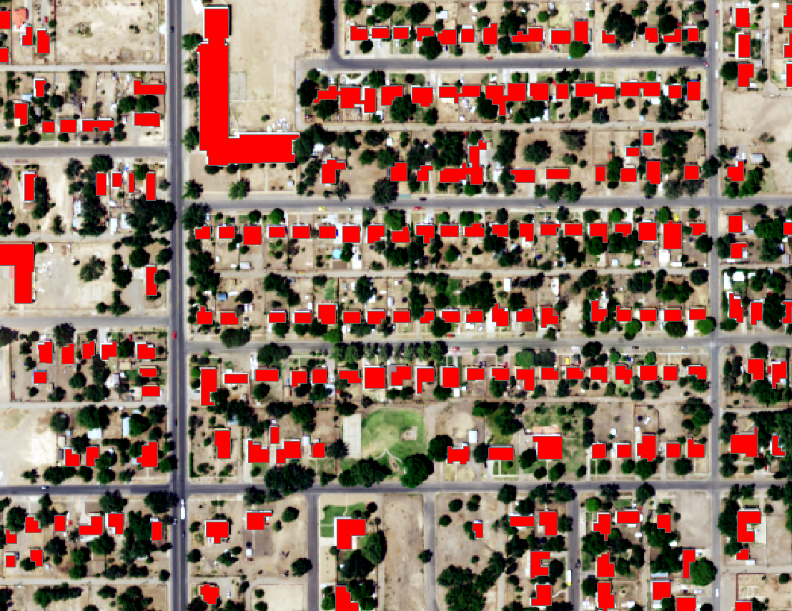
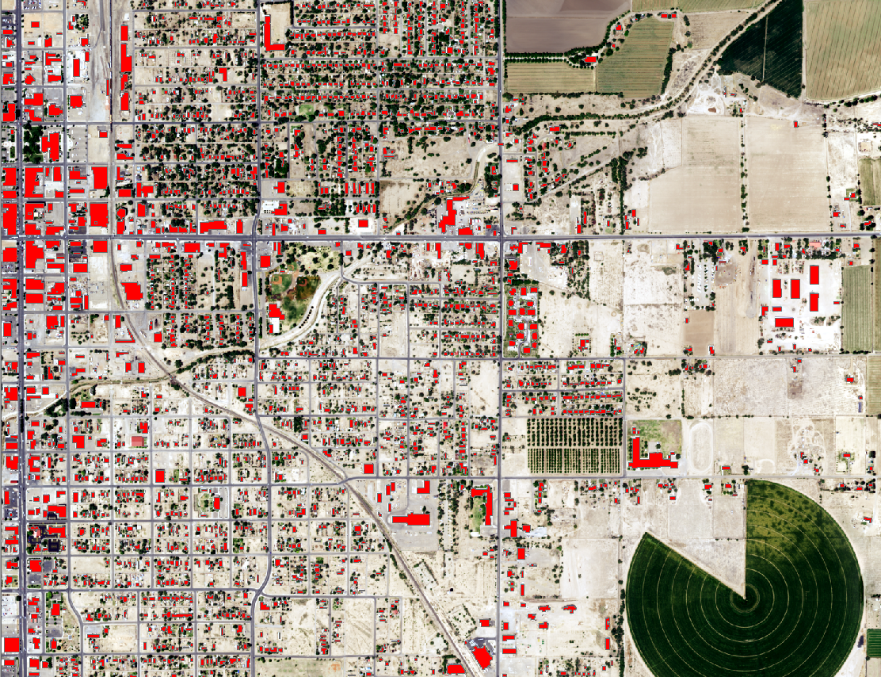
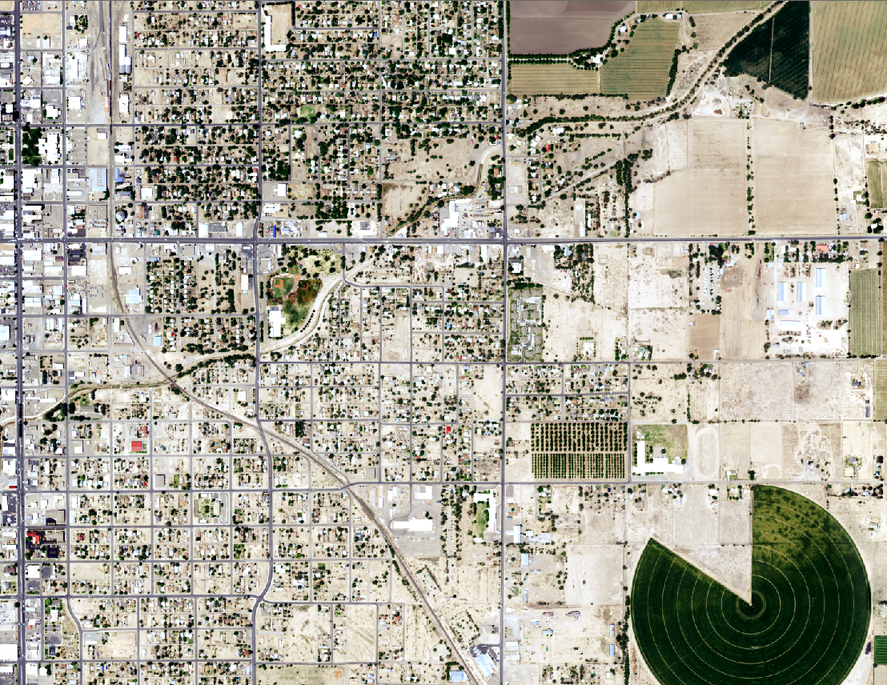
Lidar Derived Products

Slide 16
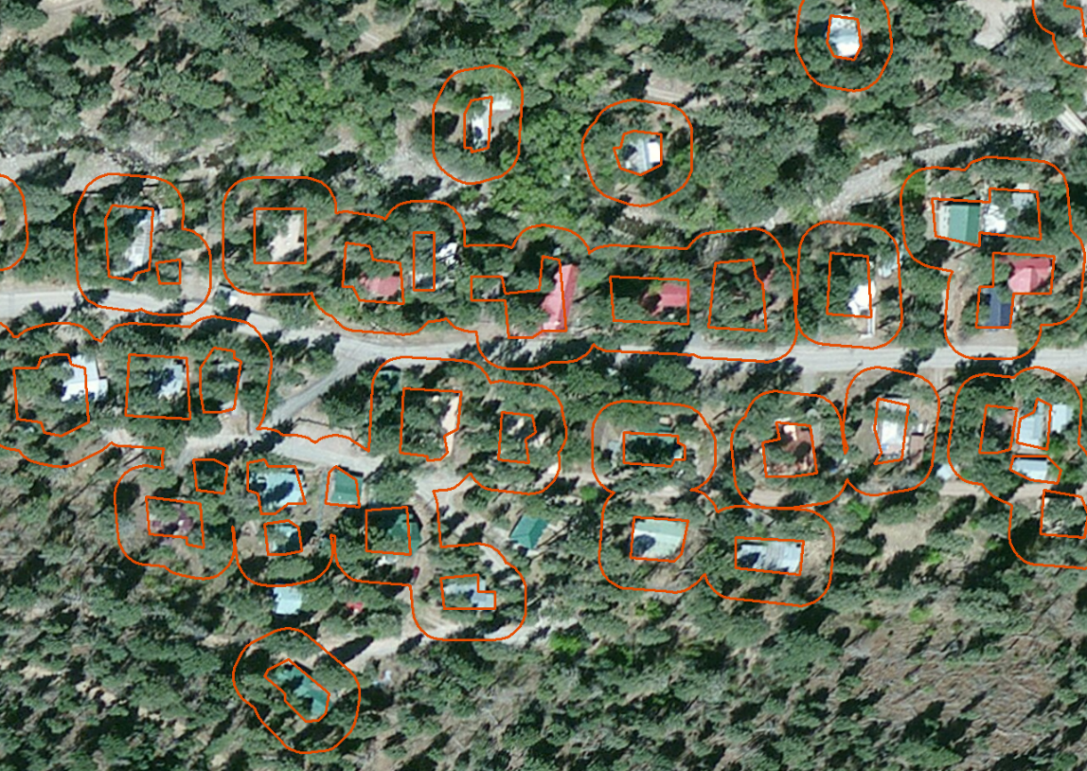
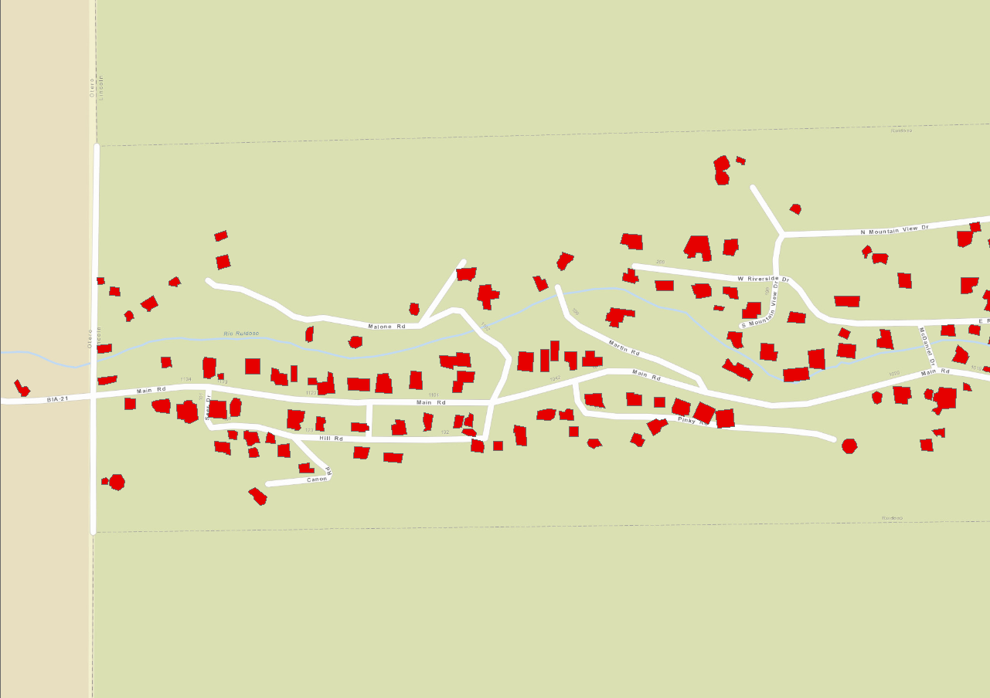
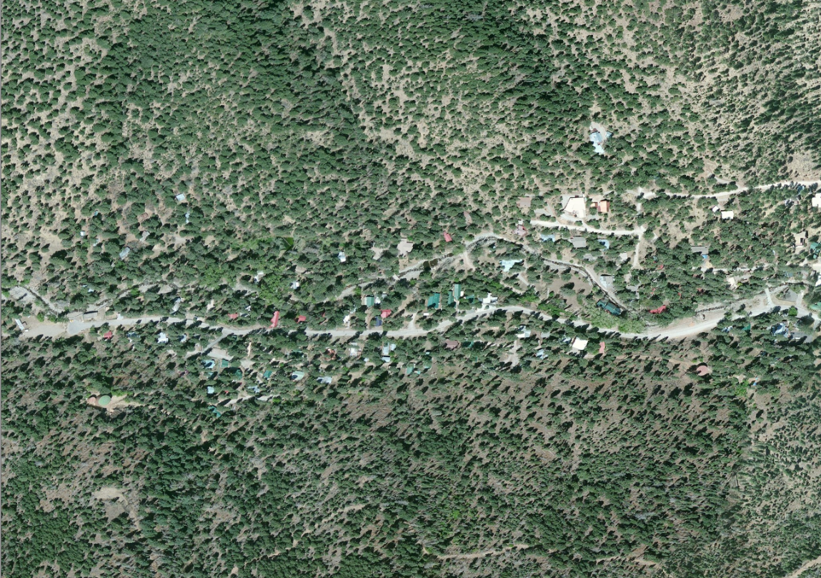
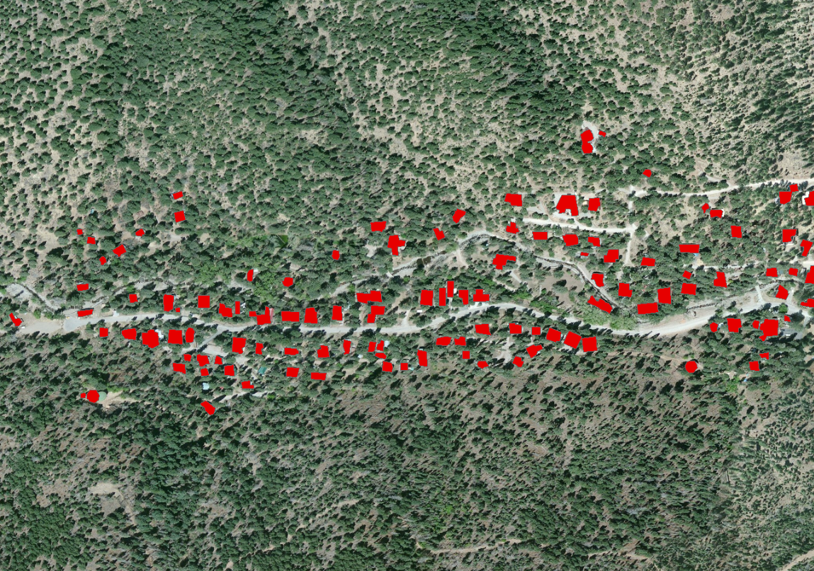
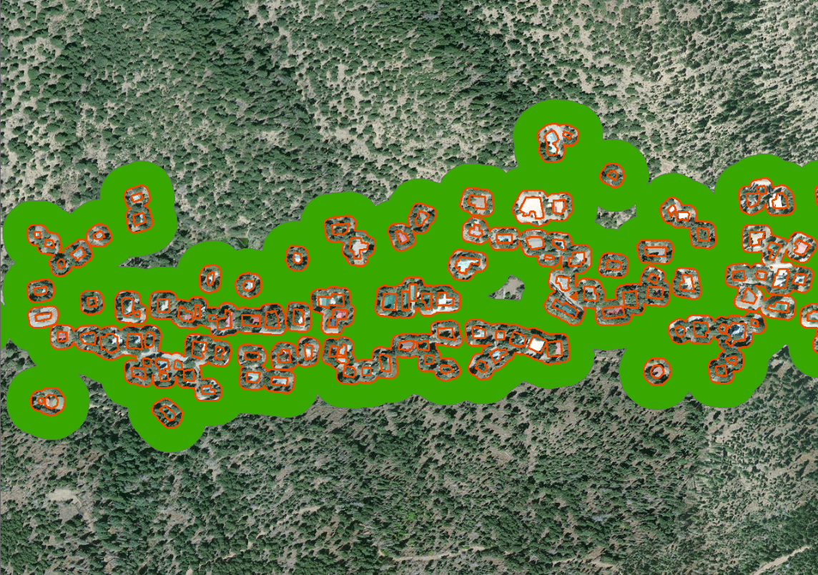
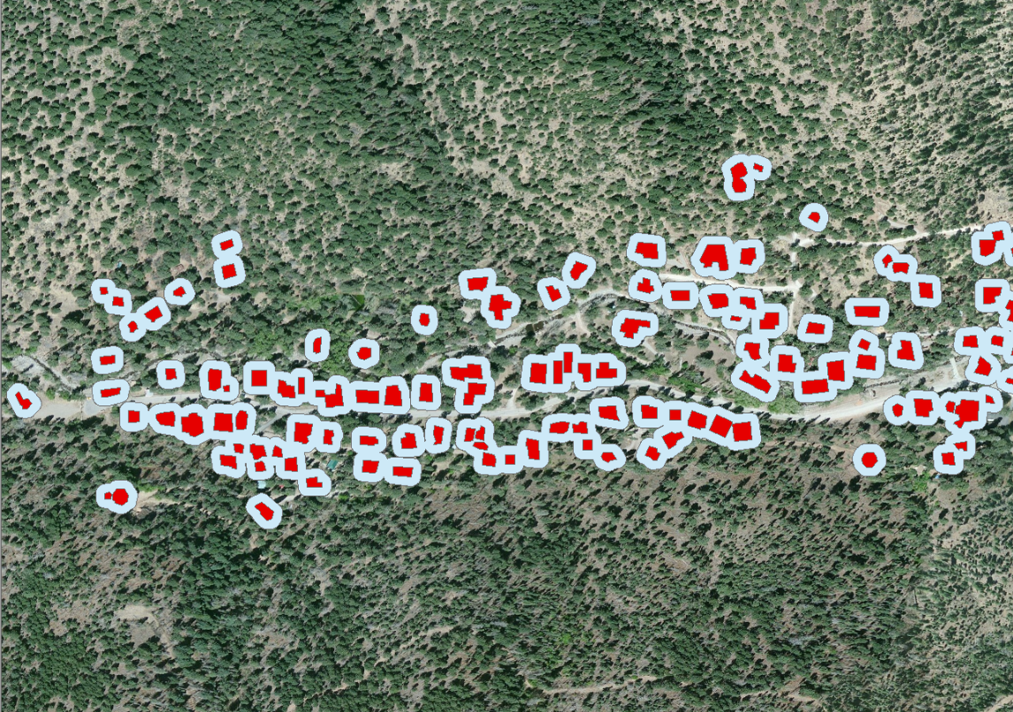
Rio hondo lidar products
Notes:
Ruidoso Upper Canyon Location
Upper Canyon map with building footprints
Image of buildings
Image with building footprints
Footprints with defensible space
Defensible space and reduce fuel zone (CalFire specs recommended thinning and clutter removal)
Close up of imagery with defensible space polygons

Slide 17
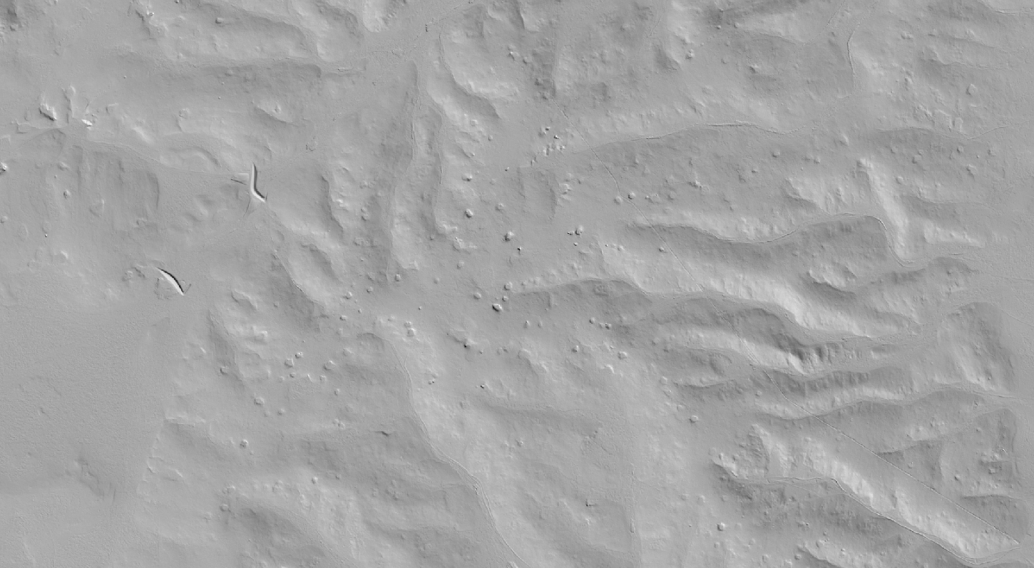
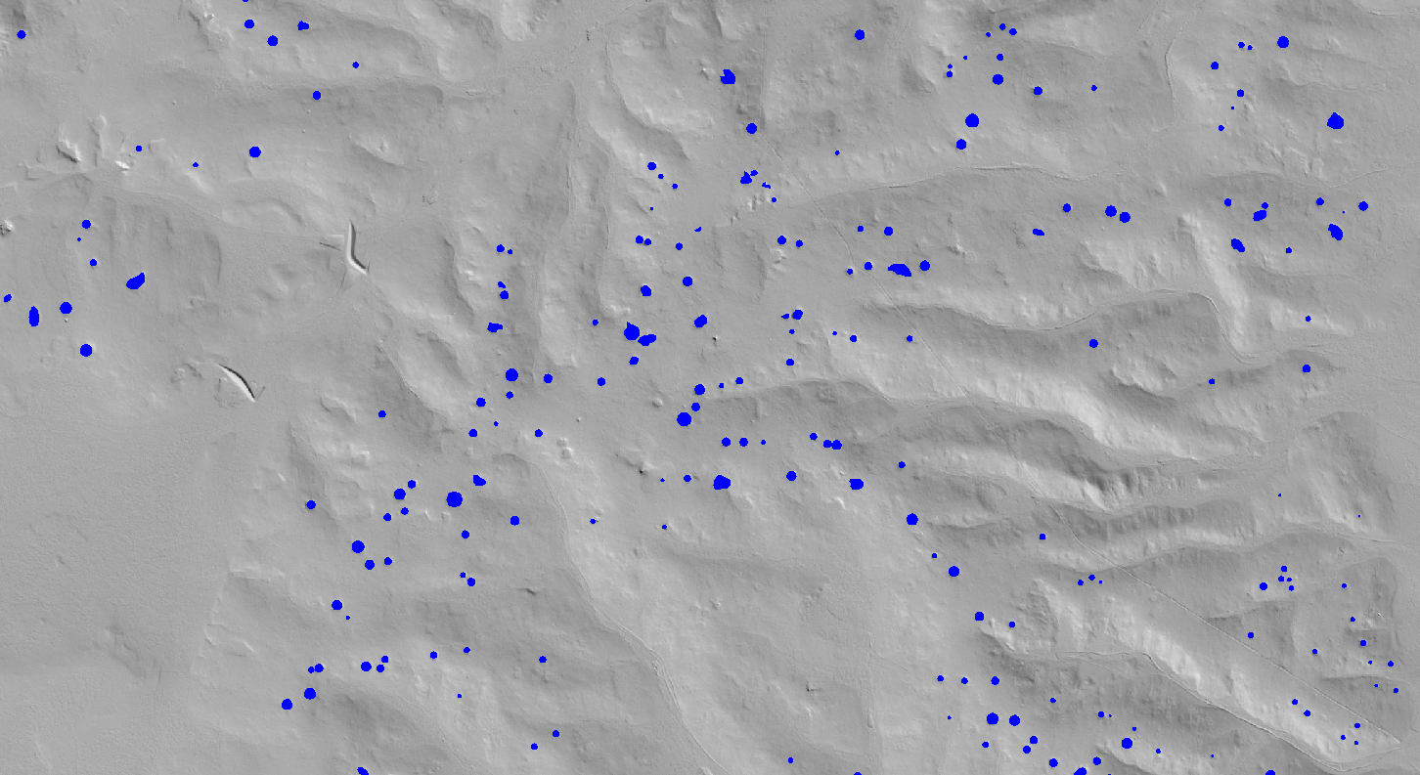
Sinkhole Mapping
Notes:
A portion of this watershed is underlain by limestone which has created a karstic terrain including the threat of sinkholes.
These could be seen in the shaded relief (above) fairly effectively and one of the goals of the project was to map them.
The sinkholes were mapped by subtracting the filled bare earth DEM from the original bare earth DEM.
3007 sinkholes identified

Slide 18
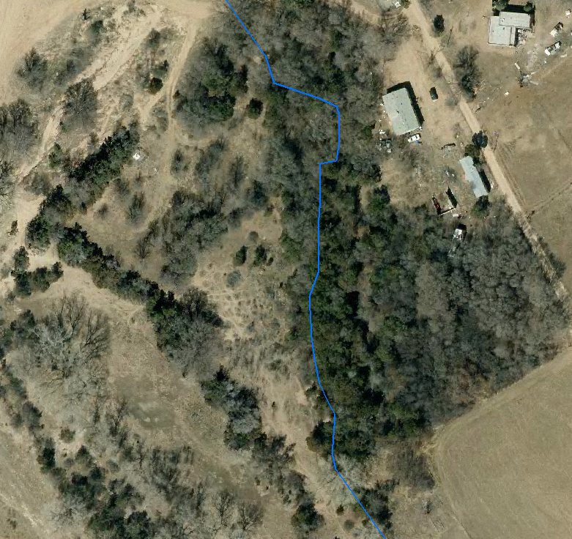
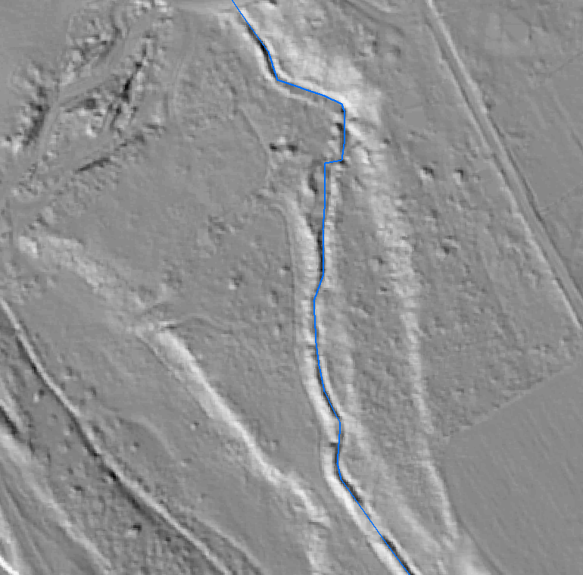
Acequia Mapping

Slide 19
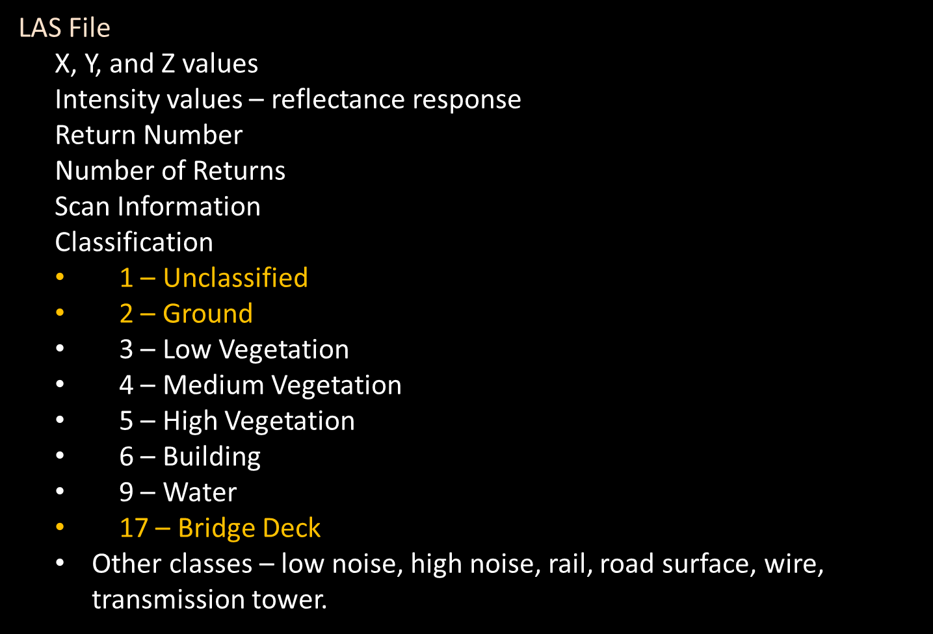
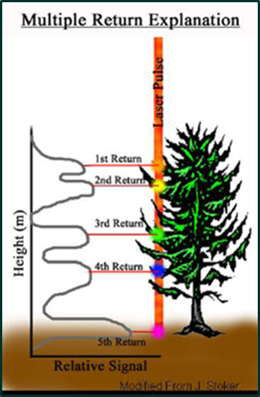
Point Cloud Derived Products
The LiDAR point cloud has the potential to be completely classified although it usually comes with only Ground, Bridge Deck features classified (yellow).

Slide 20
Base Level Engineering (ble)

Slide 21
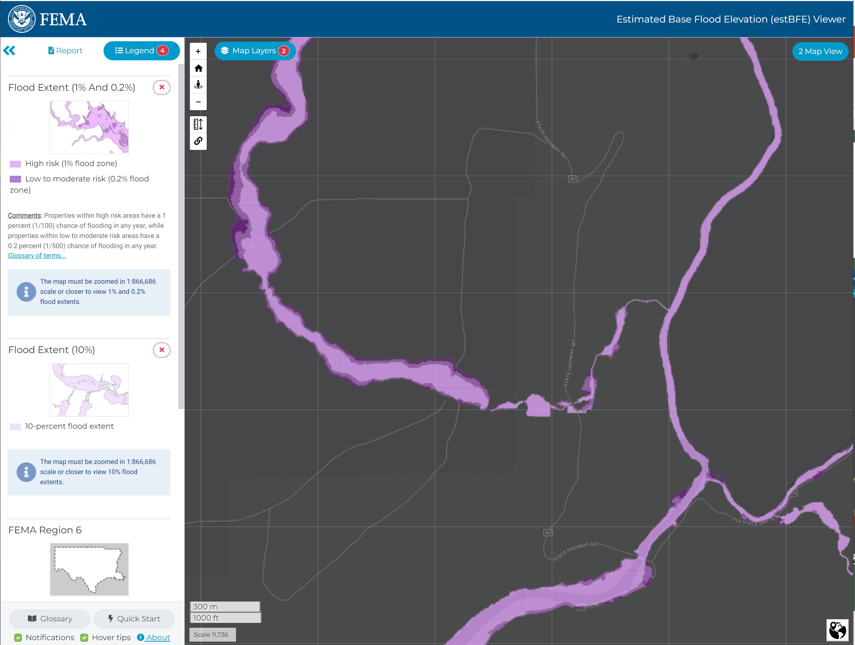
BLE Data
Flood Hazard data by watershed
More extensive than regulatory data
Flood Depth & Extent Grids
Uses
Hazard mitigation
Planning
Evacuation routes
https://webapps.usgs.gov/infrm/estbfe/

