Slide 1
GIS 167: MSAG MAINTENANCE
Presented by: Sandeep Talasila, GISP
The NM EDGE
NM Cooperative Extension Service &
NMSU Department of Government
March 18, 2025
Offered Zoom Live Online

Slide 2
Pre-Test Guidelines
Use your full name when logging in.
The link will be in the chat string.
Pre-test will be open starting 15 minutes before class through 10 minutes into class.
If you are late to class, you could receive a zero for your pretest.
You will have 10 minutes to take the test, so please watch your time! Be sure to submit before time expires.
The pre-test is closed book.
Use it to help you identify what you don’t know and where you will want to ask questions during the class.
Please do not talk to the instructor or to others while tests are in progress.
Notes:
Title: MSAG & MSAG Maintenance
Updated by: Sandeep Talasila Date: June 2022
Updated by: Glen Condon Date: September 2016
Created by: Glenn Kammerer Date: Unknown
Get a show of hands to validate all this. We are not taking the time to show them how to build an MSAG from scratch – or train them on how to use/understand GIS terms. Make sure no one is completely lost here.

Slide 3
Ground Rules for Participating in Class
Please turn off your email, text & other distractions. PLEASE PUT YOUR PHONE AWAY!
Make sure video is on throughout the class. It helps us all to see each other’s faces and is required.
Mute yourself to avoid distracting background noise.
Unmute when sharing your thoughts and identify yourself (a quick “hey this is Sally”).
Please raise your hand in the participant box, and/or use chat to share your thoughts & questions.
Please be prompt after breaks.
Be present and participate! Please do not leave the class (except, of course, if there is an emergency). There will be 2 breaks during class.
Repeat - Please put your phone away
Notes:
Title: MSAG & MSAG Maintenance
Updated by: Sandeep Talasila Date: June 2022
Updated by: Glen Condon Date: September 2016
Created by: Glenn Kammerer Date: Unknown
Get a show of hands to validate all this. We are not taking the time to show them how to build an MSAG from scratch – or train them on how to use/understand GIS terms. Make sure no one is completely lost here.

Slide 4
Course Assumptions
You are familiar with the New Mexico 911 (NM911) Program
Your PSAP(s) have E9-1-1 and Wireless 9-1-1
An MSAG is already established in your PSAP(s), though it may or may not be up to date, accurate, or synchronized completely with GIS
You are familiar with GIS in some capacity, whether you are an editor or an end user of GIS products
You may or may not be familiar with 9-1-1, 9-1-1 terminology, or how GIS data is used in the current and Next Generation 9-1-1 environments
Notes:
Title: MSAG & MSAG Maintenance
Updated by: Sandeep Talasila Date: June 2022
Updated by: Glen Condon Date: September 2016
Created by: Glenn Kammerer Date: Unknown
Get a show of hands to validate all this. We are not taking the time to show them how to build an MSAG from scratch – or train them on how to use/understand GIS terms. Make sure no one is completely lost here.

Slide 5
New Mexico 911 (NM911) Program
https://www.nmdfa.state.nm.us/local-government/nm-911-bureau/

Slide 6
New Mexico 911 (NM911) PROGRAM
The NM911 Program administers essential emergency reporting and dispatch services accessible by calling 9-1-1 through forty-two disparately funded municipal and county-run public safety answering points (PSAPs or 911 centers) located throughout the state
The NM911 Program was created by Section 63-9D-1 through 63-9D-20 NMSA 1978 (“Enhanced 911 Act”) to further the public interest and protect the safety, health, and welfare of the people of New Mexico by enabling the development, installation, and operation of enhanced 911 emergency reporting systems to be operated under shared state and local government management and control
Managed by the New Mexico Department of Finance & Administration (NMDFA)
More Information: https://www.nmdfa.state.nm.us/local-government/nm-911-bureau/
There is a Senate Bill (SB 137) introduced in NM Legislature this year to rename it as the “911 Act”, and to make some modifications to current law
Notes:
SENATE BILL 137
57th legislature - STATE OF NEW MEXICO - first session, 2025
INTRODUCED BY Michael Padilla
RELATING TO COMMUNICATIONS; RENAMING THE ENHANCED 911 ACT AS THE 911 ACT; RENAMING THE ENHANCED 911 FUND AS THE 911 EMERGENCY SERVICE FUND; RENAMING THE ENHANCED 911 BOND ACT AS THE 911 BOND ACT; UPDATING DEFINITIONS; INCREASING THE 911 SURCHARGE; UPDATING THE USES OF THE 911 SURCHARGE; EXPANDING GRANT FUNDING.

Slide 7
Our Role
The NM911 Program contracted with the Earth Data Analysis Center, University of New Mexico (UNM EDAC) to –
Securely acquire geospatial data from local government entities, validate and process data into the statewide model
Assist GIS data providers with data corrections
Compare GIS data with MSAG and ALI data to create synchrony between all three datasets
Assist GIS data providers and MSAG Coordinators with synchronizing GIS-MSAG-ALI datasets by updating and correcting data discrepancies

Slide 8
PSAP - Public Safety Answering Point
A 9-1-1 Call Center

Slide 9
Public Safety Answering Point (PSAP)
A PSAP is a “Public Safety Answering Point” or your 9-1-1 center that takes and dispatches 9-1-1 calls
New Mexico has consolidated in to 42 PSAPs
40 funded by the E911 Fund: 35 Local Govt. (County, City), 2 Tribal, and 3 Department of Public Safety (NMDPS)
A PSAP boundary generally meant to conform to a administrative boundary county, municipality, or Native American boundaries. However, the reality is that this rarely is true

Slide 10
Public Safety Answering Point (PSAP)
The reason this is not true is that originally, with “Basic” 9-1-1 (which preceded Enhanced 9-1-1), landline telephone exchanges determined call routing.
A telephone exchange cannot be ‘selectively’ routed to different PSAPs unless E9-1-1 was in place with MSAG, etc.
With Basic 9-1-1, an entire exchange routed to one PSAP, regardless of how many counties or cities that exchange was in
E9-1-1 brought “selective” routing – telephone exchanges could be split up and routed according to the ESN on the road. Split the road at the exchange boundary and give each portion a different ESN. Besides determining responders, ESNs determine routing.
Your individual GIS area of responsibility can represent:
One entire PSAP
Part of one PSAP
Part of two or more PSAPs

Slide 11
Current 9-1-1 Systems
Basic 9-1-1: the emergency and its location are communicated by voice (or TTY) between the caller and the call taker/dispatcher
Enhanced 9-1-1: call is selectively routed to the appropriate PSAP; and the PSAP has equipment and database that displays callers information (phone number and address) on screen to the call taker/dispatcher
Wireless Phase I: the call taker automatically receives caller’s wireless phone number and the location of the cell tower handling the call. The call is routed to a PSAP based on cell site/sector information
Wireless Phase II: call takers receive both the caller’s wireless phone number and their location information. The call is routed to a PSAP either based on cell site/sector information or on caller location information.
Source: nena.org
Add a section for Next Gen 911 – future 911
Notes:
TTY – Teletypewriter
https://www.nena.org/page/911Statistics

Slide 12
MSAG – Master Street Address Guide
What is it, who maintains it, and how is it essential for emergency response?

Slide 13
Master Street Address Guide (MSAG)
Backbone of the “Enhanced”9-1-1 (E9-1-1) System
Enhanced 9-1-1 provides the landline caller’s location information along with the voice call and call-back number
For landline calls, the location is an MSAG-valid 9-1-1 address
What exactly is it?
A database containing all valid road names, address ranges, community and emergency responder codes
Relational Database – Civic addresses associated with landline phones are validated against the MSAG and “tied” to an MSAG record when they are loaded into the 9-1-1 system

Slide 14
Master Street Address Guide (MSAG)
To be MSAG-valid, the address must “fit” within an MSAG record
Every landline (TN) record is scrubbed against the MSAG, and pulls the ESN and Community information from it
Managed by the PSAP
Hosted by Intrado (9-1-1 Database Provider) on behalf of the PSAP

Slide 15
An MSAG Extract – Example
A snapshot of MSAG database, Guadalupe County, NM – May 2022

Slide 16
MSAG & Wireless Call Handling
Wireless 9-1-1 routing is not based on the MSAG or addressing in any way currently
Nationwide, at least 75-80% of all 9-1-1 calls originate from cell phones
Wireless 9-1-1 routing is based on the SECTOR of the tower that handled or carried the call, regardless of whether it is a Phase I call (tower/sector info only) or a Phase II call (coordinates of device that placed the call).
Each sector of each tower is given its own routing, and all sectors of a tower can route to the same PSAP (or different PSAPs*)
A single sector of a tower CANNOT route to more than one PSAP at one time, even if it “covers” parts of two or more PSAPs
In Next Gen 911, call routing is based on the caller’s location
GIS DATA IS IMPORTANT !!!
Notes:
It is important to note here that the coordinates of the cell phone itself are only relevant for MAPPING the call and not for ROUTING the call.
Different PSAPs (towers near County of City lines) – A PSAP must agree to take all the calls from a sector that crosses the boundaries, with least number of call transfers – as every second is important in emergency response.
NENA 9-1-1 Statistics. As of Feb 2021 https://www.nena.org/general/custom.asp?page=911Statistics
99.4% of PSAPs have some Phase I, 99.2% of PSAPs have some Phase II 97.8% of Counties have some Phase I, 97.3% of Counties have some Phase II 98.9% of Population have some Phase I, 98.9% of Population have some Phase II
The term `some’ means that some or all wireless carriers have implemented either Phase I or Phase II service in the County or the PSAPs. In order for any carrier to provide service, the County or PSAP must be capable of receiving the service. In most cases, all carriers are implemented in a County or PSAP, but one or more may be in the process of completing the implementation.

Slide 17
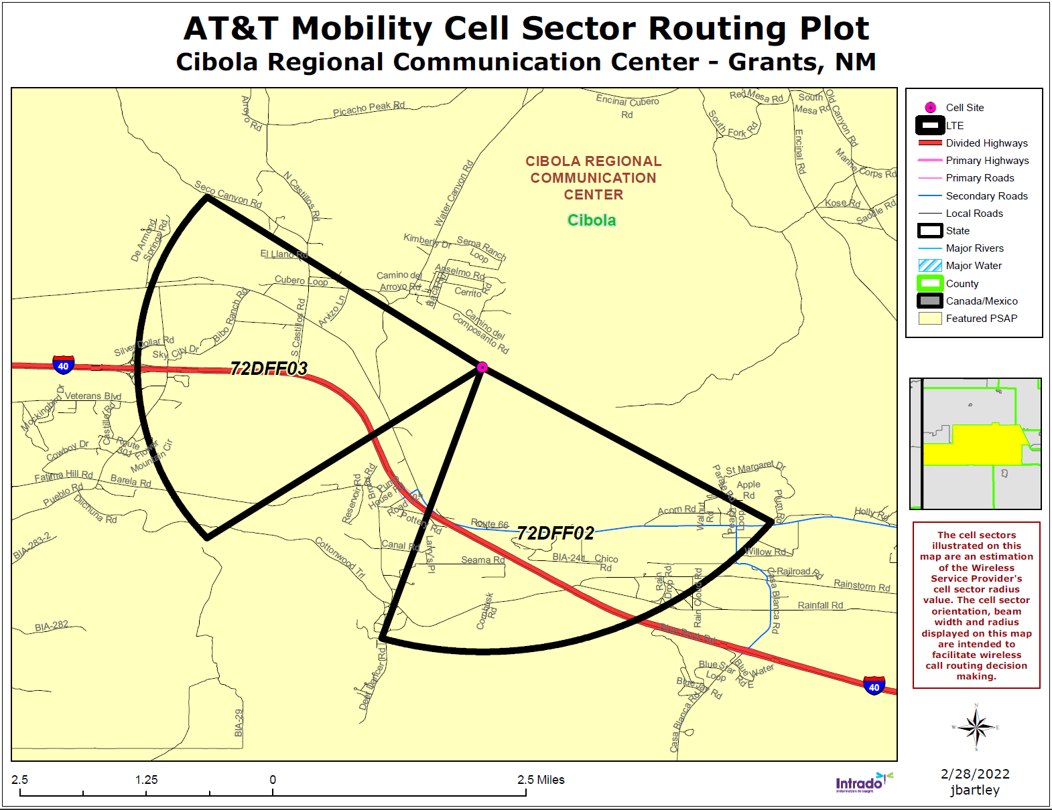
MSAG & Wireless Call Handling
Wireless Routing is determined by PSAPs
Wireless carriers usually make the first call on which PSAP should get the routing sheet and approve the routing they have determined
PSAPs must work together to determine which PSAP is most appropriate for each sector (with least number of call transfers)
NG9-1-1 (Next Generation 9-1-1) promises GEOSPATIAL routing so that the actual LOCATION of the caller, based on civic address for landline callers and actual x/y location for wireless callers, determines the PSAP to which the call is routed
Notes:
Different PSAPs (towers near County of City lines) – A PSAP must agree to take all the calls from a sector that crosses the boundaries, with least number of call transfers – as every second is important in emergency response.
Cellular Routing was implemented in 1998, due to lack of technology (geographic coordinates) calls are routed based on the tower sector maps. (Intrado video https://www.intrado.com/blog/life-safety/transforming-how-911-calls-are-routed-to-public-safety-locate-before-route#)
https://gis.utah.gov/mapping-utah-s-wireless-emergency-call-routing-system/
Add - Occasionally Cell tower locations need to be verified for a valid location information (address, or coordinates)

Slide 18
NM911 – Call Statistics
Notes:
Others include VOIP, MLTS, Telematics, Admin calls
2022 data may not be complete. Some of the PSAPs upgraded to new CHE and may have reported partial of annual volume

Slide 19
The Role of the MSAG
The MSAG assures standardized addressing – all civic addresses (with landline phones) must exactly match an MSAG record
The MSAG provides the ESN (Emergency Service Number) for each potential address in the PSAP. The ESN translates into one law enforcement agency, one fire response agency and one EMS (ambulance) agency – all appropriate for the caller’s location
The ESN routes the call. The MSAG ESN (the administrative ESN) points to a specific “routing” ESN which is associated with one PSAP
The MSAG is used by phone companies – even those that do not provide 9-1-1 service – to validate their customer service addresses
Notes:
Not all PSAPs utilize ESN for agency identification

Slide 20
The 9-1-1 Database(s)
MSAG – Master Street Address Guide – Influence and control E9-1-1
ALI – Automated Location Information – Each landline telephone number in a PSAP’s response area is loaded from each serving phone company, scrubbed against the MSAG to obtain ESN and Community information, and loaded into the ALI database. When a 9-1-1 landline call is initiated, the ten digit phone number dips into this database to obtain the location info sent to the PSAP with the voice call
ELT – English Language Translation – a table which translates each ESN to the names of the public safety providers
GIS Data – Geospatial data used to be an “add-on” and is now considered critical to control all or most of the above

Slide 21
The 9-1-1 Database: ALI
A snapshot of location information based on the ALI and MSAG records. New systems do include GIS components
A snapshot of ALI database for Portales, NM - 2021
Notes:
Glenn: VERY OLD ALI dump – from the days when they got the location information on a small screen with no mapping. Call this a “raw” dump but it does show the basics.

Slide 22
The 9-1-1 Database: ELT
ESN | POLICE | FIRE | AMBULANCE
869 | HOBBS PD | HOBBS FD | HOBBS EMS
870 | LEA COUNTY SHERIFF | HOBBS FD | HOBBS EMS
870 | LEA COUNTY SHERIFF | HOBBS FD | HOBBS EMS
870 | LEA COUNTY SHERIFF | HOBBS FD | HOBBS EMS
870 | LEA COUNTY SHERIFF | HOBBS FD | HOBBS EMS
871 | LEA COUNTY SHERIFF | KNOWLES FD | LOVINGTON EMS
872 | LEA COUNTY SHERIFF | KNOWLES FD | HOBBS EMS
880 | LEA COUNTY SHERIFF | HOBBS FD | HOBBS EMS
880 | LEA COUNTY SHERIFF | HOBBS FD | HOBBS EMS
881 | LEA COUNTY SHERIFF | KNOWLES FD | LOVINGTON EMS
882 | LEA COUNTY SHERIFF | KNOWLES FD | HOBBS EMS
883 | LEA COUNTY SHERIFF | MONUMENT FD | HOBBS EMS
884 | LOVINGTON PD | LOVINGTON FD | LOVINGTON EMS
885 | LEA COUNTY SHERIFF | LOVINGTON FD | LOVINGTON EMS
886 | LEA COUNTY SHERIFF | TATUM FD | TATUM EMS
887 | LEA COUNTY SHERIFF | MALJAMAR FD | HOBBS EMS
888 | JAL PD | JAL FD | JAL EMS
889 | LEA COUNTY SHERIFF | JAL FD | JAL EMS
890 | EUNICE PD | EUNICE FD | EUNICE EMS
891 | LEA COUNTY SHERIFF | EUNICE FD | EUNICE EMS
892 | TATUM PD | TATUM FD | TATUM EMS
893 | LEA COUNTY SHERIFF | MALJAMAR FD | LOVINGTON EMS
A snapshot of ESNs for Lea County, NM
Notes:
Note that you can “trick” the ELT but using a / with a back-up responder name so on 883 imagine “Monument Fire Dept/Hobbs Fire Dept”

Slide 23
The 9-1-1 Database: GIS
GIS Data that influences the MSAG
Street centerlines
Individual Fire/Law/EMS Boundaries
ESZs
MSAG Community Boundaries
PSAP Boundaries
GIS will be discussed in detail later in the training with a dual focus:
GIS and MSAG must be synchronized
MSAG will ultimately be “contained” in GIS
The GIS data at the PSAP in the PSAP’s mapping application is expected to show the caller’s location and verify the responder data

Slide 24
MSAG & Next Generation (NG)9-1-1
Next Generation 9-1-1 (NG9-1-1) uses geospatial data instead of the tabular MSAG to validate and route calls
MSAG is replaced by GIS in the form of Location Validation Function (LVF) and Emergency Call Routing Function (ECRF) and ALI database will be replaced by the Location Information Server (LIS)
It is important to make sure existing data is up-to-date and accurate
Good News!!! You’re very likely already doing all or most of what is needed for NG9-1-1, but how close are you?
Notes:
https://www.vestapublicsafety.com/news-events/blog.php?id=110&Is+Your+Data+NG9-1-1+Ready

Slide 25
Synchronization
MSAG-ALI-GIS databases must be synchronized for accurate 9-1-1 call mapping and routing
NENA recommends a 98% match rate between the datasets
MSAG | GIS
Calle Hermosa | Hermosa St
N 1st St | N First St
County Road A022 | CR A022
Highway 528 N | N Highway 528
Jersey Ln | Jersey La
Not Synchronized
Notes:
Note that these are just ROAD NAME sync issues – there are many other issues involving ESNs, Communities and Ranging to deal with too.

Slide 26
MSAG Components
What are MSAG components and how to update them?

Slide 27
MSAG Components
DI – Road Direction/Prefix
STREET – Road Name (with street type & post-dir)
LOW – Low Address
HIGH – High Address
COMM – Community
ST – State
O_E – O/E/B parity
ESN
DATE MODIFIED
EXCHANGE
ENTITY
MSAG
Notes:
Note that the low and high address fields have no relevance to even/odd or left/right.

Slide 28
MSAG Components
DI – DIRECTION/PREDIR
The Pre-Directional is two characters and is limited to N/S/E/W/NW/NE/SW/SE
No spaces are allowed in the two character predirectionals
The field is blank if there is no predirectional, OR if a post-directional is used instead of a predirectional
STREET – ROAD NAME
Contains all road name components except for the Pre-Directional
Pre-types are not used in MSAGs
There is no ALIAS field in an MSAG. While the ALIAS can be entered as a separate record, it is not recommended as it confuses addressing and mapped location
Precise spelling and USPS-valid street types should be used at all times
Notes:
Glenn: NOTE that sometimes MSAGs have all four road name fields split out and sometimes not

Slide 29
MSAG Components
LOW – Low Address
The lowest potential address (either even or odd) for the record/road segment
There is no distinction between left/right
The lowest number that should ever be used is “1” even though “0” is a numeric that is allowed
Never use “0” as a low. The Santa Fe ALI data years ago had hundreds of “0” addresses in its 911 database because of the MSAG allowing “0” as a house number
HIGH – High Address
The highest potential address (either even or odd) for the record/road segment
There is no distinction between left/right
The highest number that should ever be used is the highest potential address on that road segment.
Some entities attempt “actual” addressing only. The road may be 1 – 1875 by its length, but the last actual address is 1001. Some entities cut the MSAG off at 1001 then extend it if an address is issued higher than 1001. This may minimize error but it maximizes maintenance efforts
Notes:
Inflate the ranges to avoid higher error count or potential errors. Not a good practice

Slide 30
MSAG Components
O_E – O/E/B parity
Does the record refer to the Even side of the road, the Odd side of the road, or Both sides?
If a record is coded E, it should begin with and end with an even number such as 100 – 148
If a record is coded O, it should begin and end with an odd number such as 101 – 149
Emergency service boundaries often follow roads such that the even addresses are within Fire District A and the odd within Fire District B
Both ESNs and Communities can have E/O designations
Notes:
Glenn – explain potential vs. actual addressing

Slide 31
MSAG Components
COMM – Community
By NENA standards, legacy MSAG Communities must follow ZIP Code Boundaries
Not all 9-1-1 Database providers use this rule – some use a city name for incorporated cities and a county name in all unincorporated areas
NG9-1-1 call for Postal community names, Incorporated and Unincorporated community names
A community name in the MSAG which is attached to an ALI record is meant to
Resolve address duplication (the same road name and range in two or more places in the PSAP, such as in two incorporated towns that each have a Main St.
Give “relevance” to the address to responders and dispatchers who can more easily place it in the PSAP response area with knowledge of the community’s location
Example: Entire To’hajillee chapter was given a community of “Albuquerque” because there is no post office called To’hajillee.”
Notes:
Glenn: A bit about NENA standards – National Emergency Number Association – work with USPS, Census, URISA, etc. Always evolving, especially with NG9-1-1
ZIP Codes are lines, not polygons
And the USPS does not maintain ZIP code “Boundaries”
And even if they did, they don’t work well in New Mexico
Nonetheless, it’s the rule
But that’s changing with NG9-1-1

Slide 32
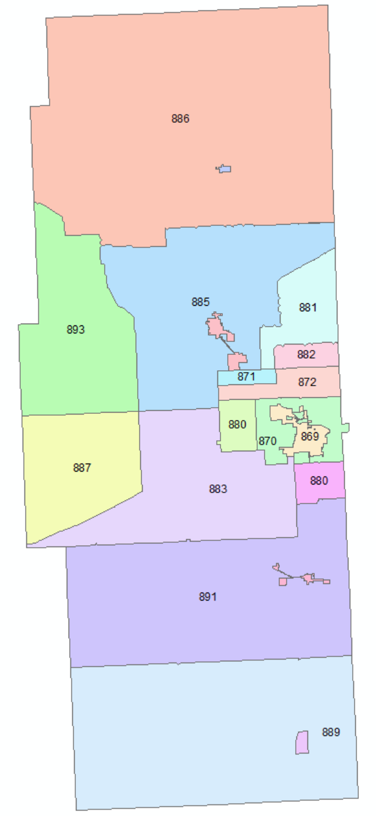
MSAG Components
ESN – Emergency Service Number
A 3-5 digit number which translates into a unique set of emergency providers (Fire/Law/EMS)
Overlaying fire/law/EMS boundaries and creating individual polygons with unique sets of responders creates the ESZs – Emergency Service Zones
Each ESZ is given one ESN
Each unique ESN routes to one and only one PSAP
Every resident within a specific ESZ will have the same set of emergency providers – same law enforcement, same fire response, same ambulance service
ESNs for Lea County, NM
When a resident calls 9-1-1, the emergency providers dispatched are the same in a given ESN.
In 869, a resident is served by Hobbs Police Dept., Hobbs Fire Dept., and Hobbs EMS
Notes:
Glenn:

Slide 33
MSAG Components
EXCHANGE
Telephone exchange for landline phones
This field was not used in New Mexico MSAGs by Lumen, may used by other LECs
DATE MODIFIED
The date default is the date the record was added to the MSAG
Updated to current date whenever an MSAG change or addition is made
MSAG
Code displaying the PSAP or GIS jurisdiction who the MSAG belongs to given by Intrado (inconsistent)
Examples: LVPDNM – Las Vegas Police Department, SKIVNM – Taos Ski Valley
Notes:
Glenn:

Slide 34
MSAG Updates: When?
An MSAG must be updated to accurately reflect the current addressing and MSAG boundaries. Therefore, if any of these change, the MSAG must be changed
A few examples
New street additions
Changes to existing street
a road is renamed
changes to existing street ranges
an existing road is lengthened
An existing road is rerouted and renamed or readdressed (as in when the state changes the mile markers on state highways – again!)
A road is closed/deleted
Any Response Boundary is changed – Fire, Law, EMS – as in when a city expands its boundaries
A community boundary changes or the name changes (usually from changes to post offices)
The MSAG is NOT changed when a new address is added to an existing road that already exists in the MSAG with a range that accommodates the new address
All of these require a GIS change too, so wouldn’t it be great if you only had to change the GIS!

Slide 35
MSAG Updates: Who?
MSAG updates can be generated by a newly platted subdivision, a change to a State Highway, the joining of two fire departments into one, a new policing arrangement between a city and the sheriff or DPS or a post office closing. Who tracks all of these things?
Generally, depending on the size and complexity of the county, municipality of PSAP, one of the following maintains the MSAG:
Rural Addressing
Planning and Zoning
The Assessor
GIS/IT
PSAP
MSAG Coordinators
In New Mexico, the Intrado 911Net on-line system is used for MSAG updates and ALI error resolution

Slide 36
MSAG Updates: Who?
Ultimately, no matter who actually maintains the MSAG, the 9-1-1 Director for the PSAP has the ultimate responsibility for it. Errors in the MSAG translate to real people with real life-threatening emergencies who cannot be found quickly enough to save their life or their property or both
Keep in mind that one department or person often fulfills may roles – Rural Addressing may be a function of E9-1-1 or P&Z or the Assessor while GIS may reside in any of those places or in its own department
Because many processes influence the MSAG, relationships are crucial!!!

Slide 37
Circumventing Errors
Establish close, working relationships among addressing authorities and GIS Data Sources to update the MSAG as roads are planned and added to the MSAG before residents on them request phone service
Create process/work-flow plans to pro-actively update the MSAG whenever MSAG-related changes occur
ESZ boundary changes
New Roads
Road Name Changes
Road Range Extensions
Notes:
When an address verification request comes from the Telco that require contacting customers, county or city has to validate these addresses and correct them with the telcos

Slide 38
Process/Work – Flow Examples
Example 1: Planned Rural Subdivision
Planning approves new rural subdivision
Rural Addressing approves road names and assigns address ranges
GIS adds roads to GIS centerline layer
GIS determines ESZ and Community from MSAG boundary layers
MSAG Coordinator adds new roads to MSAG
Residents begin moving in, requesting telephone service from the Local Exchange Carrier (LEC)
OR
Planning approves new rural subdivision and platted road names
GIS/Addressing drives subdivision with GPS and adds features to GIS centerline, using addressing plan for ranging and plat for road naming
GIS determines ESZ and Community from MSAG boundary layers
MSAG Coordinator adds new roads to MSAG
Residents begin moving in, requesting telephone service from LEC
Notes:
These are sample scenarios and need to be adapted to the reality in your county or municipality

Slide 39
Process/Work – Flow Examples
Example 2: City Road Name Change
City officials approve renaming city street (“Main St” to become “Bill Richardson Blvd”)
Planning/Addressing changes road name in their records and notifies city residents, post office, Public Works (signage)
Planning/Addressing notifies MSAG coordinator of road name change
Planning sends change to GIS (if separate department)
MSAG Coordinator updates MSAG
If Lumen franchise, Intrado is contracted to make changes to the Lumen data
If other telephone company is involved, MSAG coordinator gives old/new (address change) list so that customer service records can be changed.

Slide 40
Process/Work – Flow Examples
Example 3: State Highway Designations are Changed
Example 4: Long private driveway to become a named private lane
Example 5: County Road is “abandoned”
Example 6: City incorporates formerly “rural” area
Example 7: Road is re-routed or straightened
Notes:
Discuss with attendees how each of these might work

Slide 41
MSAG Updates: How?
Intrado Integrated User Portal (9-1-1 NET) Portal
You’re not changing the MSAG – you’re submitting a change which must be accepted by Intrado
Intrado then notifies you through the system if the change is accepted
When accepted, you will receive a confirmation for the change request work order submitted
Unaccepted edits may need additional review and verification
9-1-1net.intrado.com
Notes:
Add a screenshot to search for the change requests – Archive MSAG CRs

Slide 42
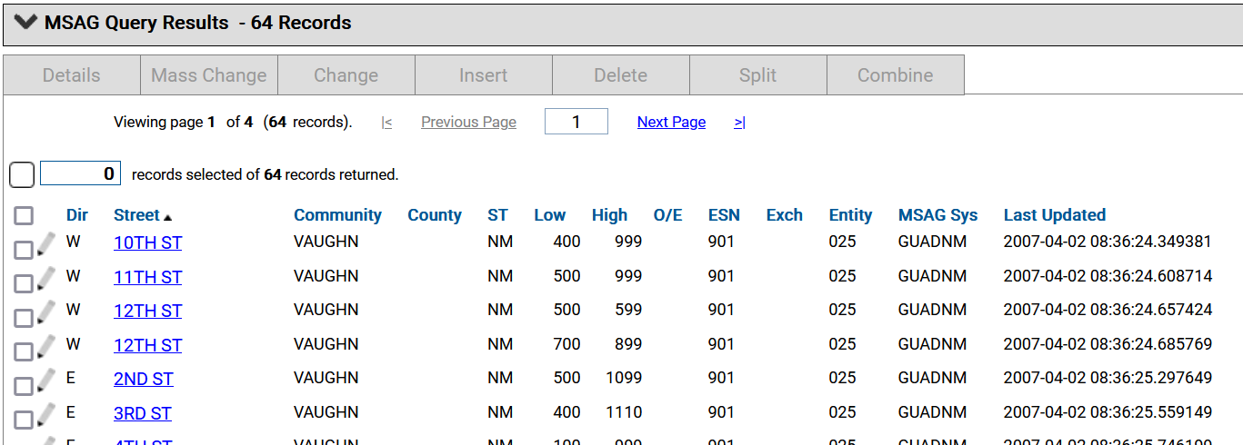
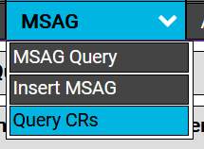
MSAG Updates: Tools/Functions
MSAG Tools
MSAG Query
MSAG Insert
Query CR
Notes:
Glenn – some info from your personal experience will be helpful.

Slide 43
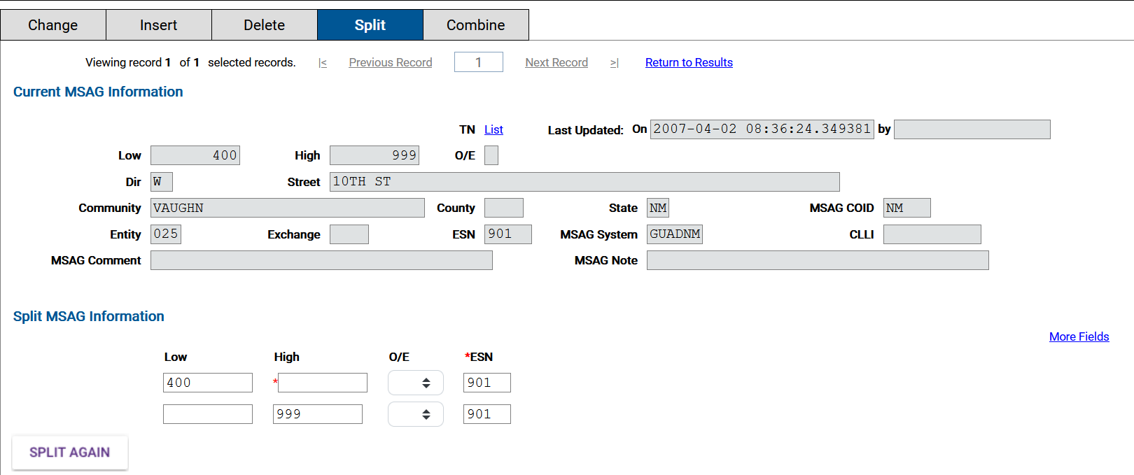
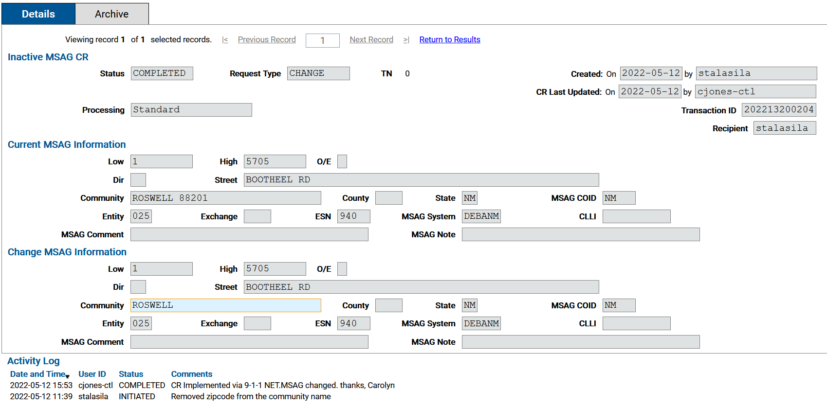
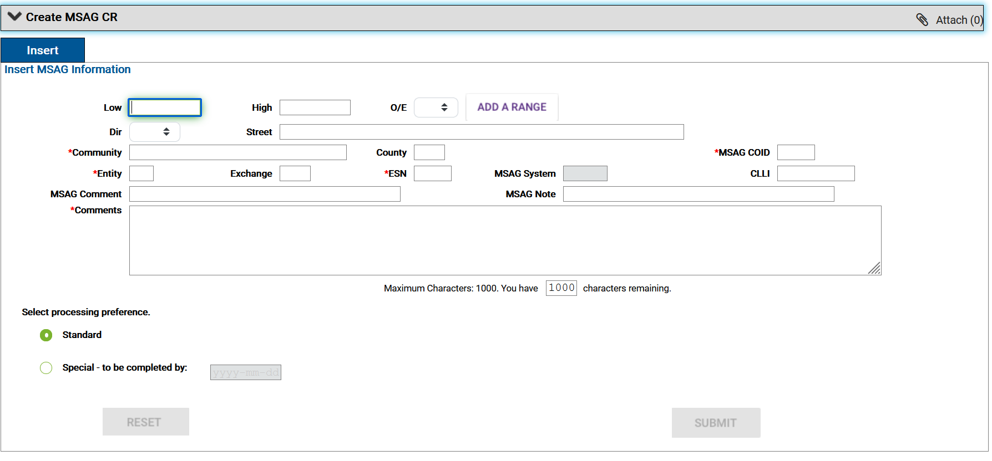
MSAG Split
Query Change Request
MSAG Insert

Slide 44
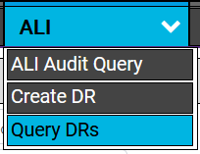
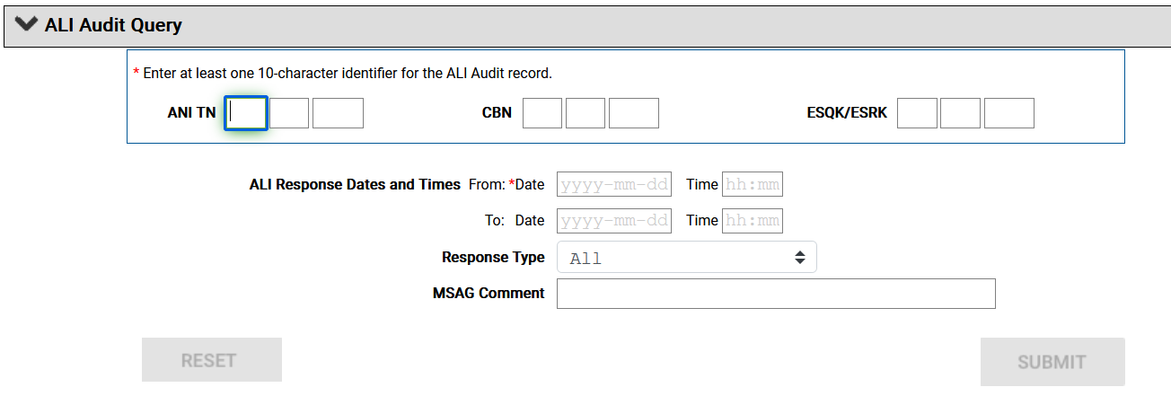
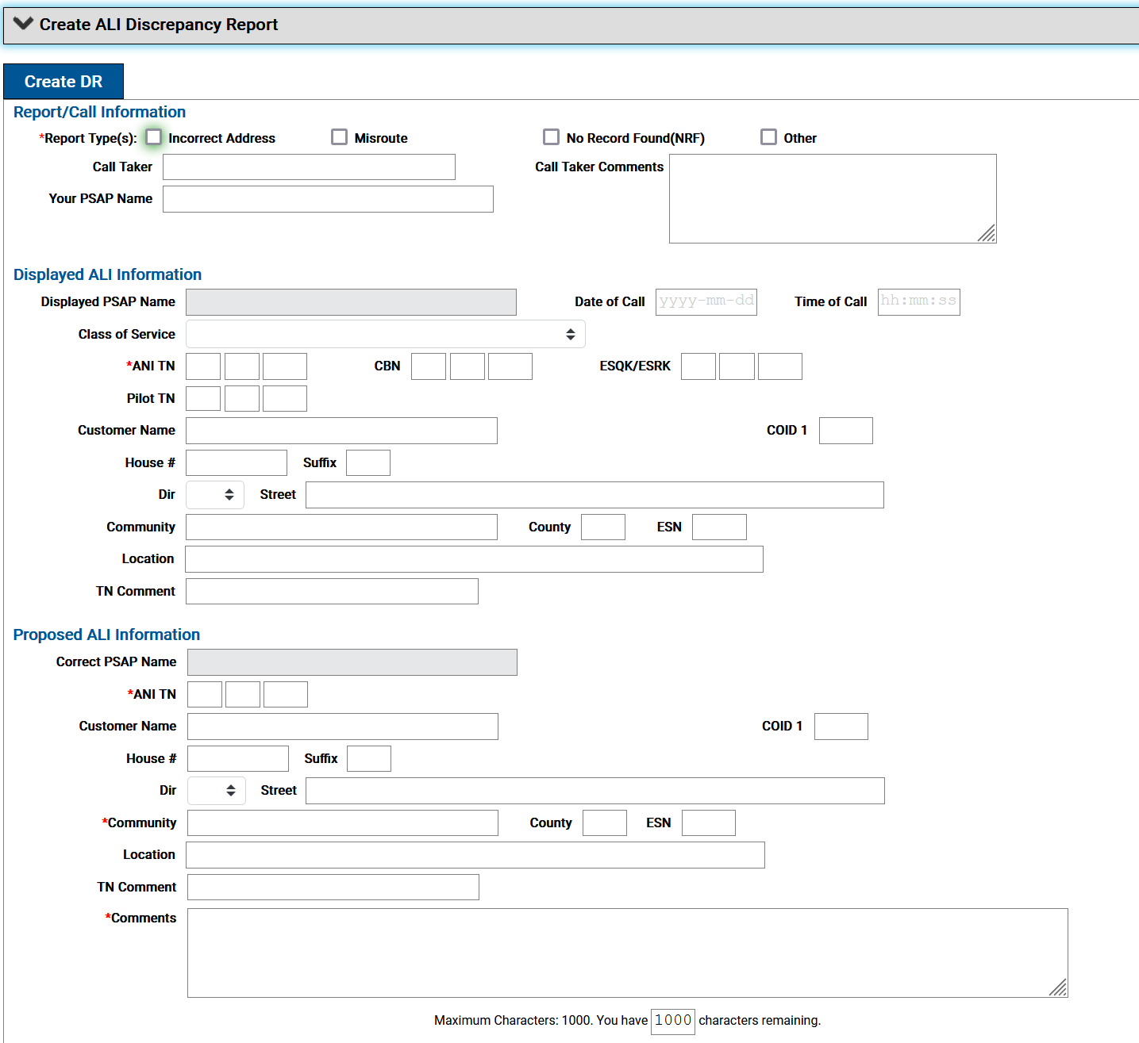
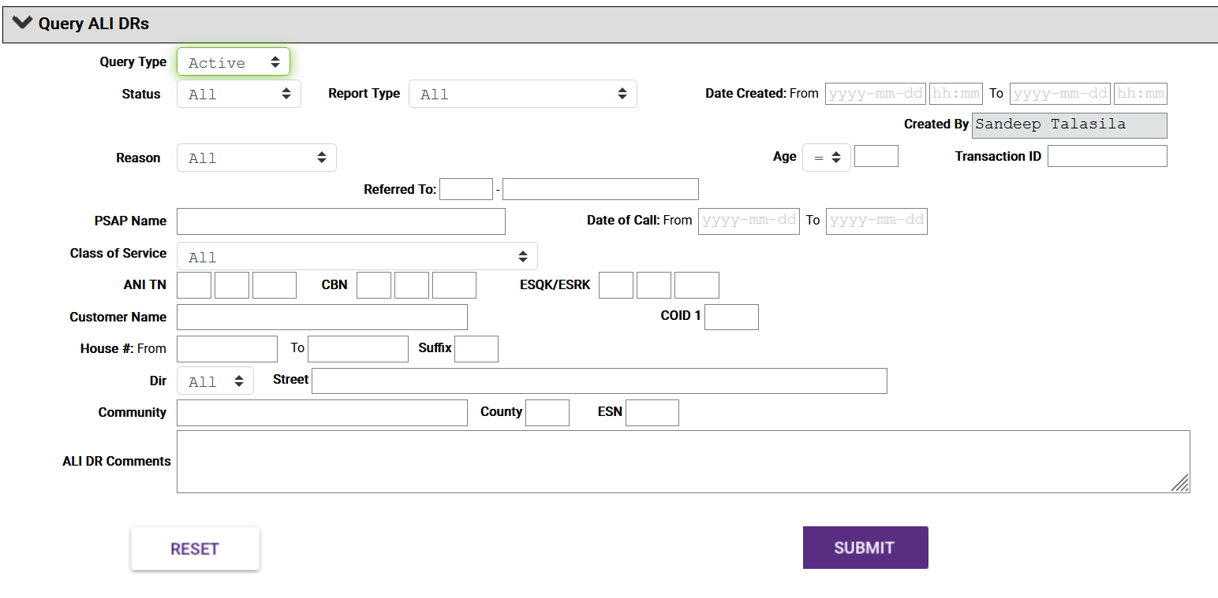

Slide 45
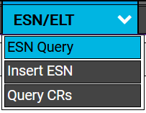
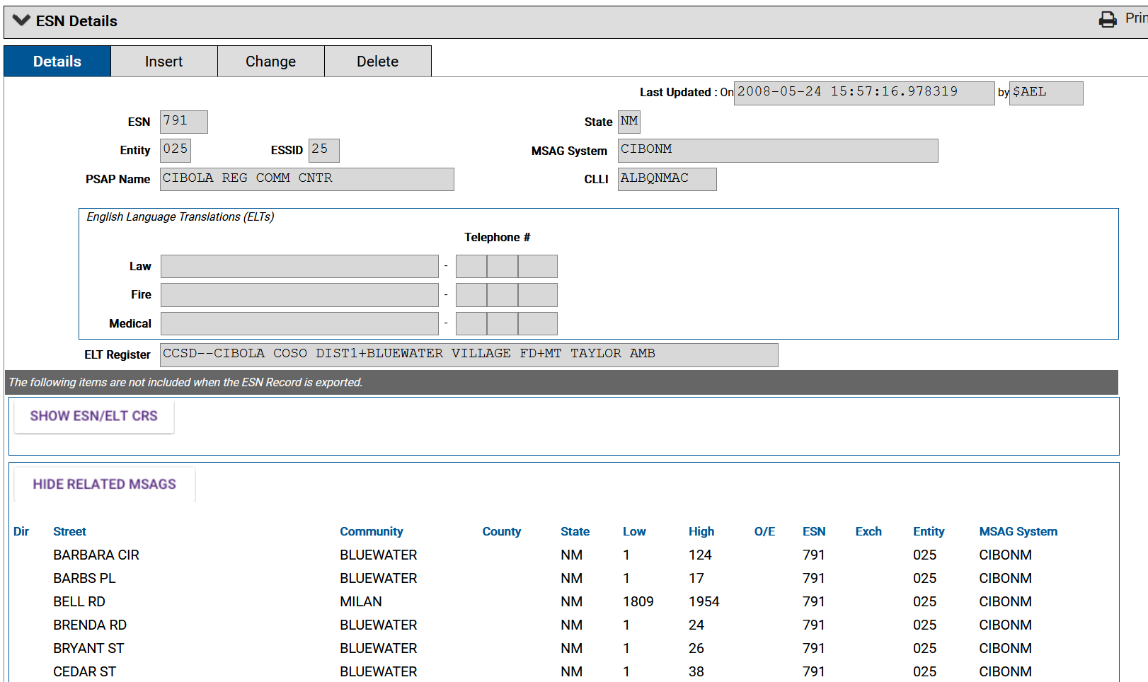

Slide 46
9-1-1 NET: Request Status(es)
Active Request Statuses
Inactive Request Statuses
Initiated
Pending
Referred
Requested
Suspended
Updated
Approved
Completed
Denied
Rejected
Archived
Notes:
A MSAG Request, ANI/ALI Discrepancy Report, TN Change Request, or ESN Change Request report will have one of the following statuses:
Referred – request as been referred to a Service Provider for update by the Intrado Data analyst.
Requested - request is submitted by the Intrado Data Analyst and is being investigated/processed by the County Coordinator. In this case, the County Coordinator has the authority to INITIATE or DENY the request made by the Intrado Data Analyst but does not have the authority to delete the request. If the County Coordinator initiates the request, the request follows Initiated status procedures.
Suspended - The investigation/processing of the request by the assigned Intrado Data Analyst is paused pending the retrieval of additional information from the user who submitted the request. If a request lists with this status, you should expect to find a related message from the Intrado Data Analyst. This message is in the Comments field of the request. This field is viewed by performing an Active Request Status function on the request. Requests that have this status cannot be deleted or archived, and they must be updated by the submitting County Coordinator before they can be processed further (refer to the 9-1-1 NET Users Guide for more information.)
Updated - This request has been updated by the submitting County Coordinator to contain additional information that was requested by an Intrado Data Analyst. Requests that have this status cannot be deleted or archived.

Slide 47
MSAG – Bad Data
Bad MSAG data is caused from lack of knowledge, lack of process, personnel changes and even laziness
Bad data is often introduced when the 9-1-1 process begins as partial areas may not be addressed (entire Pueblos, for example, in Santa Fe or Sandoval counties)
Catch-All – a record designed to catch and validate unaddressed areas
Look for “Sandoval County 1-999999 or Picuris Pueblo 1-999999 or
Rio Grande Subdivision 1 – 999999

Slide 48
MSAG – Bad Data
Spelling – alternate spellings for the same road with some TNs attached to one record and some TNs attached to the other – but they’re all the same road
Greenbriar Rd
Green Briar Rd
Greene Briar Rd
Directionality – same road with different directionals or street types:
NW Anton Chico Rd
Anton Chico Rd NW
Anton Chico Rd
N Anton Chico Rd
N Anton Chico Rd

Slide 49
MSAG – Bad Data
Overlapping Ranges with Different Communities
Because ZIP communities make so little sense, you might see things like this
State Highway 101 / 1 – 1799 / Bernalillo
State Highway 101 / 1500 – 2399 / Corrales
It’s the same road but there is not an agreement where one community stops and the next starts and it is allowable in the MSAG!

Slide 50
MSAG Updates: Corrections
An MSAG record can’t be deleted if there are ALI records associated with it (tied to it)
You must first query all the addresses (TNs) on the road you wish to delete and give them new addresses on a road that already exists in the MSAG before you can delete
Sometimes, you’ll have to add that road in first
You must tell Intrado what to do with the addresses/TNs on the “wrong” road before deleting. Example: move all records on “Greenbriar Rd” to “Green Briar Rd” – but first be sure the “Green Briar Rd” record has the correct range)
And if Lumen is not the telephone company for the area being changed, you must first make the MSAG change with Intrado to add the correct road, then send address updates to the individual phone company. And the local phone company will need that MSAG change too!

Slide 51
Local Exchange Carrier (LECs) & MSAG Updates
While Lumen (formerly CenturyLink) holds the 9-1-1 Database contract for the state, and contracts with Intrado, there are a dozen or more other phone companies in New Mexico
Each maintains customer service records with valid 9-1-1 addresses
Every time one of those records changes, the local phone company updates its records with Intrado through an SOI (Service Order Input)
These are done every day, and pass all adds/changes/deletes in their systems to Intrado for the 9-1-1 database
Making a change with Intrado does not make a change with the local phone company. And their data will overwrite what’s in the 9-1-1 database, so must be accurate too!

Slide 52
701/709 Error Reports
MSAG maintenance includes dealing with individual TNs that “fall out” and cannot be loaded into the system because they failed when matching the MSAG
The resident is supposed to give a valid 911 address when requesting service or a service change but not all phone companies enforce this
It is absolutely possible for a local phone company to give a resident or business service, accept their address, then load the address to Intrado and have it “fall out” and become an error for you to resolve
701/709 error report is provided by the local exchange carriers serving a PSAP area which details the phone numbers that were not successfully loaded into the 911 ALI database due to an MSAG or other error
Notes:
701/709 definition from NMAC 10.6.2-E-911-Rule

Slide 53
701/709 Errors
“701” indicates that the house number not in MSAG record
“709” indicates that the street not found in the MSAG
For errors from telephone numbers in Lumen franchise area: errors are reported through 9-1-1 NET. Lumen contracts with Intrado for this service.
For errors from telephone numbers in other LECs: a representative from each phone company should contact the MSAG Coordinator to report and resolve the error. Many use telephone or e-mail.

Slide 54
701/709 error Corrections
701 errors
Verify that the house number is correct by working with appropriate addressing authority (city/county). Check the correct house number against the MSAG to assure it is in range and provide the corrected information to the local exchange carrier
If the house number on the error report is correct, modify the address range in the MSAG to accommodate the error record
MSAG changes must be made through 9-1-1 NET even if they are made to correct errors in other telephone company’s franchise areas

Slide 55
Example: 701 Corrections
601 Cottonwood St
1620 Arroyo Seco Rd
Check MSAG:
Cottonwood St 100 599 B
Contact addressing authority and verify that 601 Cottonwood St is a valid address
Yes, two homes have been added to the end of the block and given the addresses 600 & 601. No new homes will be added after these two
Update MSAG through 911NET
Extend range on Cottonwood St to “601”
Check MSAG:
Arroyo Seco Rd 1 1610 B
Contact addressing authority and verify that 1620 Arroyo Seco Rd is a valid address
No, Addressing Authority has not issued that address. However, 1602 was recently issued. Verify that customer name and other information is correct for that new address.
Correct Address and Return to LEC
Record should be changed to “1602 Arroyo Seco Rd”

Slide 56
701/709 error Corrections
709 errors
Check the road name in the error record against the MSAG to determine if it is simply misspelled. If the road name is misspelled, submit the correction back to the appropriate local exchange provider. This does not require an MSAG update
If the road name is not simply misspelled, consult with the appropriate addressing authority to verify the address. If the base road name if valid, check directional and street type (suffix).
If the road name in the error record is valid but is not yet in the MSAG, verify the spelling, range, community and ESN and submit an MSAG update using 911NET

Slide 57
Examples: 709 Corrections
811 Chamayo Rd
94 Mendoza Rd
Check MSAG for Road Name
Chimayo Rd 1 899 B
The road name is misspelled.
Correct spelling in error record and return to LEC.
Check MSAG for Similar Spelling
Road name not misspelled—no “Mendosa,” for example
Check MSAG for similar Road Names
Calle de Mendoza found, range 1 – 99
Verify with addressing authority that 94 Calle de Mendoza is valid address for customer in question
Submit correct record (94 Calle de Mendoza) to LEC

Slide 58
Examples: 709 Corrections
115 Hatch Dr
Check MSAG for Similar Road Names
No similar roads—no Hatch St, N Hatch Dr, Patch Dr, etc.
Contact addressing authority to verify address in question
Addressing authority advises that Hatch Dr is new street in rural subdivision.
Verify correct designation and address range from addressing authority
Hatch Dr 1 149 B Ranchos de Taos
Add new record to MSAG using 911Net

Slide 59
No Record Found – NRF
A landline 9-1-1 call from a phone number “in error” will display as “NRF” (No Record Found)
Dispatcher must verify address, determine appropriate responders and manually search for street on map if unfamiliar with the location
NRF reports are sent to the service provider/LECs on a daily basis for immediate corrections (within 3 days).

Slide 60
GIS & The MSAG
GIS data and MSAG must be synchronized
GIS Layers required for MSAG
Road Centerlines
ESZ Boundaries
Community Boundaries
9-1-1 Community Boundaries (for NG9-1-1)
Telephone Exchange Boundaries (NENA)
While Address points are critical for 9-1-1 and must sync with centerlines, they are not part of the MSAG process.
Notes:
Whew! Good luck with this!

Slide 61
GIS & The MSAG
ROAD CENTERLINES
Parsed road name (STR_DIR, STR_PRETYPE, STR_NAME, STR_TYPE, POST_DIR)
Address Ranges: (L_ADD_LOW, L_ADD_HIGH, R_ADD_LOW, R_ADD_HIGH)
MSAG Community Name (MSAG_COM_L, MSAG_COM_R)
ZIP Code (ZIPCODE_L, ZIPCODE_R)
ESN (ESN_L, ESN_R)
ESZ BOUNDARIES
Combine Law/Fire/EMS into one polygon layer
Assign official name as used by 9-1-1
Assign official ESN as used by 9-1-1 and controlled by the 9-1-1 Database provider

Slide 62
GIS & The MSAG
MSAG COMMUNITY BOUNDARIES
Should reflect a good approximation of ZIP Codes
Name must be an accepted name of a US Post Office (some alias names are allowed in the system but must be verified by the usps.gov ZIP+4 address locator
TOPOLOGY
All centerlines must be segmented wherever they cross or meet an MSAG boundary and appropriately ranged
All centerline segments must be snapped vertex to vertex to boundaries they follow
All boundaries that are coincident must be snapped vertex to vertex to each other
All boundaries and roads should be edge-matched to neighboring PSAPs

Slide 63
GIS-MSAG Comparison
MSAGs were often created before GIS was being used. They have legacy errors.
Sometimes, GIS was not developed in conjunction with 9-1-1 or addressing.
Sometimes they are both wrong.
Sometimes the road signage doesn’t match either the GIS or the MSAG.
Sometimes, different GIS entities (Assessor/9-1-1) have road naming data that does not agree
You can’t get anywhere unless you start somewhere!!!
Notes:
Whew! Good luck with this!

Slide 64
GIS-MSAG-ALI Comparison
The New Mexico 911 (NM911) Program, performs comparison between GIS, MSAG, and ALI databases. Results are generated in the form of a report and geospatial data.
GIS data providers and PSAPs are recommended to review these reports and make necessary data corrections to improve the accuracy and synchronization of both datasets.
Never assume one source is correct above the other. The NM911 Program recommends GIS data providers and PSAPs to collaborate to –
Establish an authoritative dataset to edit the non-authoritative data
Develop a workflow/procedures for data updates
Notes:
Glenn – you should show RACT results here

Slide 65
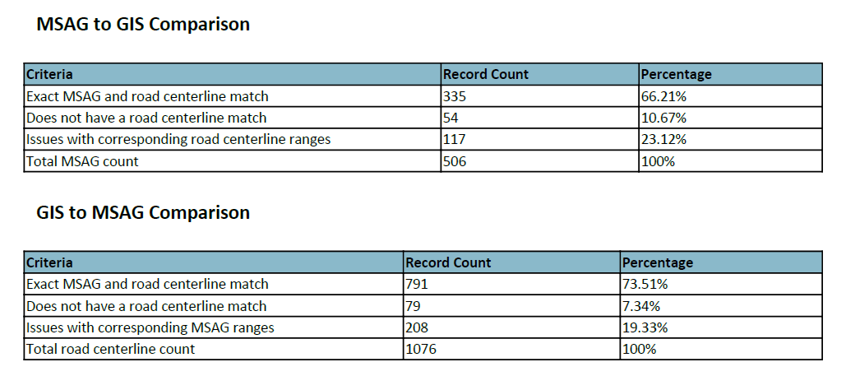
GIS-MSAG-ALI Comparison
MSAG and GIS Datasets used for Comparison
Snapshot of Quarterly GIS-MSAG-ALI Comparison Stats, De Baca County – March 2022
Notes:
MSAG Record count – Source Data: 509 and GIS: 506 – eliminated Wireless or VOIP calls rows

Slide 66
GIS-MSAG Comparison – Interpreting Results
BILLYTHEKIDDR|FORTSUMNER|00942 – Not in NM911 road- Rng: 3466-3968
Derived from GIS data (road centerlines)
Derived from MSAG from 911NET
In GIS data, address range 3466-3968 is part of ESN 943.
In MSAG data, address range 3466 – 3969 is duplicated for ESN 942 & 943
Fix: Data Providers & PSAPs must coordinate to establish the authoritative dataset and update the non-authoritative dataset!

Slide 67
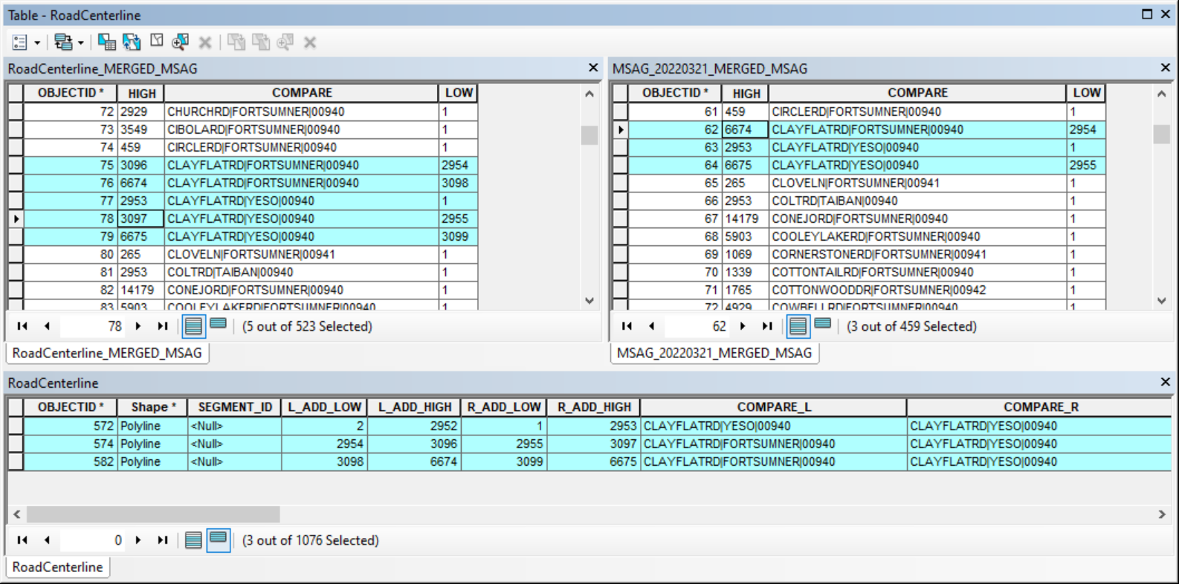
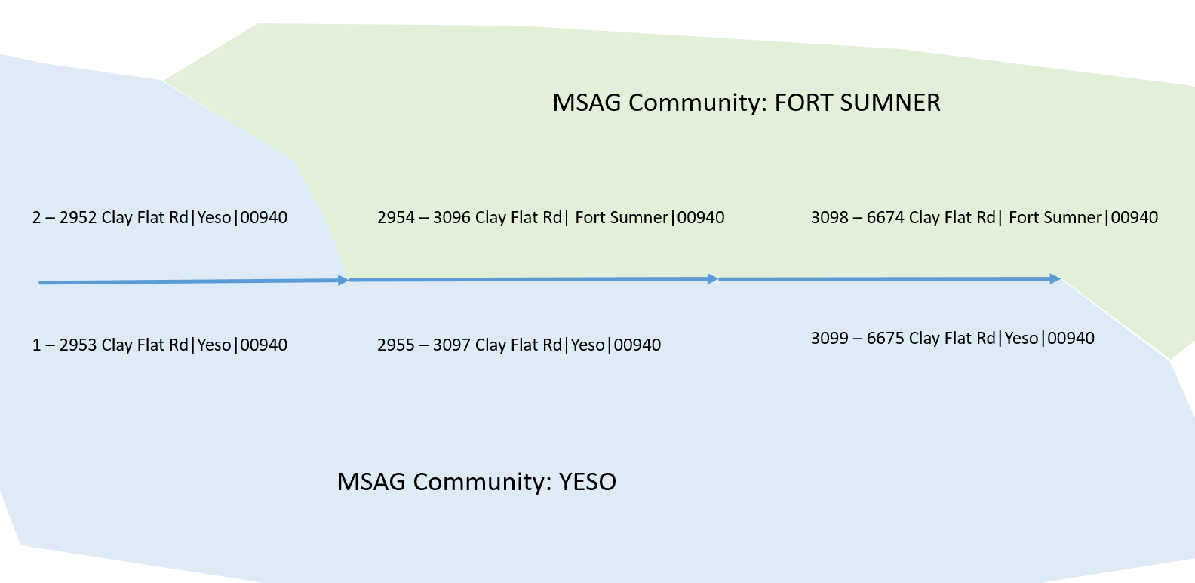
GIS-MSAG Comparison – Interpreting Results
CLAYFLATRD|FORTSUMNER|00940 – Not in NM911 road- Val: 3097
In GIS data, Value 3097 is part of YESO and not in FORT SUMNER. This is a valid error & No Correction Needed!

Slide 68
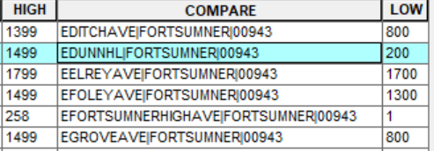
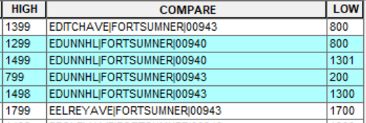
GIS-MSAG Comparison – Interpreting Results
EDUNNHL|FORTSUMNER|00943 – Not in MSAG- Rng: 800-1299, Val: 1499
EDUNNHL|FORTSUMNER|00940 - Does not have a road centerline match
Derived from GIS data (road centerlines)
Derived from MSAG from 911NET
Fix: Data Providers & PSAPs must coordinate to establish the authoritative dataset and update the non-authoritative dataset!

Slide 69
GIS-MSAG Comparison – Interpreting Results
EFOLEYAVE|FORTSUMNER|00943 – Not in MSAG- Val: 1300
EFOLEYAVE|FORTSUMNER|00940 – Does not have a road centerline match
Derived from GIS data (road centerlines)
Derived from MSAG from 911NET
Fix: Data Providers & PSAPs must coordinate to establish the authoritative dataset and update the non-authoritative dataset!

Slide 70
BEST PRACTICES
To improve data accuracy!

Slide 71
Improving Data Accuracy
Actual vs. Potential Address Ranges
An actual range in a city block reflects the highest and lowest potential address on that block as per the lot or plat system, which may assign one address for every 25 feet of frontage
A potential range in a city block ends at 99 such as 100-199, 200-299, etc.
The GIS should reflect actual ranging. The MSAG is more likely to reflect potential, and as a city has the same responders (same ESN), you’ll see 100-1299 in MSAGs
An actual range in a rural area may mean only the highest and lowest actual addresses on a given road
A potential range in a rural area means the highest and lowest potential address for the segment as per the interval or grid
The GIS should reflect potential ranging for accurate geocoding. Yes, this is different than in cities! The MSAG can reflect either, but will have to be updated if structures are added on either end

Slide 72
Improving Data Accuracy
Street type abbreviations: NENA standards call to uses the USPS standards as per Publication 28. Abbreviations are two-four characters.
AVE not AV
TRL not TR
LOOP not LP
LN not LA
Abbreviations to Shorten Road Names: There is a space limitation currently the number of characters allowable in a road name in the MSAG (28 – 36).
Bloomfield Cemetery Rd vs. Bloomfield Cmty Rd
USPS Postal Addressing Standards https://pe.usps.com/text/pub28/welcome.htm

Slide 73
Improving Data Accuracy
Pre vs. Post Directionals
NW Alameda Blvd vs. Alameda Blvd NW
S Aztec Rd vs. Aztec Rd S
Spell out all designations: Standardizing the way highways are designated across the state will result in more accurate locations and more accurate routing
State Highway 54 or NM Highway 54 or Highway 54
County Road 123
Spelling variations
Bloomfield Cemetery Rd vs. Bloomfield Cemetary Rd
Dona Ana Rd vs. Dona Anna Rd
Chisum Trl vs. Chisholm Trl

Slide 74
Improving Data Accuracy
Punctuation: NO, always avoid
Mayfield-Brown St vs. Mayfield Brown St
Jenkin’s St vs. Jenkins St
Spanish/English Names: Only one should be correct and there should not be variants in the MSAG
Ana Maria Ave vs. Avenida Ana Maria
Calle Cinturon vs. Cinturon St

Slide 75
Improving Data Accuracy
Numbers/Letters: Numbers are preferred. Letters should be used only for duplicate road names in different cities
First St vs. 1st St.
Fourth Ave vs. 4th Ave
County Road Designations: Avoid beginning road names with numbers. Use consistent designations with the “spelled out” County Road preferred as per USPS guidelines.
County Road B120 vs. B120
Road 303 vs. 303 Road

Slide 76
Post-Test Guidelines
Please wait to launch the test until you are given the okay.
Test will only be open for a certain amount of time.
The Post-Test is OPEN BOOK, but use only your class handout/materials. No outside searches please.
Please enter your full name on the test and submit when complete.
You must receive a grade of 6 or above on the post-test to pass the class.
Please do not talk to the instructor or to others while tests are in progress.
If you have follow-up questions, stick around until the post-test is over to engage in conversation with the instructor.
If you do not have questions, please do your evaluation and then you may leave the class. Please type your goodbye into chat.
Notes:
Title: MSAG & MSAG Maintenance
Updated by: Sandeep Talasila Date: June 2022
Updated by: Glen Condon Date: September 2016
Created by: Glenn Kammerer Date: Unknown
Get a show of hands to validate all this. We are not taking the time to show them how to build an MSAG from scratch – or train them on how to use/understand GIS terms. Make sure no one is completely lost here.

Slide 77
CREDITS
This class was originally developed for NM EDGE by
Glenn Kammerer
Most recently updated and presented by
Sandeep Talasila, GISP

Slide 78
All Rights Reserved
The content of this class and all associated materials have been created for, or intentionally shared with the NM EDGE and, therefore all rights are reserved.
Do Not Duplicate or Share.

