Slide 1

Geocoding
Sandeep Talasila, GISP

Slide 2
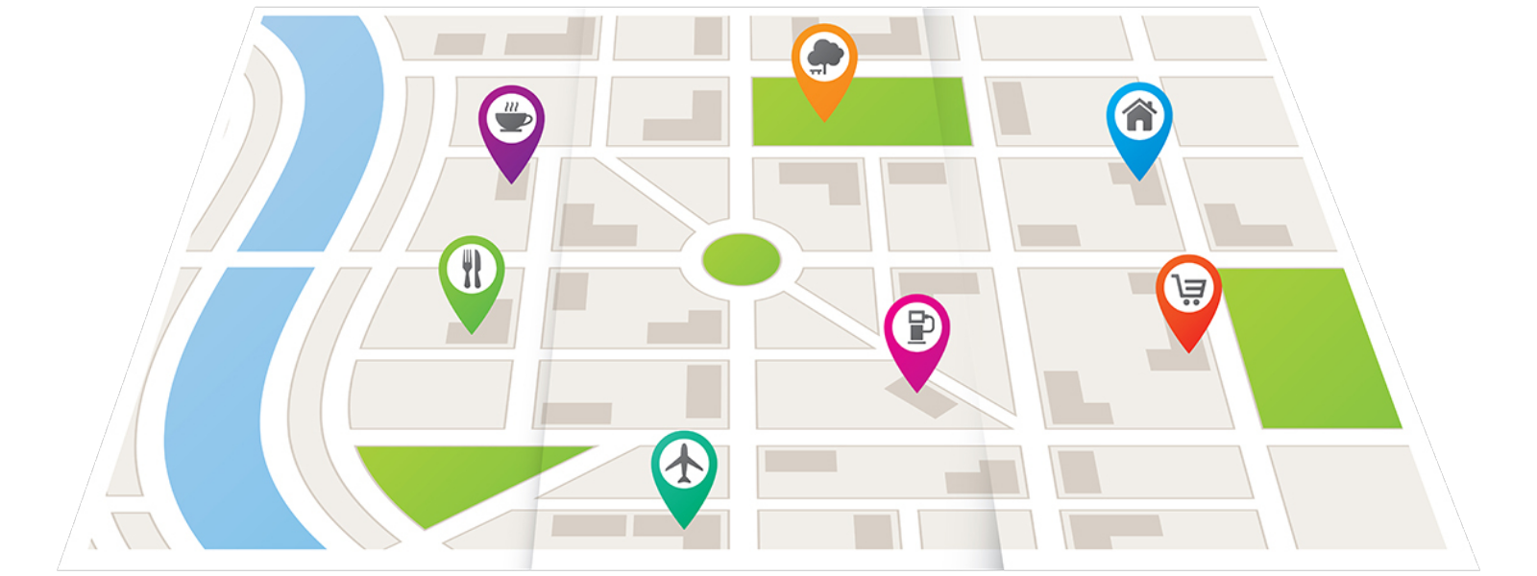
Geocoding
Geocoding is the process of transforming a description of a location – such as a pair of coordinates, an address, or a name of a place – to a location on the earth's surface. – ArcGIS
medium.com
Notes:
Transforming a description of a location to a location on the earth’s surface
Address Matching – geocoding with an address
Description of a location: such as a pair of coordinates, an address, or a name of a place
Image: https://medium.com/themap/geocoding-d4183e

Slide 3
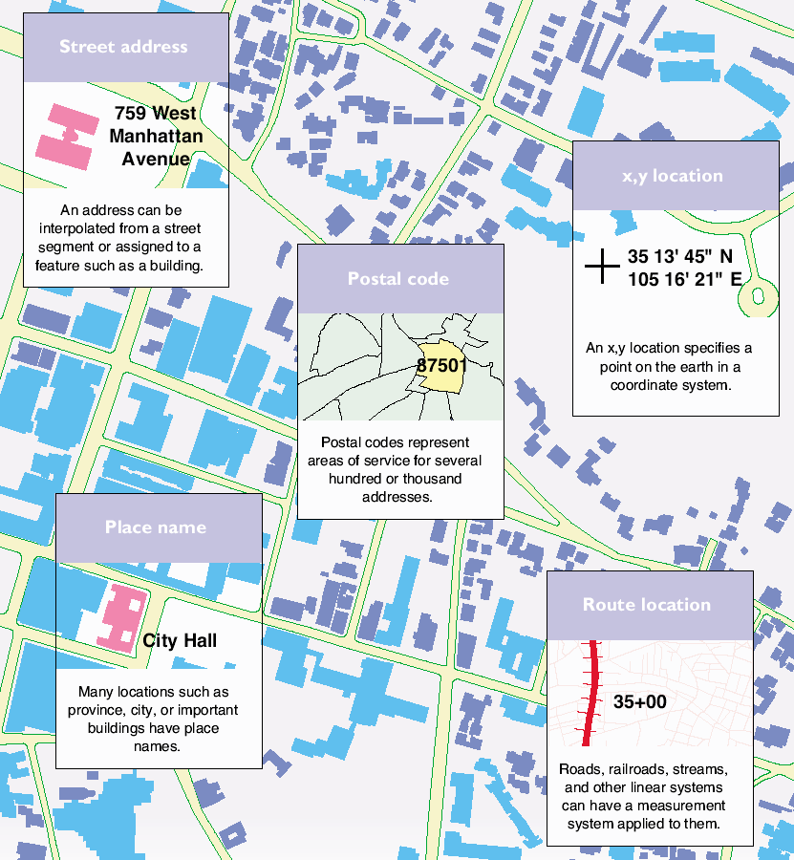
Types of Locations
Coordinates (x, y)
Street addresses
Postal codes
Place names
Route location

Slide 4
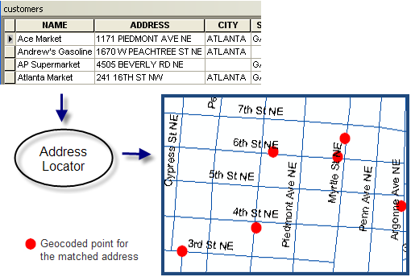
Components OF GEOCODING
Location Data
Reference Data
Address Locator
Results
ESRI
Notes:
The file to be geocoded or “locational data”
File type (text, dBase, Oracle)
Content:
Address with city and ZIP
Other important fields
The “locator” or “reference” file
Line, polygon or points
Contains reference information, e.g. addresses, city, ZIP

Slide 5
Converting (x,y) Locations
x
y
Table with fields for x and y coordinates
Spatial reference
(coordinate system)
New data layer with a point for each input (x,y) value
This is how we map GPS data!

Slide 6
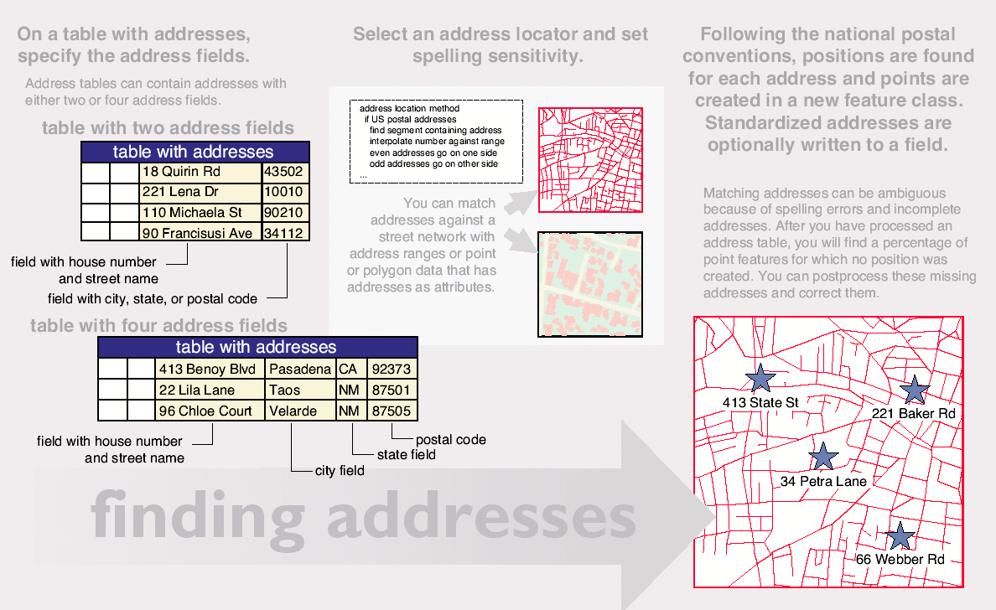
Converting Addresses

Slide 7
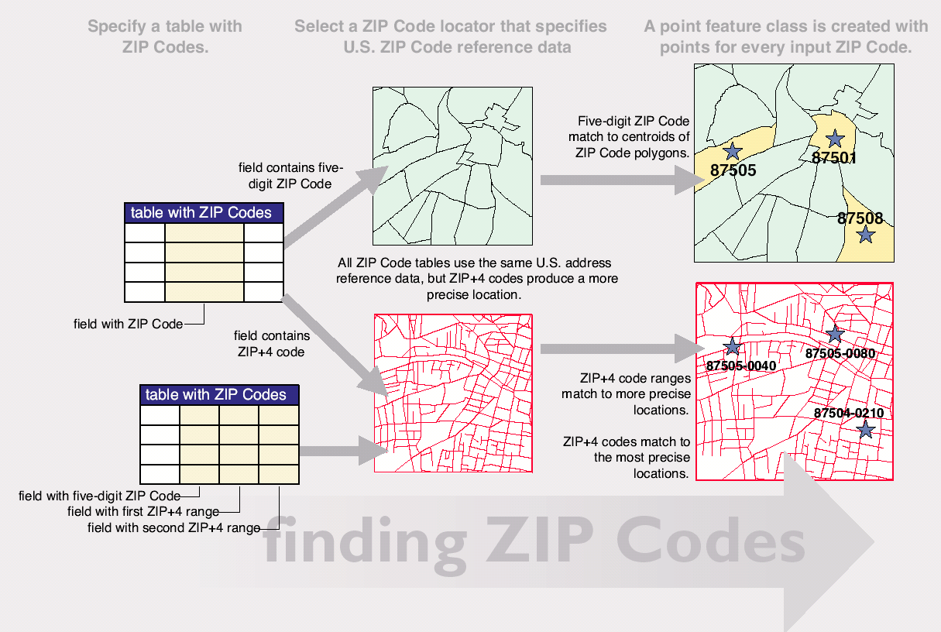
Converting ZIP Codes

Slide 8
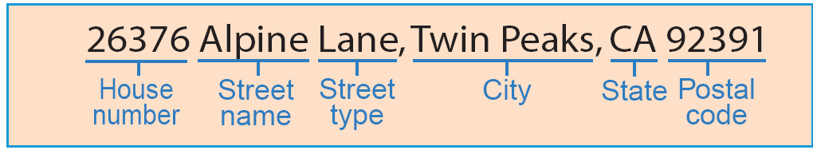
ADDRESS ELEMENTS
Address (house or building) number
Prefix direction
Prefix type
Street name
Street type
Suffix direction
Zone
Postal Code
…
Notes:
An address element is an individual component in the address, such as the house number, street name, street type, and postal code. Address elements help in the geocoding search, pinpointing an address to a particular location.
Address formats: A common address format used in the United States consists of the following series of address elements: house number; prefix direction, prefix type, street name; street type, suffix direction; and zone information such as city, state, and ZIP Code.

Slide 9
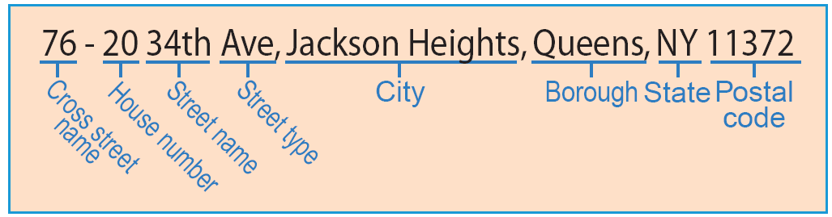
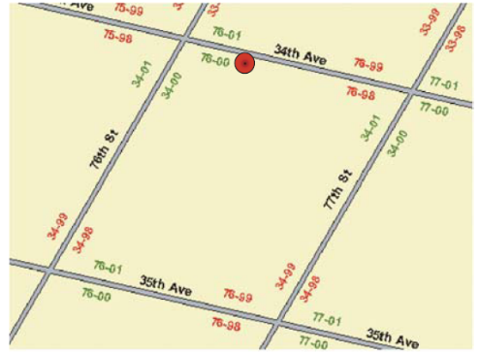

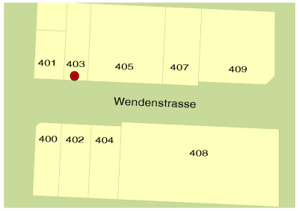
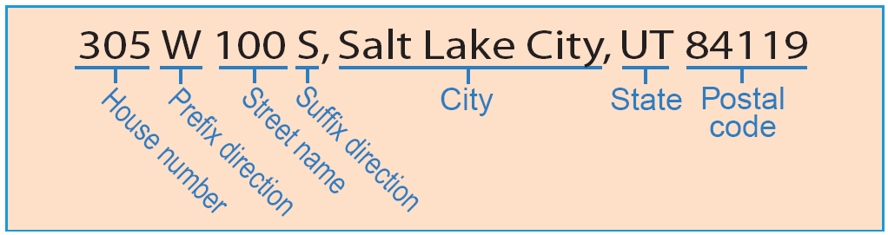
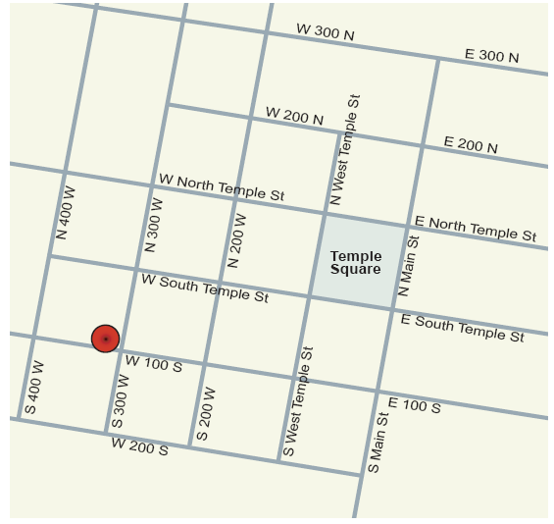
ADDRESS FORMATS
Notes:
In the mid-1920s, the Topographic Bureau of Queens unified the street names and implemented a hyphenated address style. The first number indicates either the north or west cross street. The second number indicates where on the block the building is located. Also as a general rule in Queens, avenues run east to west and streets run north to south. Queens also includes the neighborhood, or borough, where the address is located. This is a practice used in many parts of the world. While the address format used in Queens is not initially recognizable, the address format still contains the elements needed to assign it to a specific location.
Salt Lake City, Utah, also uses an alternative address format. When the streets were initially laid out in Salt Lake, the Latter-Day Saints temple was the center of the community. Roads in each direction from the temple were assigned a numeric name indicating how far they were from the temple, as well as directional value, indicating the direction from the temple that a street was located. The numeric prefix simply indicates the part of the road where the address is located. Again, while the address format differs from the common format, the basic address elements exist to locate each address.

Slide 10
GECODING WORKFLOW
Build or obtain reference data
Determine address locator style
Build an address locator
Locate addresses
Publish or maintain the address locator

Slide 11
Reference DATA
Topologically Integrated Geographic Encoding and Referencing system (TIGER)
Other Street data – Local entities or Commercial
Parcels
Zip code
…
Note: address locator needs to rebuild once reference data are updated.
Notes:
Errors in the reference data cause poor matching quality. For example, if the geometry of the reference features is incorrect, the addresses that are matched to them will also be spatially incorrect. If the name of a reference feature is misspelled, correctly spelled addresses may go unmatched. There are several potential errors to keep in mind regarding your reference data.

Slide 12
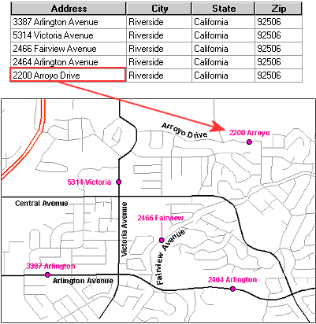
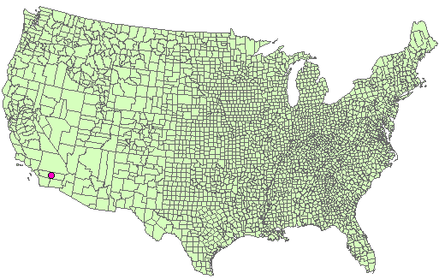
Using Street Reference File

Slide 13
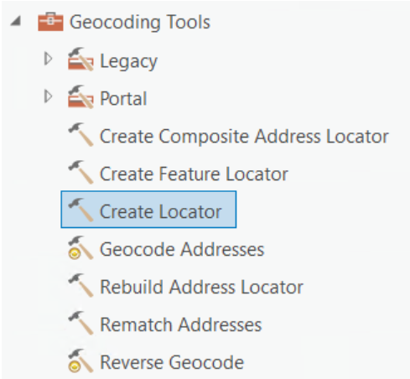
ADDRESS LOCATOR
It’s an essential geocoding tool.
It contains a snapshot of the reference data that is used for geocoding
Address locator file is created with following extensions
  *.loc, *.loz – stores reference information
Can be shared as a Locator Package or as a Service

Slide 14
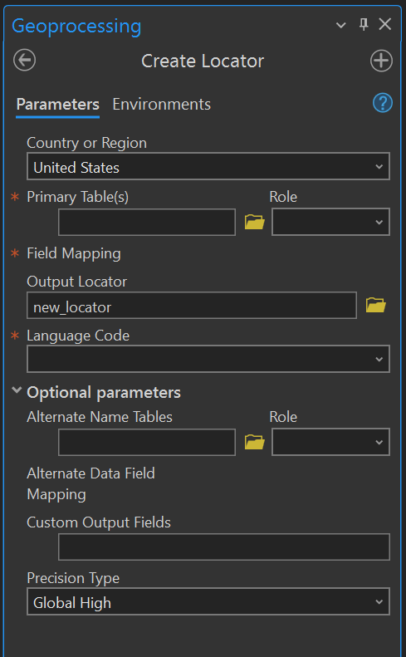
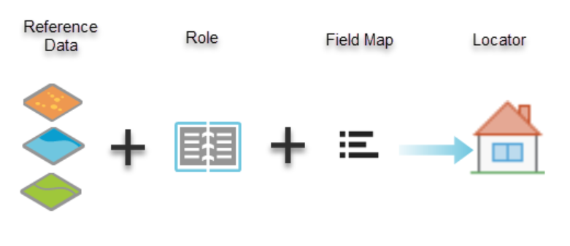
CREATE ADDRESS LOCATOR
pro.arcgis.com

Slide 15
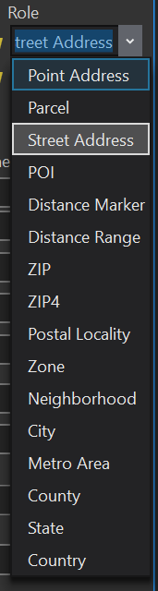
ADDRESS LOCATOR Roles
Role | Typical reference dataset geometry | Typical reference dataset representation | Address search parameters | Examples | Applications
Point Address | Points or polygons | Each feature represents an address | Address elements in a single field | 71 Cherry Ln | Finding parcels, buildings, or address points
Parcel | Points or polygons | Each feature represents a parcel | All address elements in a single field | 320 Madison St. | Finding parcels or address points
 |  |  |  | 1760820300
Street Address | Lines | Each feature has the address range for both sides of the street segment | All address elements in a single field | 2 Summit Rd. | Finding a house on a specific side of the street or street intersections
 |  |  |  | N5200 County Rd PP
 |  |  |  | 115-19 Post St.
POI | Points or polygons | Each feature represents a particular geographic place name or landmark | All place name elements in a single field | Leeds Castle, England | Finding geographic place names or landmarks in an area or the world
 |  |  |  | Sapporo, Japan
Distance Marker | Points or polygons | Each feature represents sequentially nymbered markers placed along roads at regular intervals | Distance marker in a single field | Mile 25 I-25N, Raton, NM | Finding a distance marker sign on highway
Distance Range | Lines | Each feature represents the distance marker range for each line segment. | Distance marker range in a single field | Carr 682 KM 4.4, Barceloneta, 00617 | Finding an approximate distance along a highway
Postal | Points or polygons | Each feature represents a single postal code region or centroid | Postal code in a single field | 96822 | Finding a specific postal code location
Postal Extension | Points | Each feature represents a single postal extension centroid | Five-digit ZIP Codes and four-digit extension in separate field | 63703-0078 | Finding a specific postal extension location
Postal Locality | Points or polygons | Each feature represents the union of postal code and city in a postal code boundary or centroid. | Postal code and city in a single field | 7132 Frauenkirchen | Finding a specific locality
Administrative Areas | Points or polygons | Each feature represents a particular administrative area such as city, neighborhood, metro area, territory, region, and so on. | Administrative area name in a single field | British Columbia | Finding a specific administrative zone
 |  |  |  | North Park, San Diego
https://pro.arcgis.com/en/pro-app/latest/help/data/geocoding/introduction-to-locator-roles.htm

Slide 16
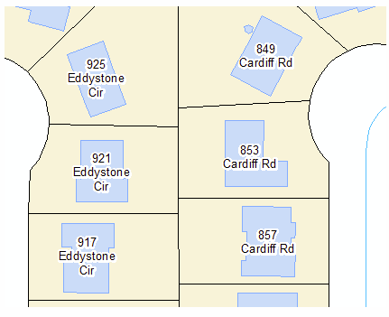
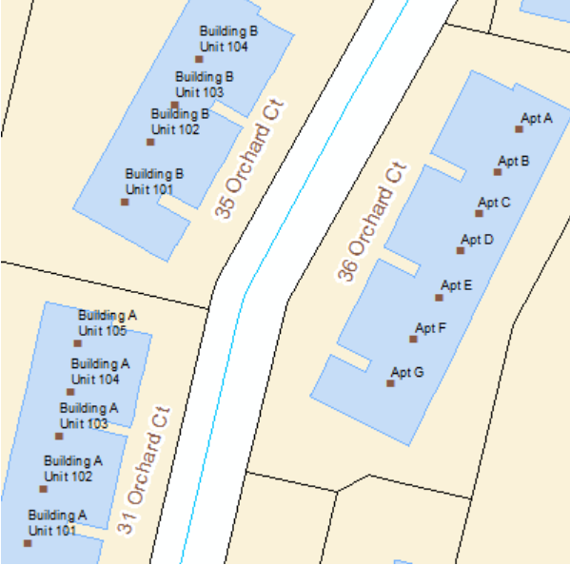
Point Address
Reference data can be polygon or point geometry
Each feature in the reference data corresponds to a single address such as a parcel or a building
Data must have individual fields that contain a street number and street name information.
ESRI

Slide 17
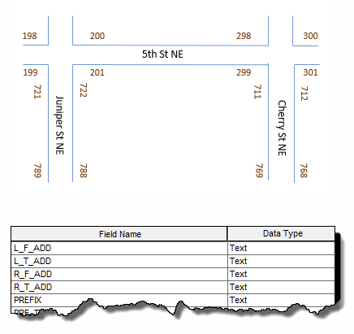
Street Address
Reference data must contain dual ranges for roads
Can provide a range of house number values
Can determine side of the road segment the address is located
Supports normal block ranges, alphanumeric addresses with grid zone, or hyphenated addresses containing cross-street information in the house number
ESRI

Slide 18
REFERENCE DATA – ROADS
A road network is represented by line segments
Each intersection is represented by a node
The coordinates of an address are interpolated linearly between the two nodes of a segment
Example: 1167 Main St.
1100
1198
1101
A
1199

Slide 19
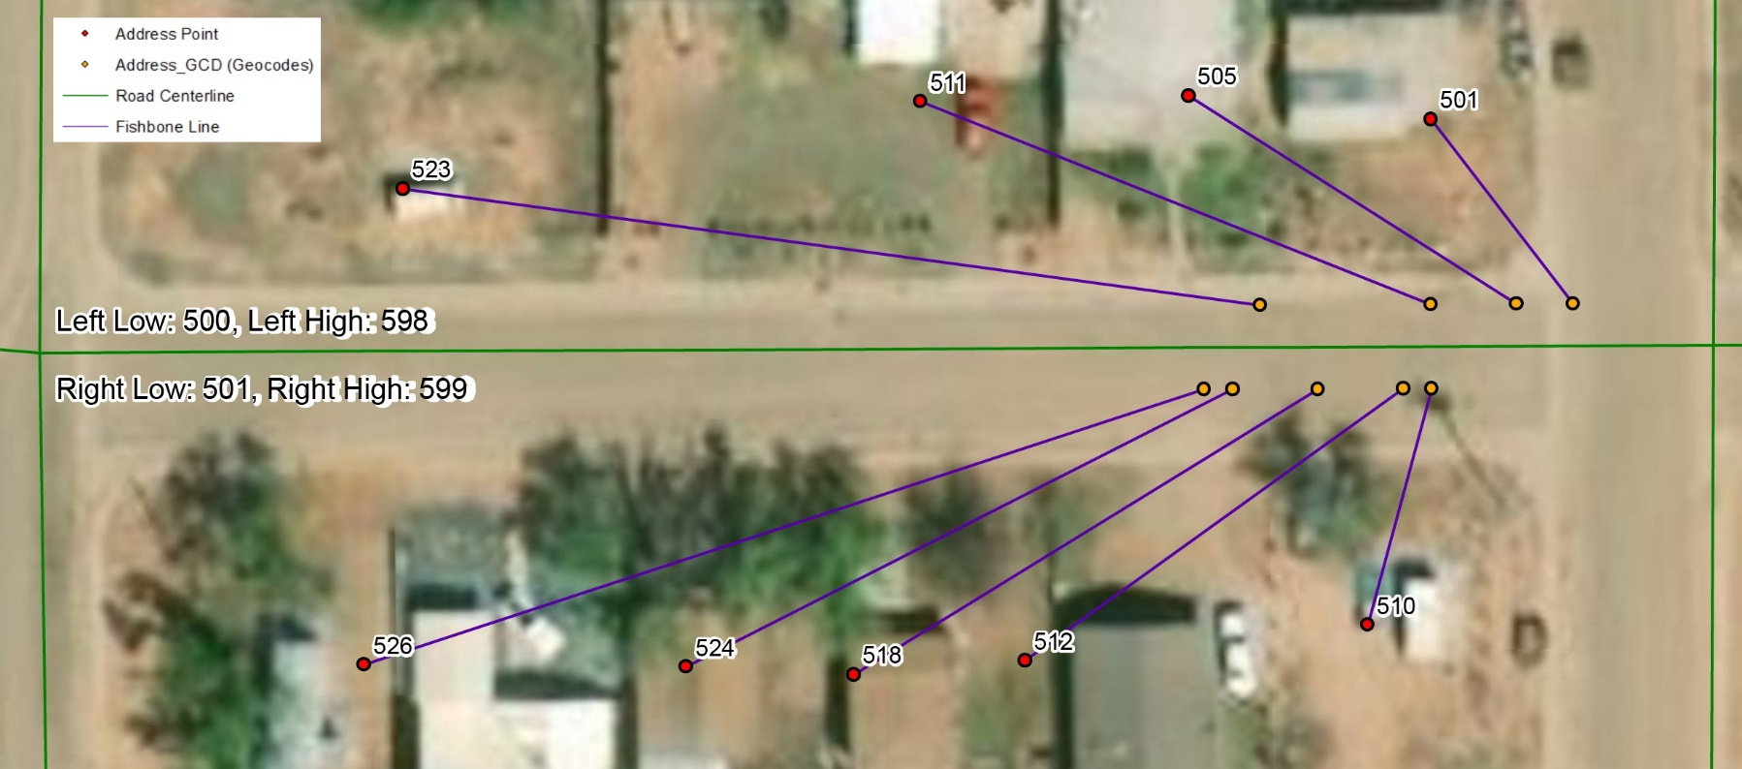
Address Interpolation

Slide 20
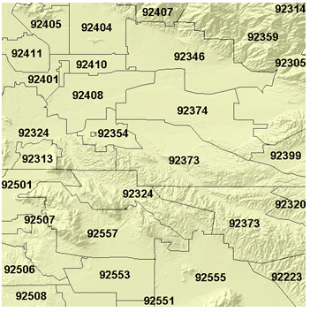
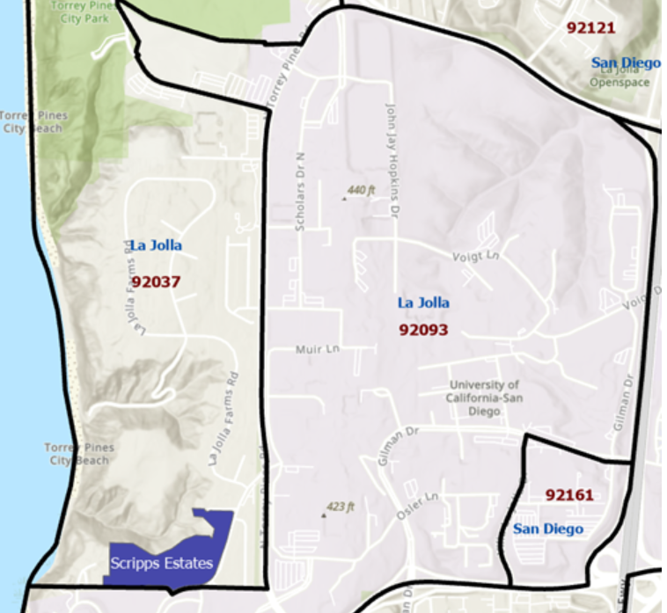
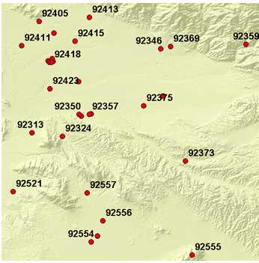
Postal
Reference data can be point or polygon geometry
Each feature must contain a field that specifies the 5-digit postal code
For polygon data the geocoded points will be at the centroid of the zip code polygon
Postal Extension enables finding a specific postal extension location
Postal locality enables finding a specific locality
ESRI

Slide 21
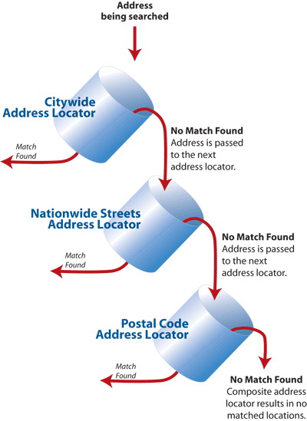
COMPOSITE ADDRESS LOCATORS
Consists of two or more individual address locators
Data are automatically matched against each of the individual locators
Selection criteria can be set for the order of the locators
ESRI

Slide 22
Multirole Locators
Allows to combine multiple reference data layers and roles into a single locator to search for multiple types of locations at once
Ex: rooftop locations, interpolated street locations, points of interest, etc.
Reduces redundant information and candidates, beneficial for performance and reducing data size
Minimize duplicate geocode results with multirole locators
Notes:
https://pro.arcgis.com/en/pro-app/latest/help/data/geocoding/combine-multiple-layers-into-a-single-locator.htm

Slide 23
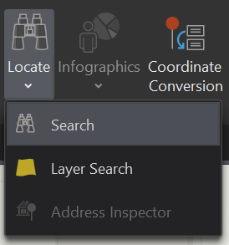
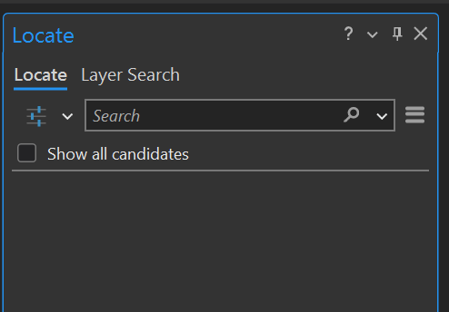
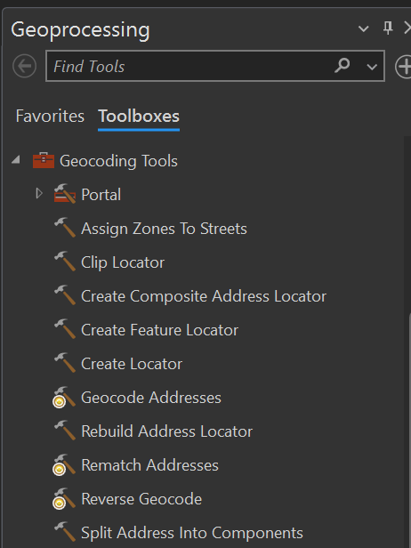
Geocoding in ArcGIS
Create an Address Locator in ArcCatalog
Locate Tool
Geocoding Process
  Add Address Locator to ArcMap
  Select the Address Table to be geocoded
  Save results as a feature class
  Review results, including unmatched addresses
  Decide on rematching strategy

Slide 24
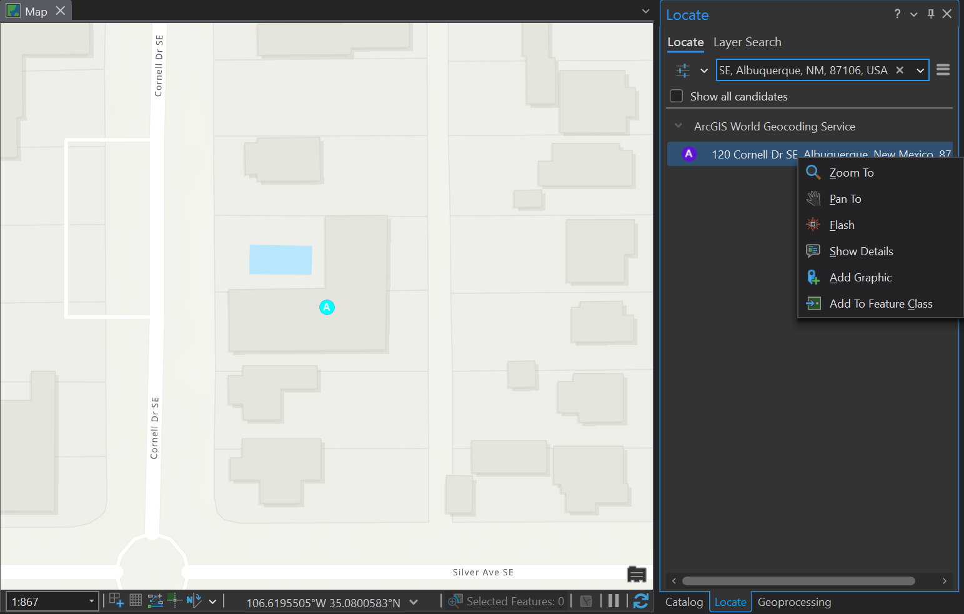
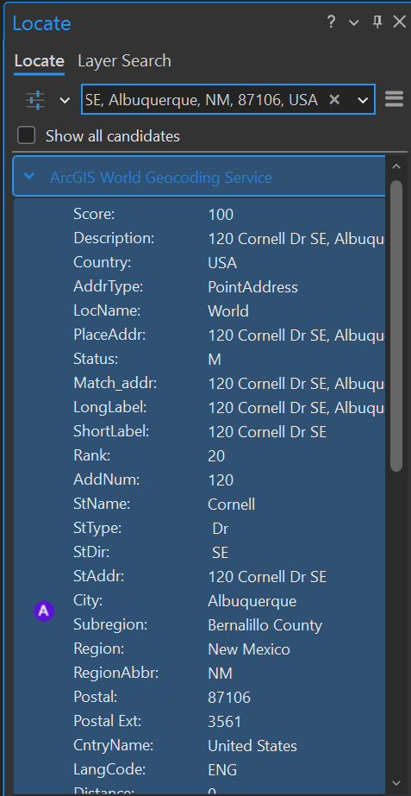
Geocoding Using the LOCATE Tool

Slide 25
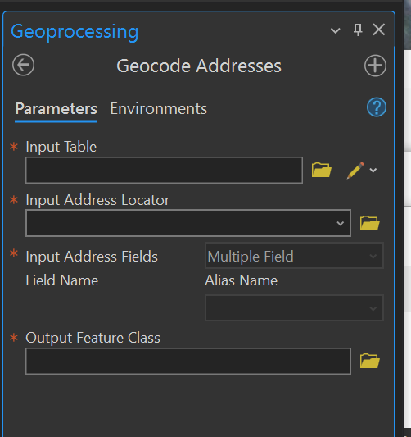
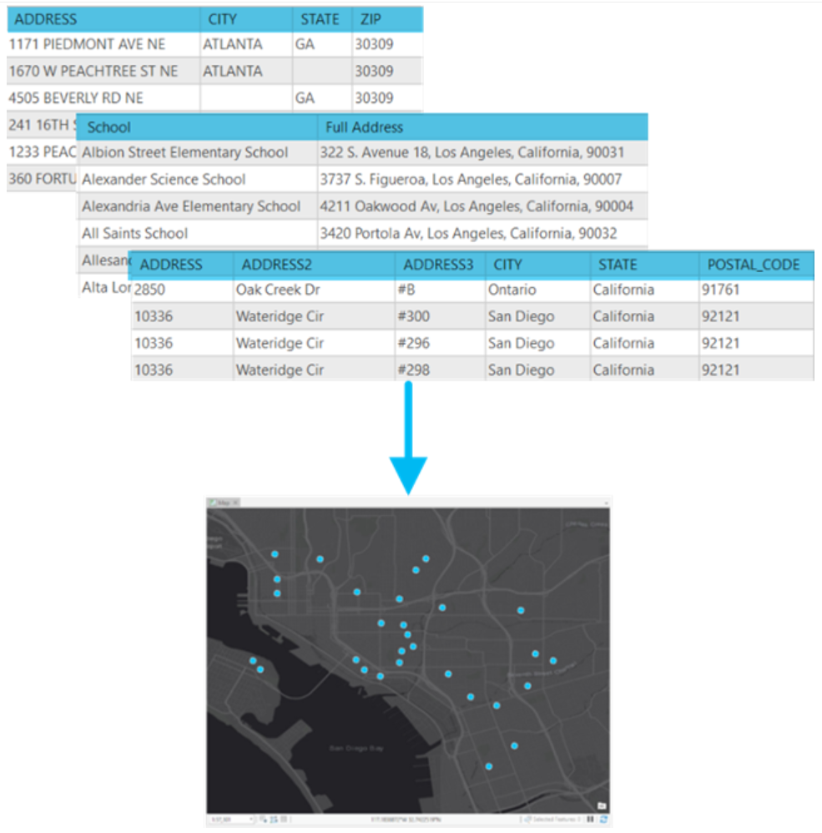
Geocode Address Tool

Slide 26
OUTPUT DATA
In addition to the user provided data, following are a few columns that are created by the software based on the locator style…
Status—A code indicating whether the address was matched. Possible values include the following:
  M—Matched. U—Unmatched. T—Tied (more than one match but different locations).
Score—The match score of the candidate to which the address was matched. The score can be in a range of 0 to 100, where 100 indicates that the candidate is a perfect match.
Match_type—A code showing how an address was matched. You can group the results based on this attribute to show how the addresses were matched or use the grouping to select records for rematching. The codes are as follows:
  A—Automatically matched or rematched.
  M—Manually matched or unmatched.
  PP—Pick by Point. The address was matched to the click point using the Pick Address from Map tool in the Interactive Rematch dialog box in ArcMap.
Match_addr—The address where the matched location actually resides based on the information of the matched candidate. For example, an input address of 123 Main St N is matched to a candidate with the suffix direction NW and all other components matched correctly. The Match_addr field will contain 123 Main St NW as the actual address that was matched.
Addr_type—The type of address that was geocoded. This attribute indicates to what kind of feature the address was matched. You can study the accuracy of the matched addresses and pattern of the matches based on the values.
  PointAddress, StreetAddress, Parcel,…
Notes:
Tied: The address has more than one candidate with the same best match score but at different locations.
https://pro.arcgis.com/en/pro-app/latest/help/data/geocoding/what-is-included-in-the-geocoded-results-.htm

Slide 27
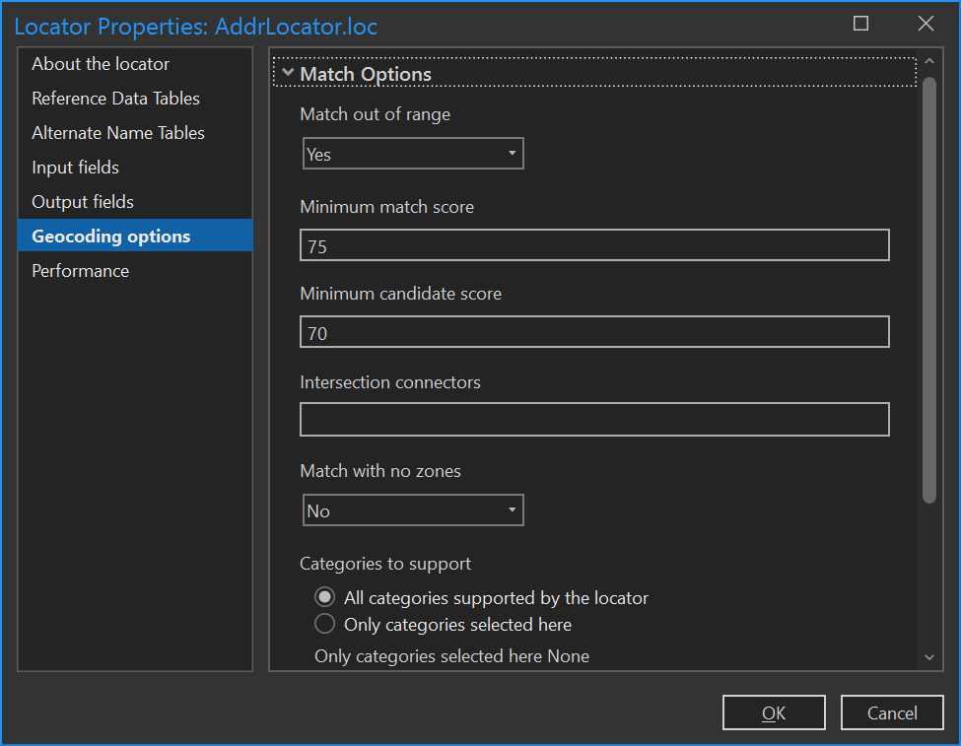
Address Locator PROPERTIES
Modify parameters
Notes:
Decide if you want to match ties. Depending on you data you could be matching to incorrect locations.
Geocoding puts point on center of road segment, most houses are not in middle of street. Decide on what offset distance is appropriate for your location. Most boundaries – census tracts, city council districts, legislative boundaries are defined along road centerlines.

Slide 28
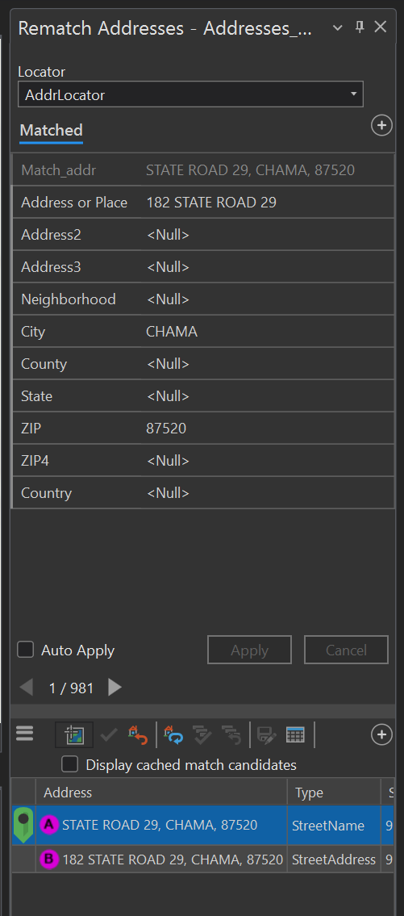
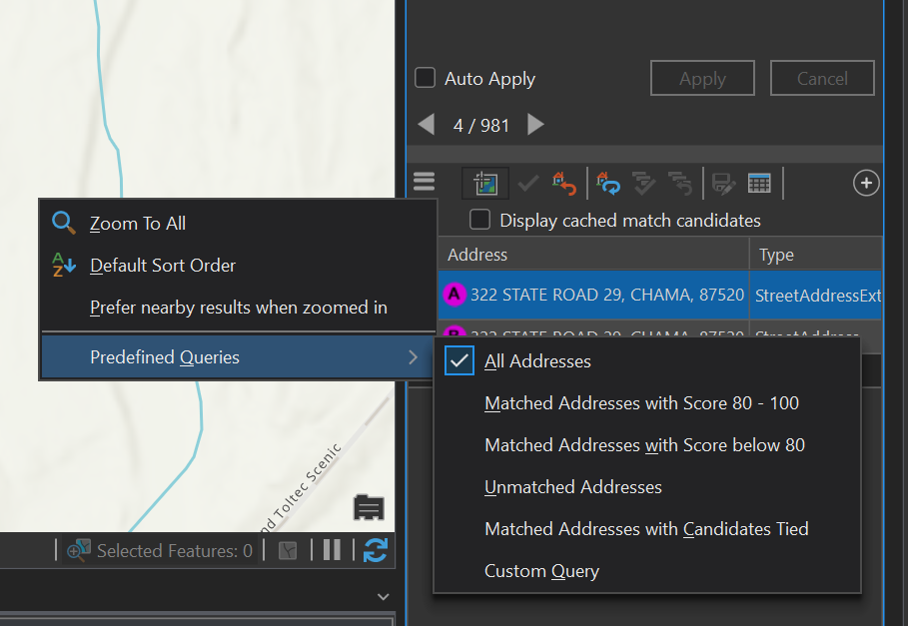
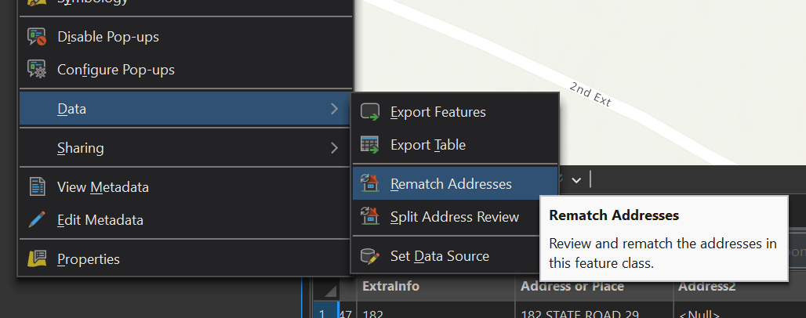
REMATCH PROCESS

Slide 29
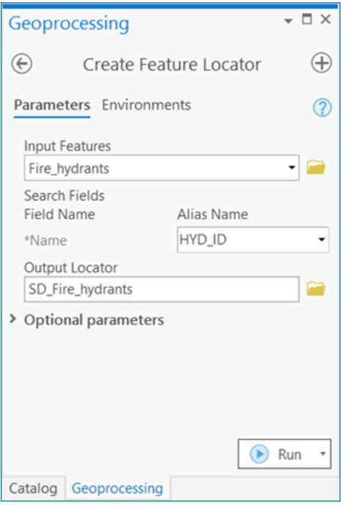
CUSTOM DATA SEARCH –
FEATURE LOCATOR
Feature Locator – Search by features
  Water meters, cell towers, oil wells, etc.
ESRI

Slide 30
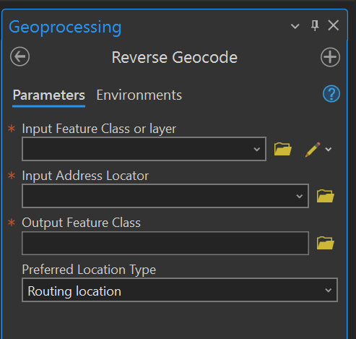
Reverse Geocoding
Searches for the nearest address, place, or intersection for the point location
Input feature class must contain point shapes with valid coordinates
Notes:
Preferred Location Type
Address location—Geometry for geocode results that represent an address location such as a rooftop, building centroid, or front door will be returned.
Routing location—Geometry for geocode results that represent a location close to the side of the street that can be used for vehicle routing will be returned. This is the default.

Slide 31
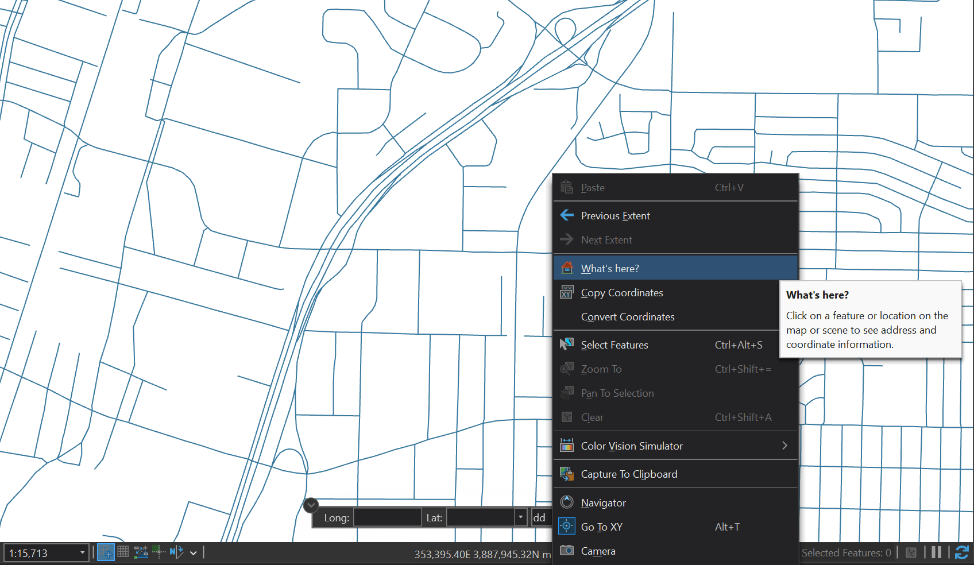
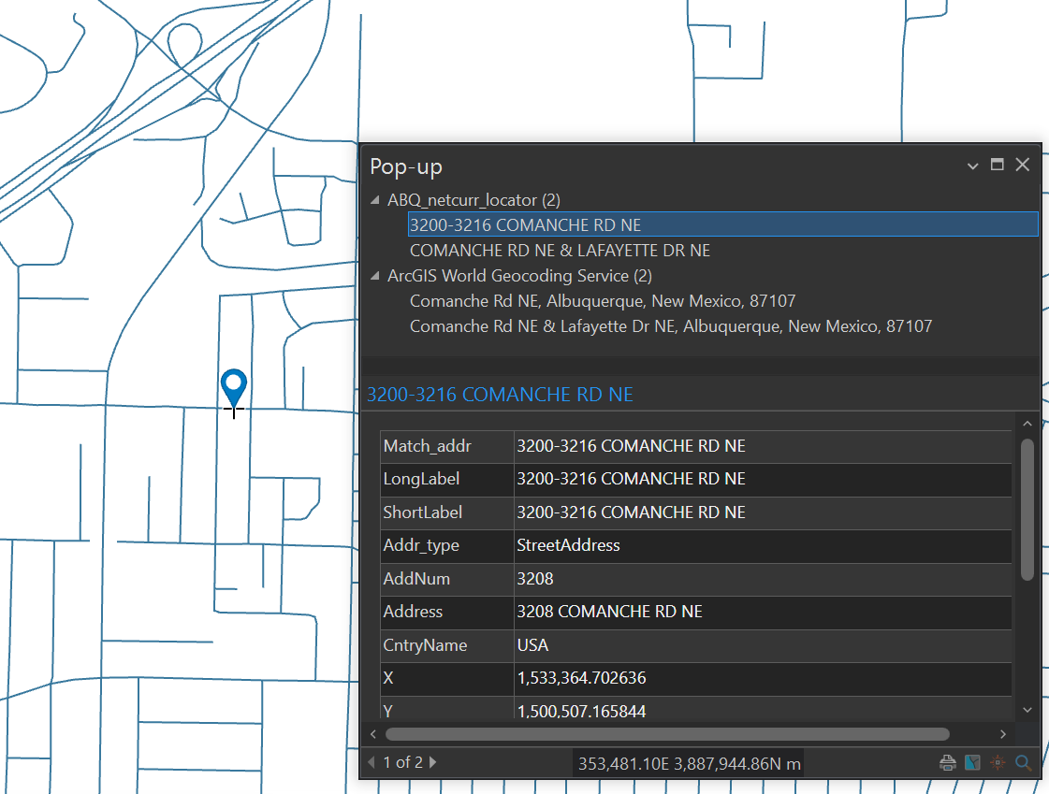
REVERSE GEOCODING

Slide 32
GEOCODING PROBLEMS
Address-matching is rarely a fully automated process.
An address may not address-match because of inaccuracies or inconsistencies in the digital street map or in the file of addresses to be matched.
Address-matching rates (the proportion of addresses that are correctly matched) will increase if efforts are made to increase the quality of the digital street map, the address file, or both.

Slide 33
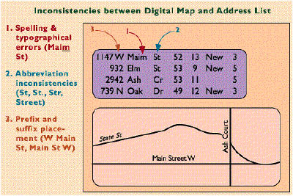
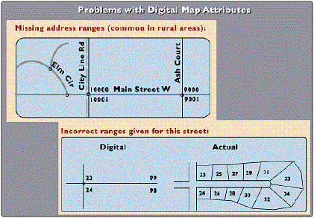
Problems – Continued

Slide 34
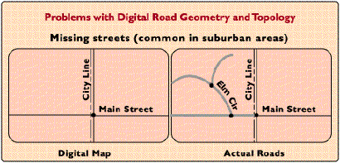
Problems – Continued

Slide 35
Practice
Geocode a table of addresses
  https://pro.arcgis.com/en/pro-app/latest/help/data/geocoding/tutorial-geocode-a-table-of-addresses.htm
Rematch addresses from a geocoded feature class
  https://pro.arcgis.com/en/pro-app/latest/help/data/geocoding/tutorial-rematch-addresses-from-a-geocoded-feature-class.htm
Create a Locator
  https://pro.arcgis.com/en/pro-app/latest/help/data/geocoding/tutorial-create-a-locator.htm

