Slide 1
New Mexico 911 Program
Resolving NM911 Errors
New Mexico APCO Conference
Farmington, May 2025

Slide 2
What is EDAC’s Role?
Monthly Tasks
GIS Data assessment and reporting
Technical support to Data Providers and PSAPs
Aggregate statewide NM911 Master Database
Assisting data providers with corrections
Quarterly Tasks
MSAG-ALI-GIS data comparison, and reporting
Assisting data providers/PSAPs with corrections

Slide 3
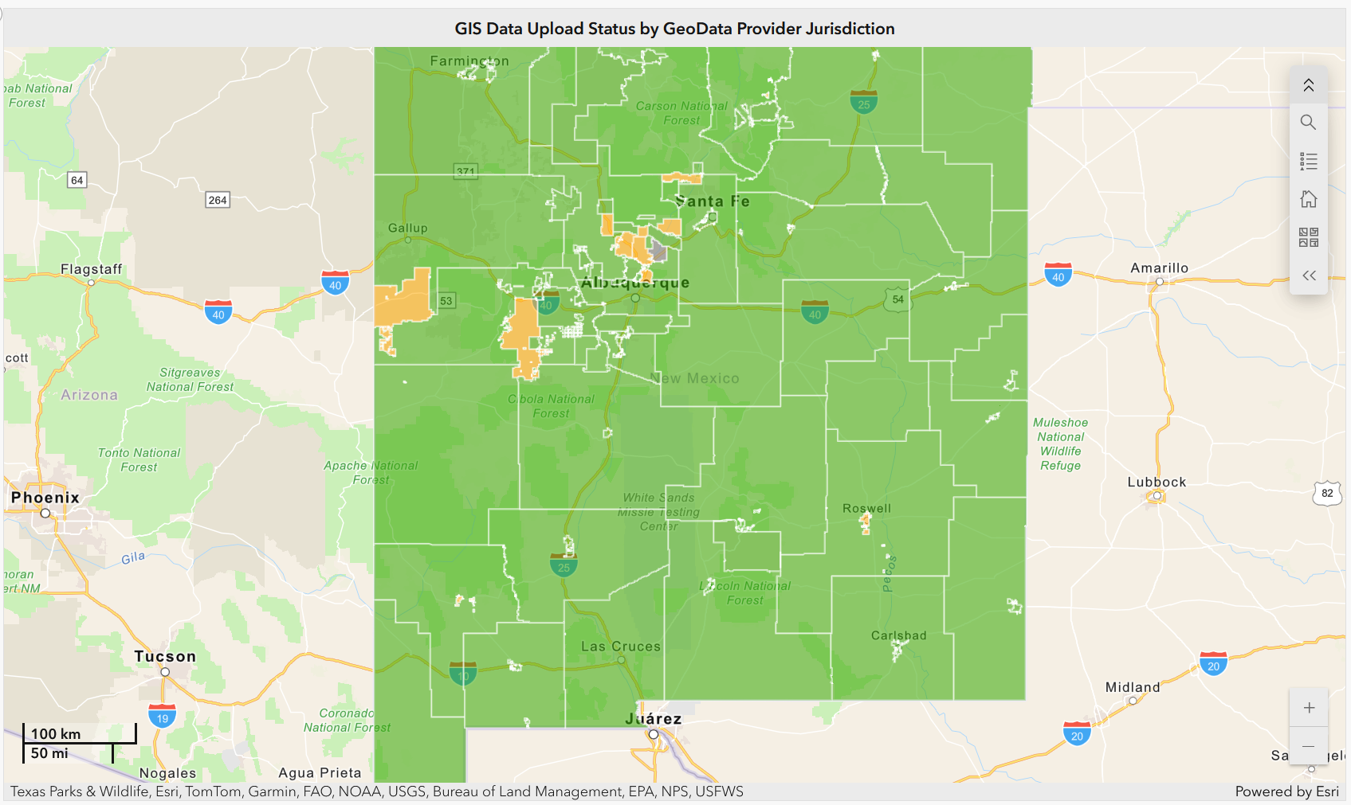
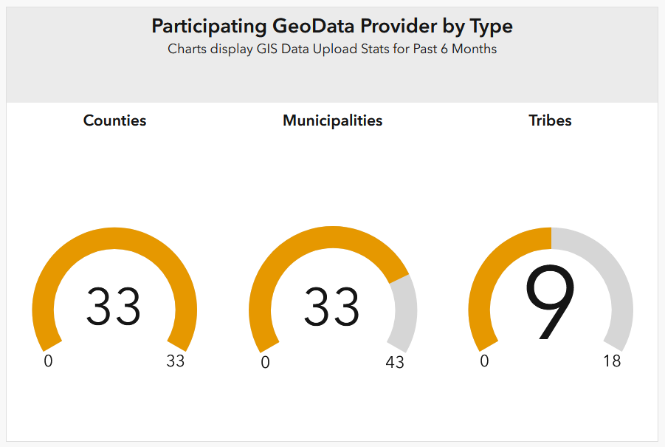
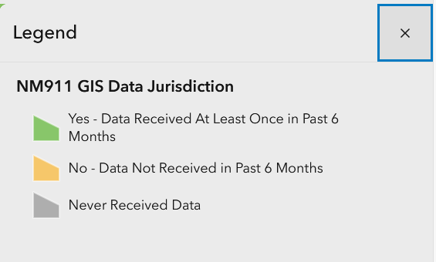
GIS Data Upload Status as of April 2025
NM911 GIS Data Status Dashboard https://nm911-hub.maps.arcgis.com
Notes:
https://nmdfa911.maps.arcgis.com/apps/dashboards/17138aaca5e540ada8411bc4c6fc42f9

Slide 4
GIS Data Model (Current/Legacy)
Required Layers
Address Points
Road Centerlines
Addressing/Administrative Boundary – Provisioning Boundary*
Emergency Service Zone (ESZ) Boundary**
Public Safety Answering Point (PSAP) Boundary
Optional Layers
Public Facilities, Community Boundary, Hydrology, Railroads, Mile Markers, Bridges
* Provisioning boundary will be used if available. Required for Next Gen 9-1-1
** Not all data providers maintain or utilize ESZs

Slide 5
NM911 GIS Data Assessment Workflow
Collection
Conversion
Processing/ Assessment
Reporting
Aggregating & Delivery

Slide 6
New Mexico 911 (NM911) Program GIS Data Assessment Workflow
Monthly GIS Data Validation Workflow
Quarterly GIS-MSAG-ALI Comparison Workflow
Collection
Conversion
Processing/ Assessment
Reporting
Aggregating & Publishing
Data Upload to the NM911 Data Portal
Check data formats
Email notification to GIS POCs
If invalid
MSAG data download from Intrado (quarterly)
ALI data download from Intrado (once a year)
Check for valid data attributes
If invalid
Notify GIS POCs & Receive Feedback
Parse data to GIS tables
Crosswalk data to NM911 GIS Data Model
Create a version of NM911 geodatabase for each GIS data provider
Extract and aggregate recent address and road data for all local jurisdictions within each PSAP boundary area
Extract data per each PSAP boundary area
Spatial and Tabular checks
Topology Checks
Data Reviewer Checks
Create Fishbone lines
MSAG to GIS Data Comparison
ALI to GIS Data Comparison
Update monthly error statistics for each data provider on the NM911 GIS Dashboard
Generate Monthly Data Assessment Reports, Quarterly MSAG/ALI/GIS Comparison Reports and corresponding error geodatabases
Upload reports and error geodatabases to the NM911 Data Portal
Technical Assistance with Data upload, Understanding reports and error data & Data Correction
Deliver to NM DFA for PSAP updates & publish to RGIS data clearinghouse for public access
Aggregate address and road data to create a statewide master datasets

Slide 7
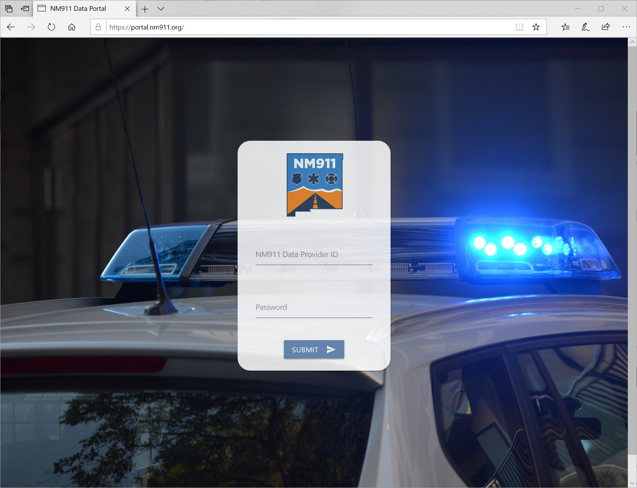
Data Collection
Data Providers were notified via e-mail each month
How: NM911 Data Portal https://portal.nm911.org/
When: 1st – 15th of each month
What: Address points, Road centerlines, and Boundaries
Accepted data formats: Shapefiles (zipped or unzipped), File geodatabases (zipped)
Notes:
If multiple uploads, duplicate data are resolved before data conversion process. Latest data are processed and all other previous uploads will be rejected.

Slide 8
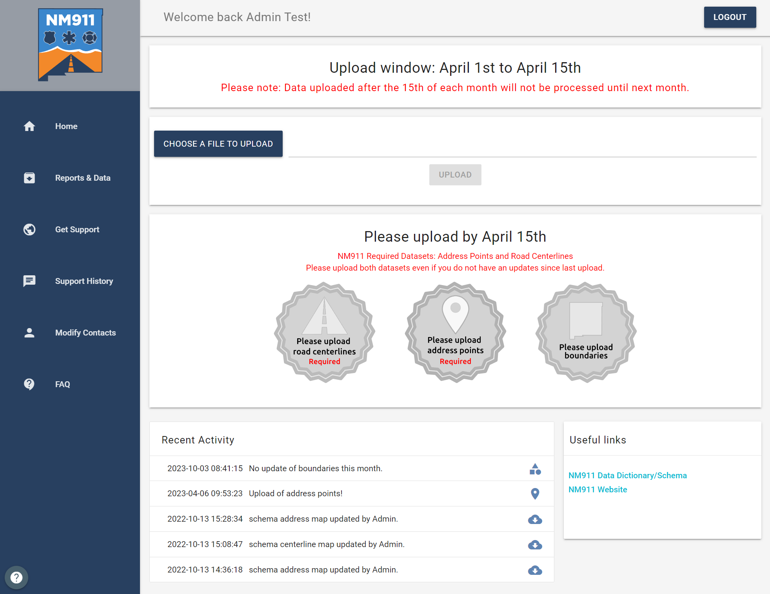
NM911 Data Portal
Acknowledgement if upload is a Success! No email – We try not to SPAM your inbox!!
As seen in the second half of each month.

Slide 9
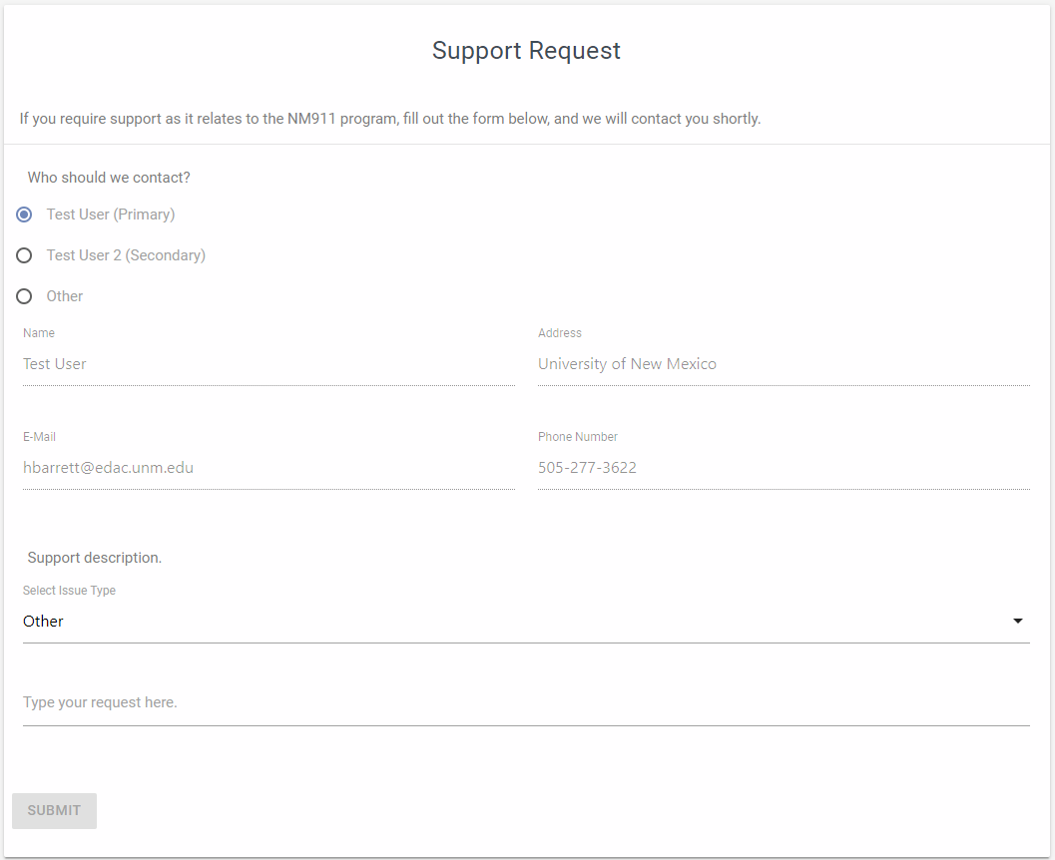
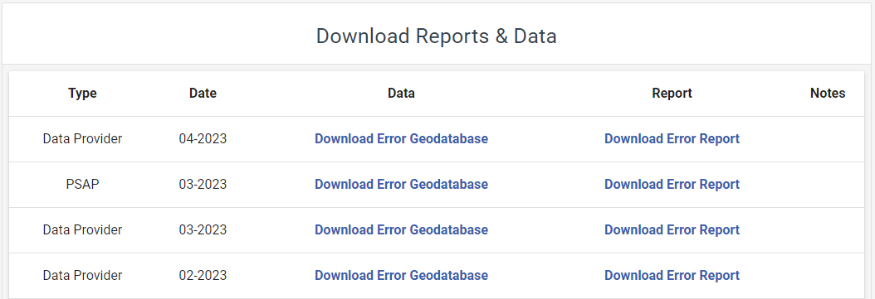
NM911 Data Portal

Slide 10
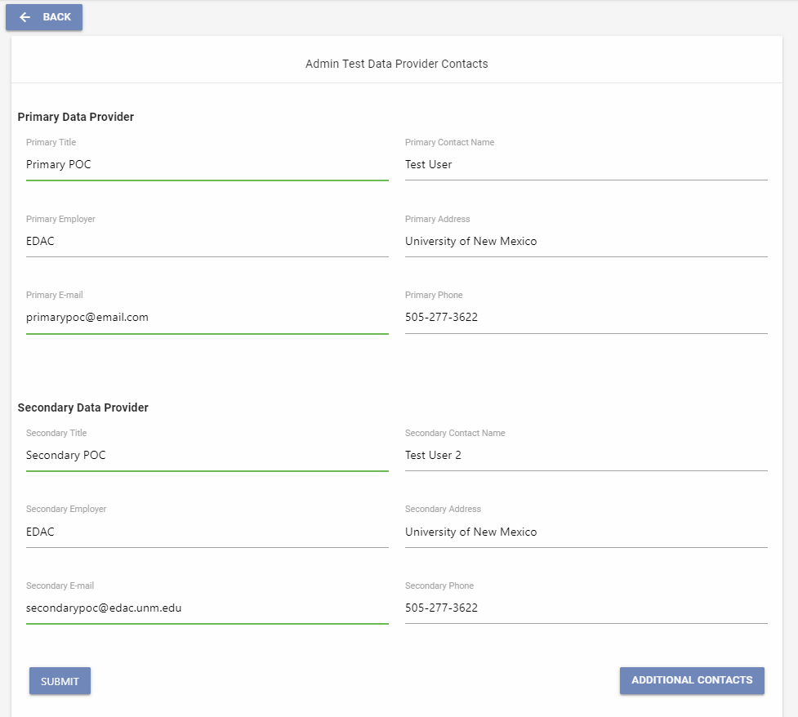
NM911 Data Portal

Slide 11
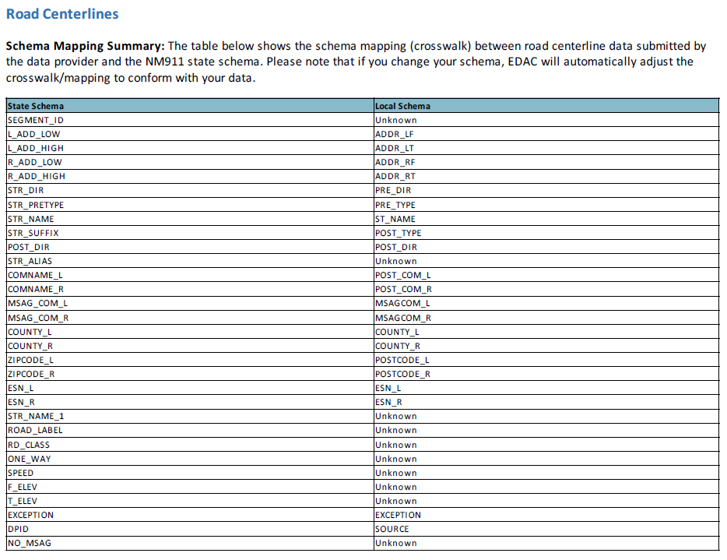
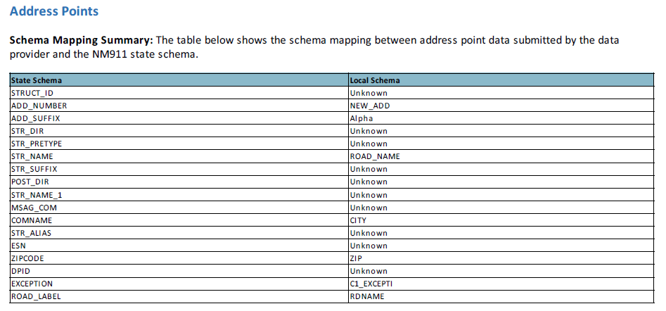
Data Translation & Conversion
Field Mapping/Crosswalk between local schema to state schema

Slide 12
Data Translation & Conversion
Data imported to State Schema
Records that doesn’t match the state schema will be exported as import errors feature class and are not included in the state database.

Slide 13
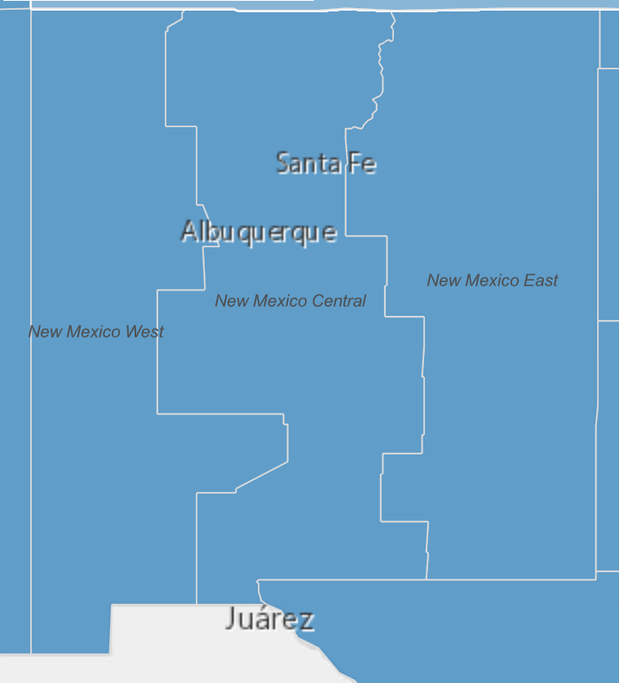
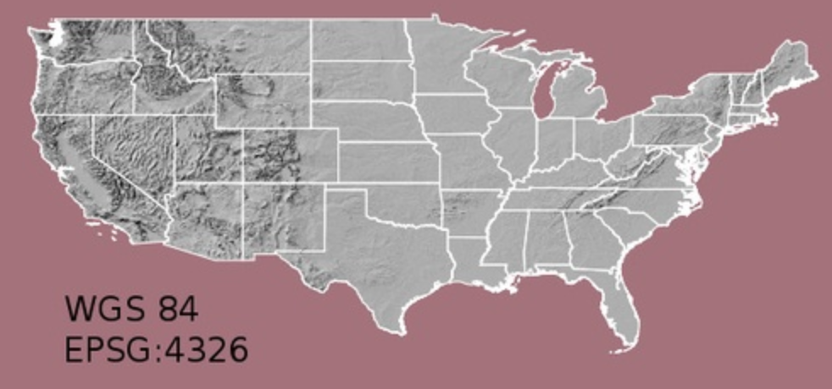
Coordinate Systems
Local Govt. GIS:
State Plane Coordinate System (SPCS)
State or Regional maps:
UTM Coordinate System
NG911 System uses World Geodetic System (WGS) 1984

Slide 14
Data Assessment
QA/QC to ensure data integrity
Spatial & Tabular Accuracy Checks
Topology Checks
Data Reviewer Checks & Attribute Rules
Datasets: Road Centerlines, Address Points, Administrative/Addressing Boundary
Fishbone Lines

Slide 15
Data Assessment
 |  | DATA REVIEWER CHECKS
1 |  | Address Point Address Number Cannot Be 0, Negative, NULL Or Blank
2 |  | Address Point Address Number Should Be Within Road Centerline Address Range
3 |  | Address Point Full Road Name Must Match Road Centerline Full Road Name
4 |  | Address Point Has Invalid Geometry
5 |  | Address Point Must Not Have Duplicate Geometry
6 |  | Address Point Street Name Cannot Be Blank Or NULL
7 |  | NM911 Topology Checks
8 |  | Road Centerline Has Invalid Geometry
9 |  | Road Centerline Left High Address Must Be Odd
10 |  | Road Centerline Left Low Address Is Greater Than Left High Address
11 |  | Road Centerline Left Low Address Must Be Odd
12 |  | Road Centerline Length Must Not Be Less than 15 ft.
13 |  | Road Centerline Must Be Broken And Snapped At Road Intersections
14 |  | Road Centerline Must Not Have Dangles
15 |  | Road Centerline Must Not Have Duplicate Geometry
16 |  | Road Centerline Must Not Have Left Side Overlapping Address Range
17 |  | Road Centerline Must Not Have Right Side Overlapping Address Range
18 |  | Road Centerline Right High Address Must Be Even
19 |  | Road Centerline Right Low Address Is Greater Than Right High Address
20 |  | Road Centerline Right Low Address Must Be Even
21 |  | Road Centerline Should Not Be Multipart

Slide 16
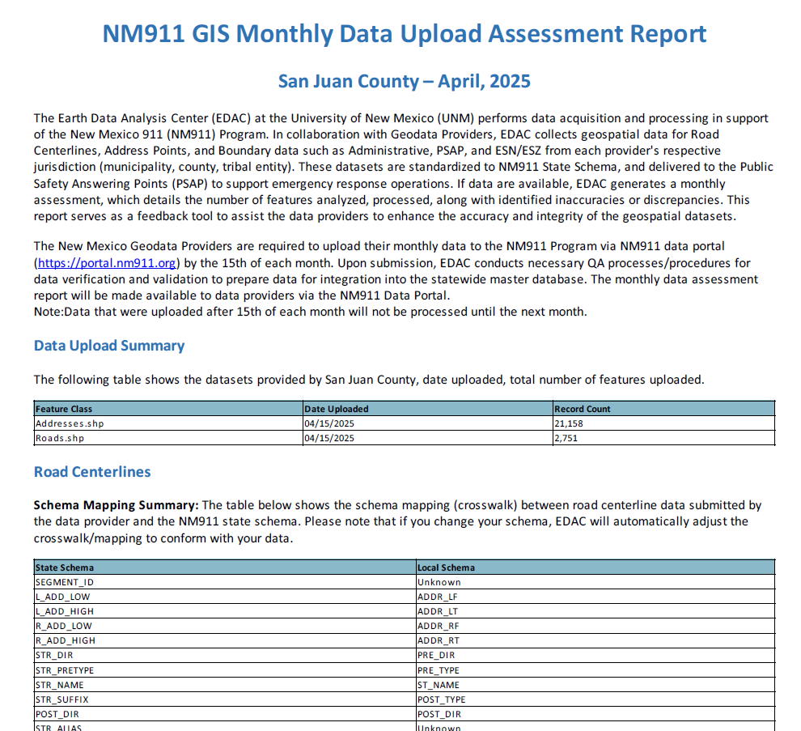
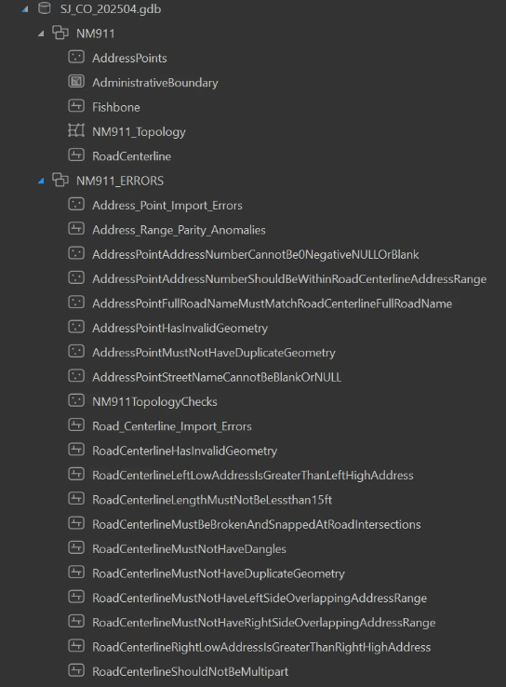
Data Reporting

Slide 17
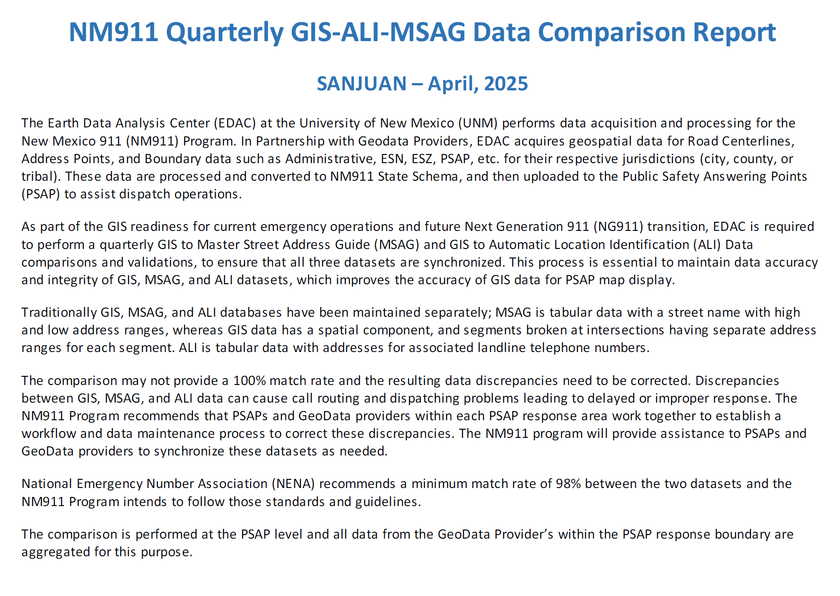
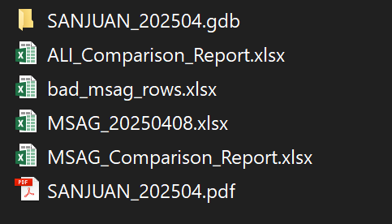
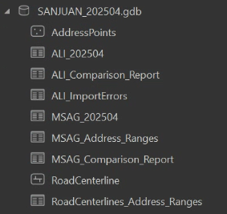
Data Reporting

Slide 18
Data Correction – Exceptions
What are acceptable exceptions?
Road Centerline Left Low & High Address Must Be Odd
Road Centerline Right Low & High Address Must Be Even
Road Centerline Left Low Address is Greater than Left High Address
Road Centerline Right Low Address is Greater than Right High Address
Can be marked as Exceptions based on ground conditions
Exception data column. Mark “Y” or “1” (based on the field data type: TEXT, INTEGER) if there is an exception and leave the column blank if no exception

Slide 19
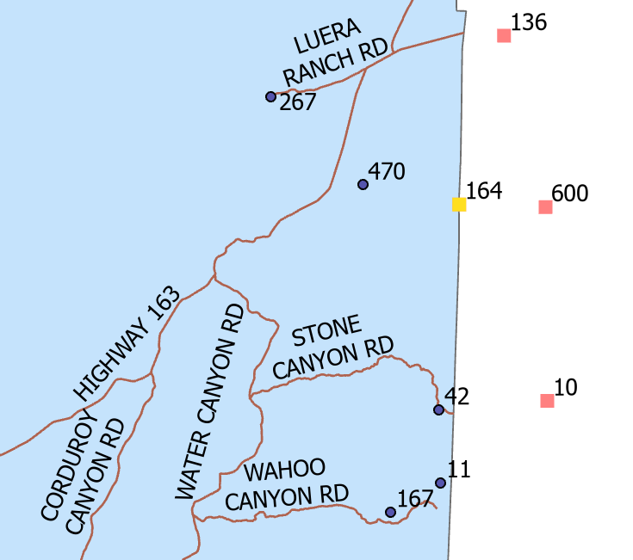
Data Correction – Topology
Address Point Must Be Properly Inside the Administrative Boundary
Administrative Boundary can be replaced with Provisioning/ Addressing Boundary, if available.

Slide 20
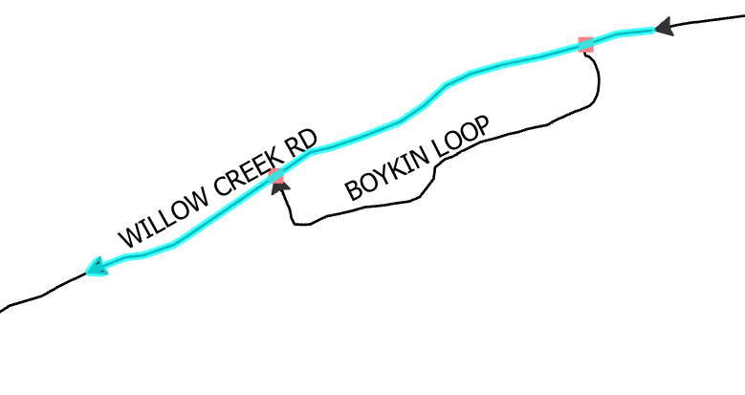
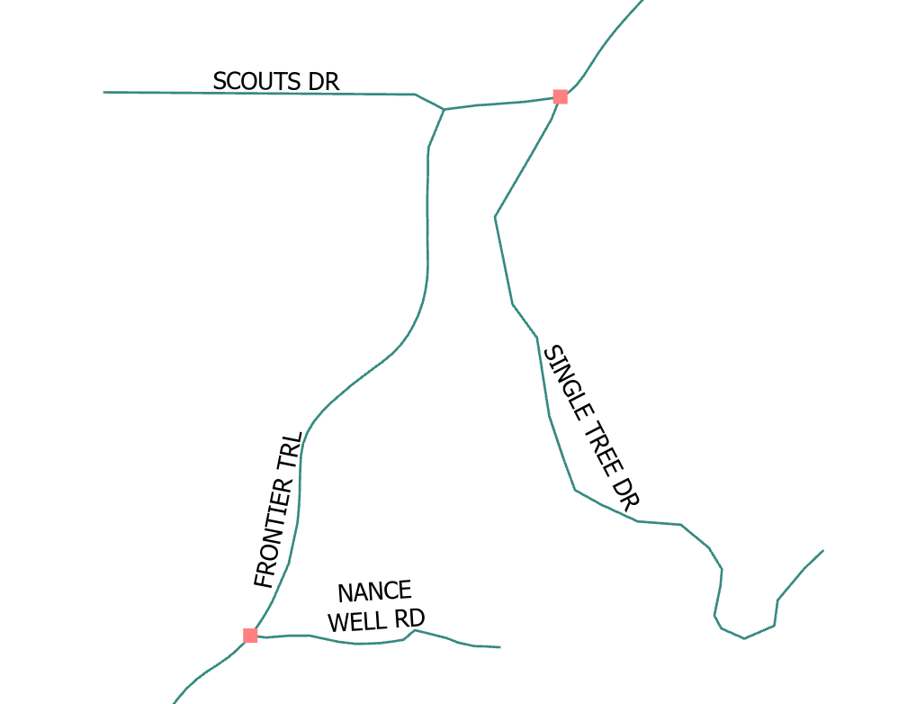
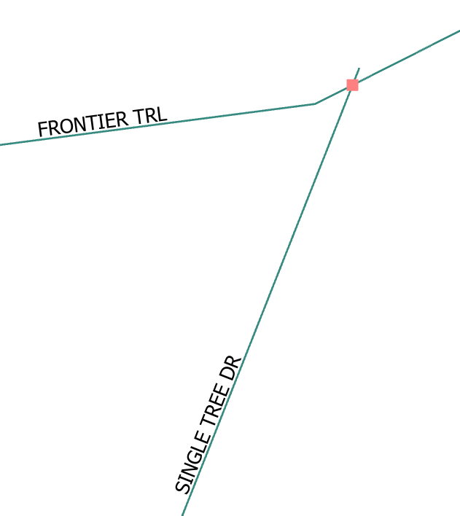
Data Correction - Topology
Roads must be broken and snapped at intersections

Slide 21
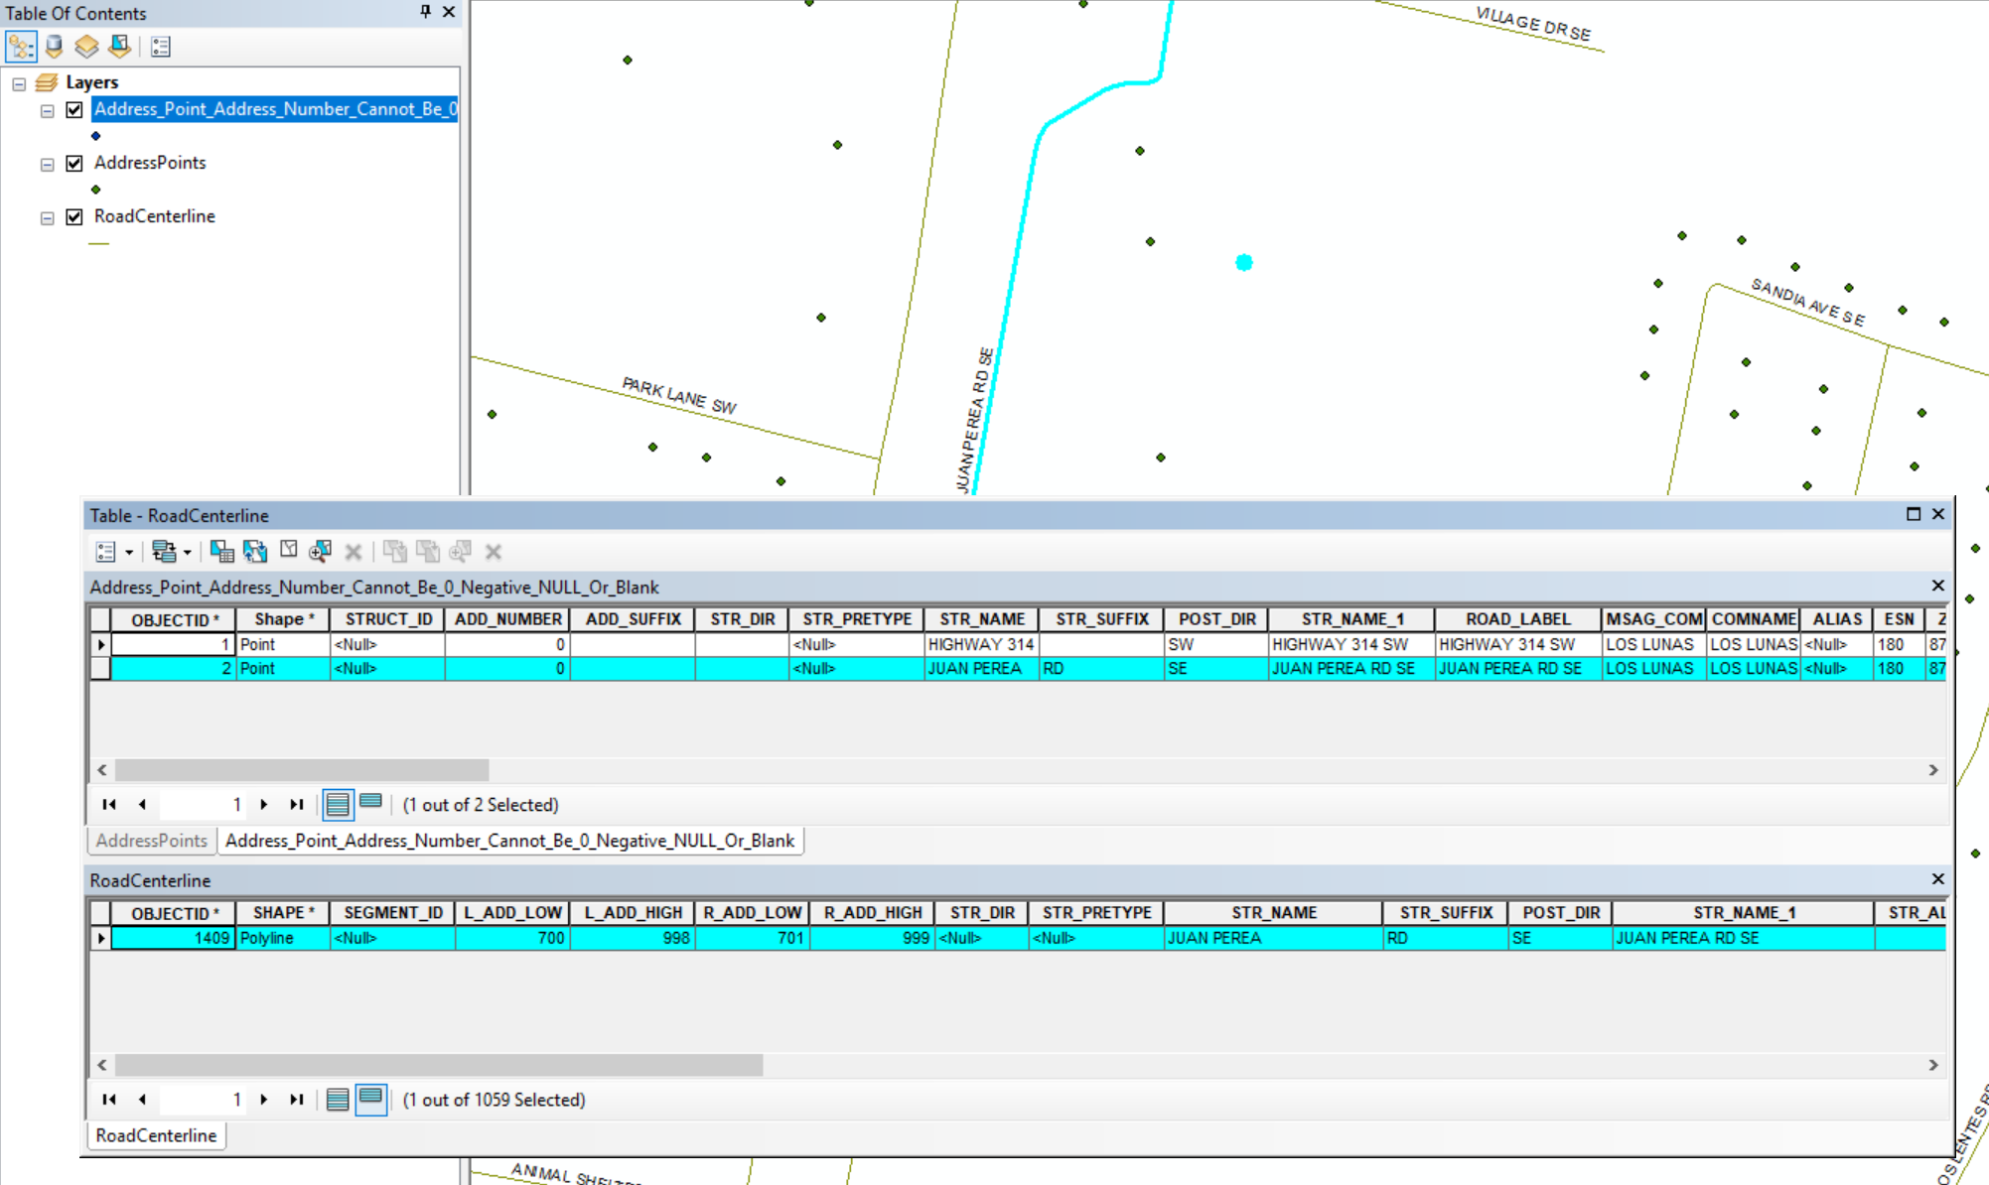
Data Correction – Address Points Examples
Address Point Address Number Cannot Be 0, Negative, Null or Blank
Ex: 0 JUAN PEREA RD SE

Slide 22
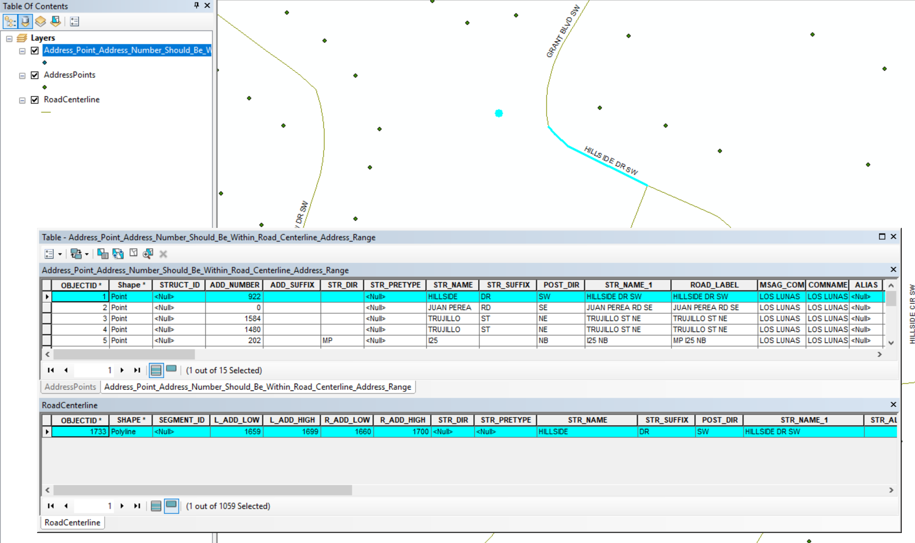
Data Correction – Address Points Examples
Address Point Address Number Should Be Within Road Centerline Address Range
Ex: 922 HILLSIDE DR SW

Slide 23
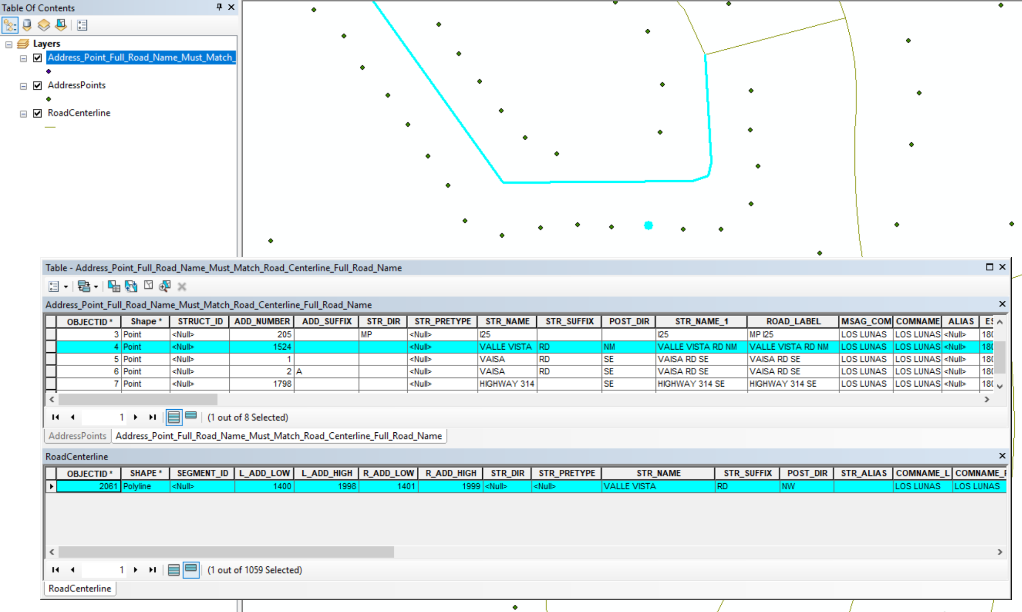
Data Correction – Road Centerline Examples
Address Point Full Road Name Must Match Road Centerline Full Road Name
Ex: VALLE VISTA RD NW

Slide 24
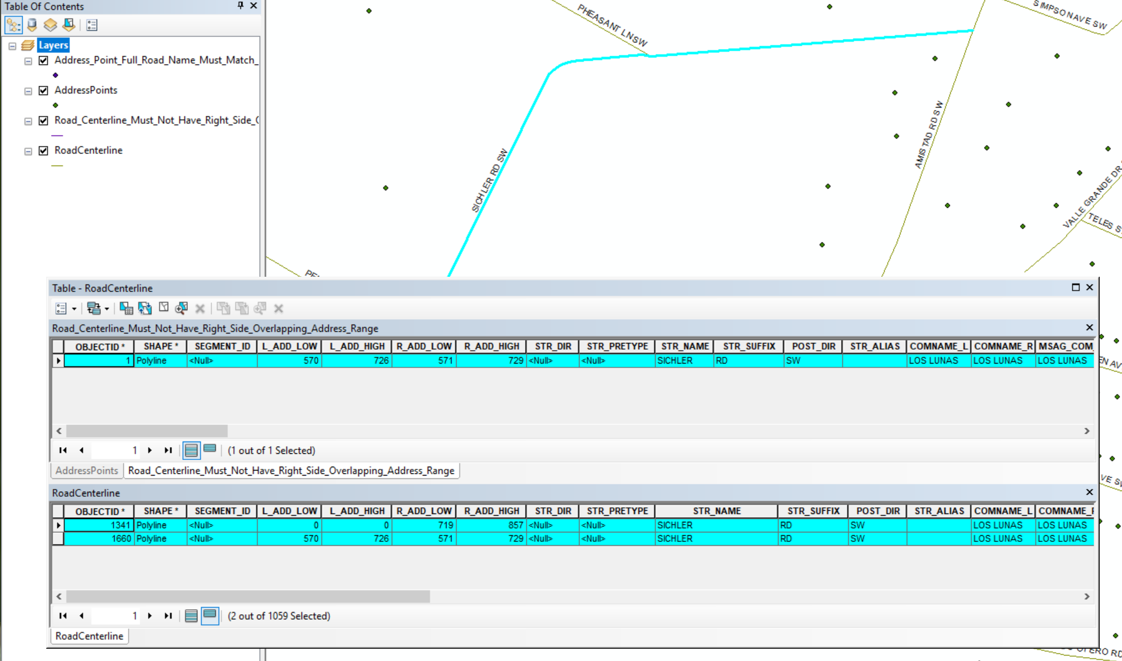
Data Correction – Road Centerline Examples
Road Centerline Must Not Have Right Side Overlapping Address Range
Ex: SICHLER RD SW

Slide 25
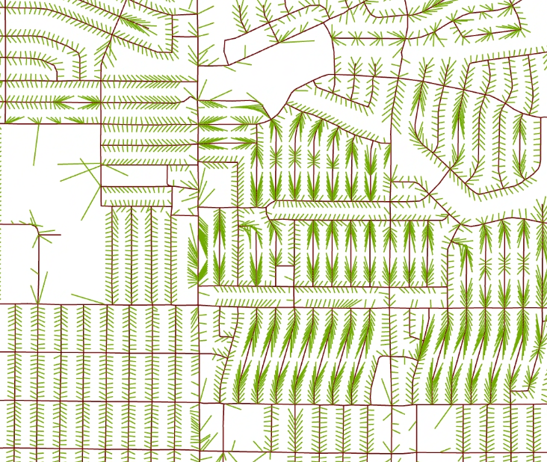
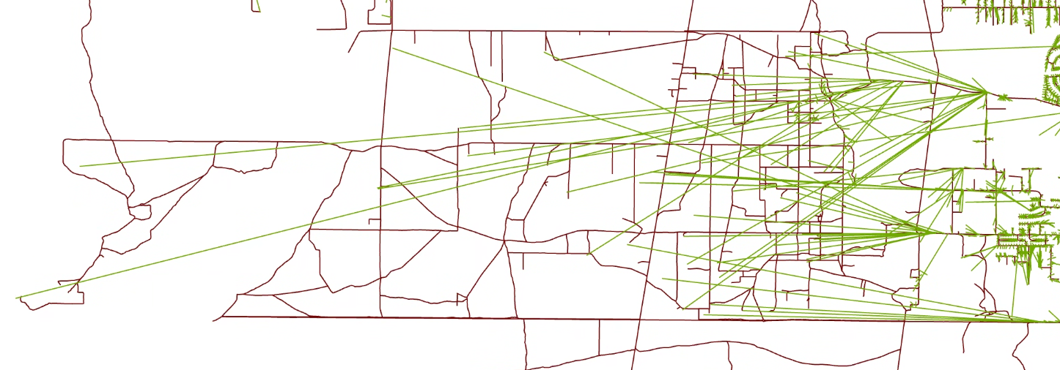
Fishbone Lines
Visually Compare road centerlines to address points
Out of numerical order
On the wrong side of the street
On the wrong block
On the wrong side of the city

Slide 26
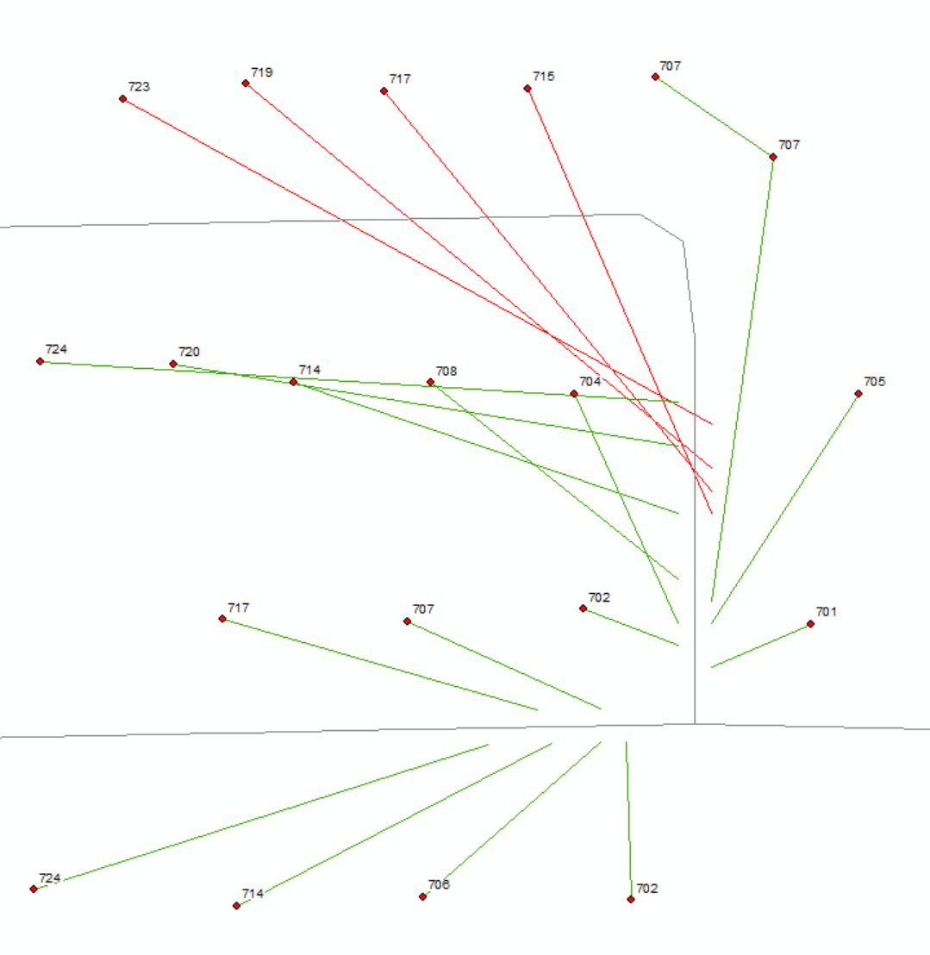
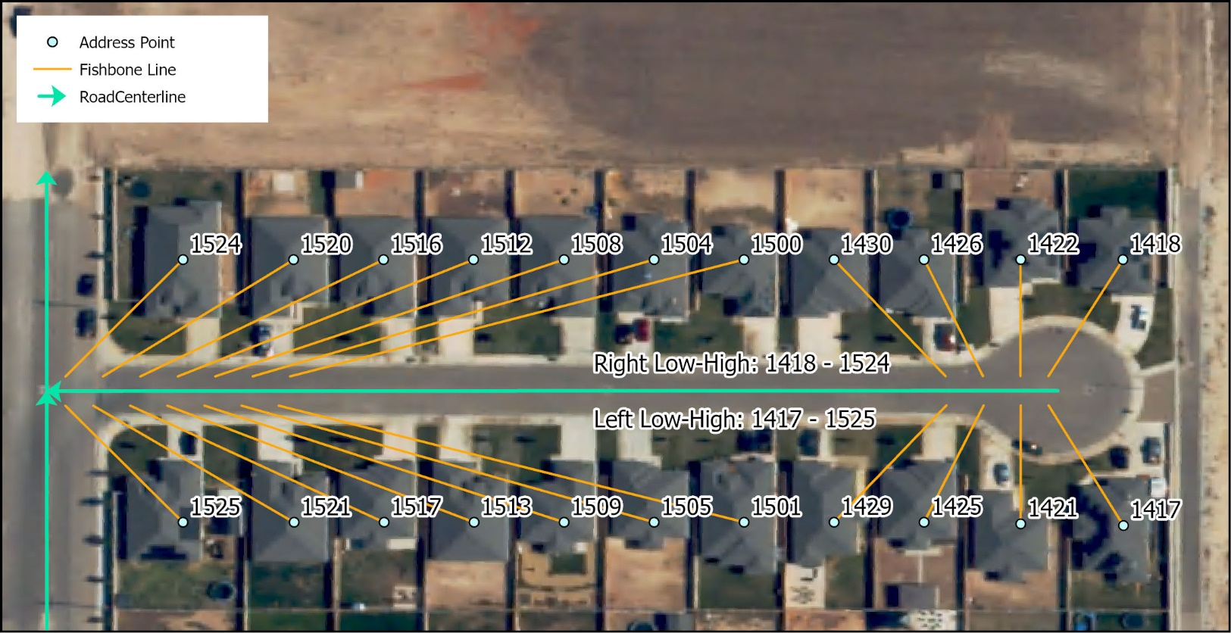
Fishbone Analysis
GOOD

Slide 27
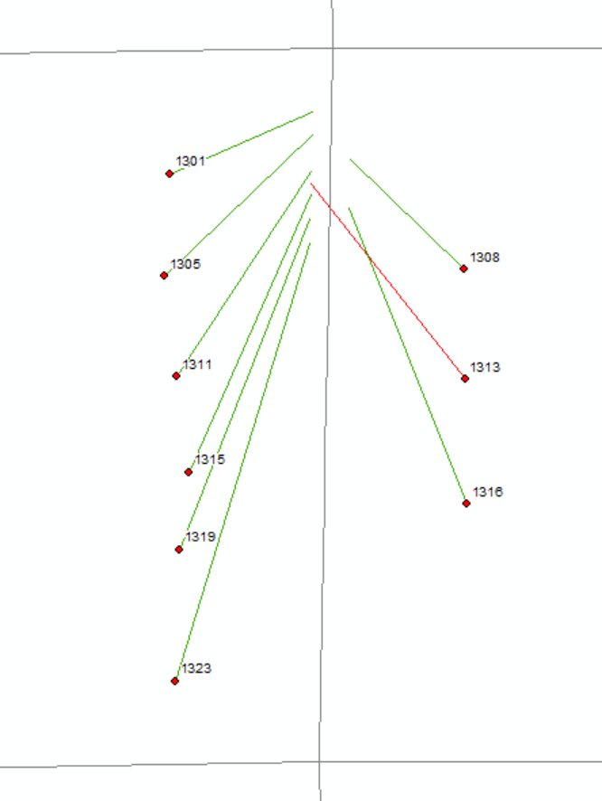
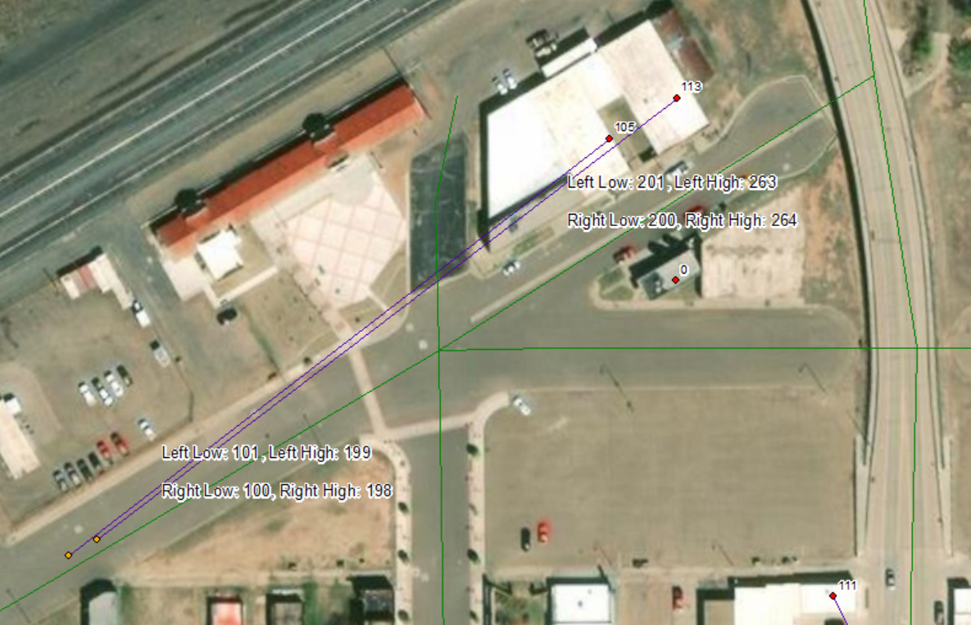
Fishbone Analysis
BAD
Notes:
Query data to identify data inaccuracies
Ex: Wrong side of the street or Block: show every fishbone that intersects a street centerline

Slide 28
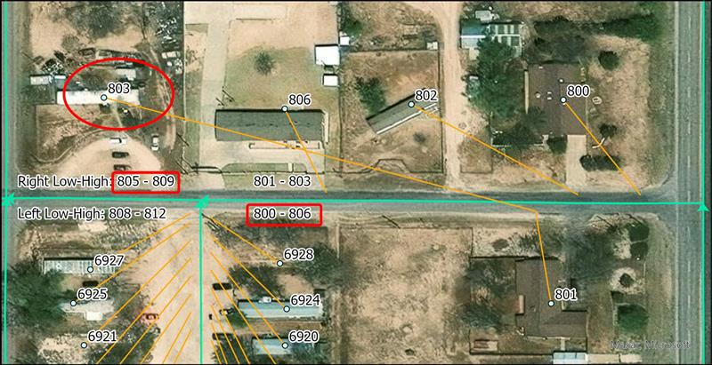
Fishbone Analysis
Multiple issues –
Incorrect addressing/ placement
Overlapping address ranges

Slide 29
Fishbone Analysis – Good or Bad?
Catron County, NM
Notes:
Driveways do not intersect. Points are placed on the structure instead of the access point.

Slide 30
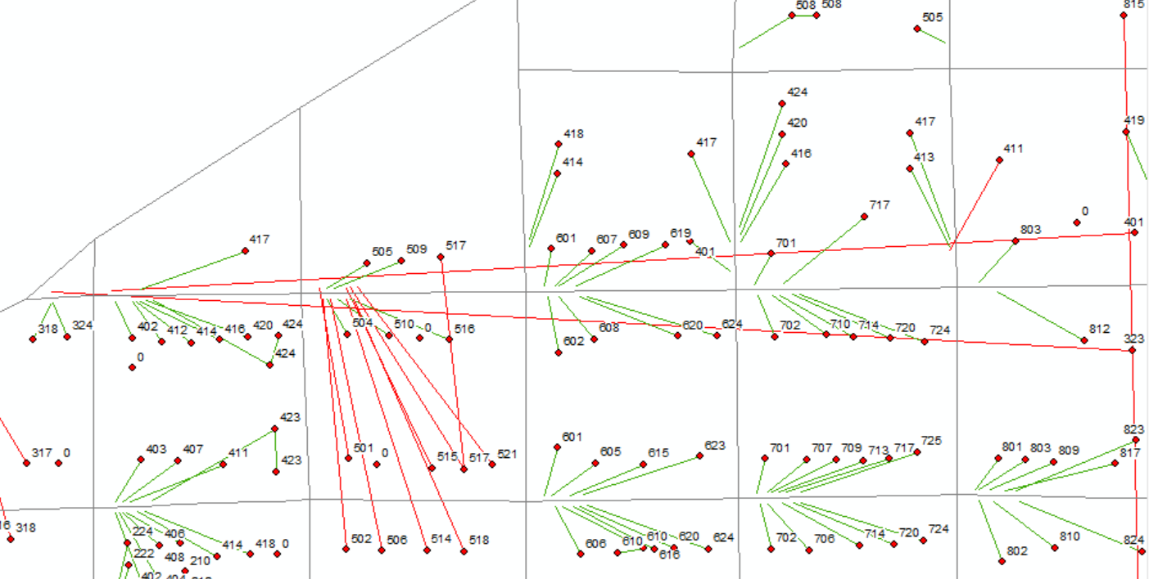
Fishbone Analysis
Notes:
Red: Incorrect data. Longer lines indicate more serious error. i.e. valid address points are miles from where they should be

Slide 31
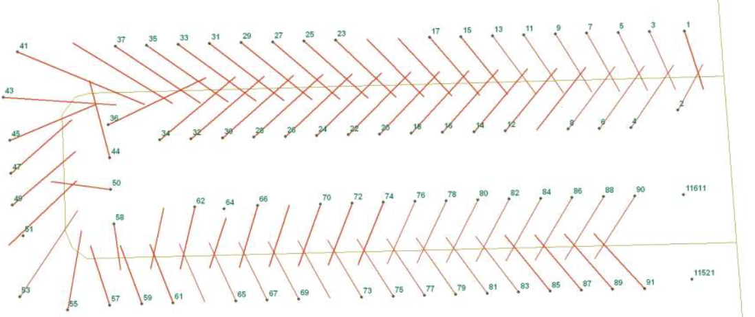
Fishbone Analysis
Fix: Address range of the road centerline needs to be flipped odd/even

Slide 32
Address Parity Anomalies

Slide 33
GIS-MSAG-ALI Comparison
Quarterly Assessments
Essential for Next Generation 911 (NG 9-1-1) data transition
NENA recommends a 98% match rate between the datasets
Data Providers and PSAPs must prioritize to improve data accuracy
Data for Comparison
GIS – monthly data uploads from GIS Data Providers
MSAG – quarterly data downloads from Intrado
ALI – yearly data extract from Lumen (formerly CenturyLink)

Slide 34
The 9-1-1 Database(s)
MSAG – Master Street Address Guide – Influence and control E9-1-1
ALI – Automated Location Information – Each landline telephone number in a PSAP’s response area is loaded from each serving phone company, scrubbed against the MSAG to obtain ESN and Community information, and loaded into the ALI database. When a 9-1-1 landline call is initiated, the ten digit phone number dips into this database to obtain the location info sent to the PSAP with the voice call
ELT – English Language Translation – a table which translates each ESN to the names of the public safety providers
GIS Data – Geospatial data used to be an “add-on” and is now considered critical to control all or most of the above
GIS Data is CRITICAL for NG911

Slide 35
MSAG Vs GIS Data
A snapshot of MSAG database, Guadalupe County, NM
A snapshot of Road Centerline attribute table, Guadalupe County, NM

Slide 36
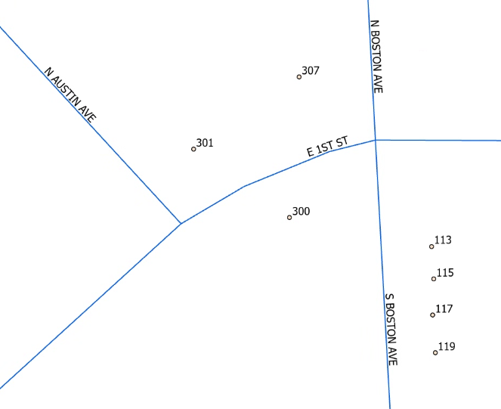
ALI Vs GIS Data
A snapshot of ALI database for Portales, NM
A snapshot of Address points, Portales, NM

Slide 37
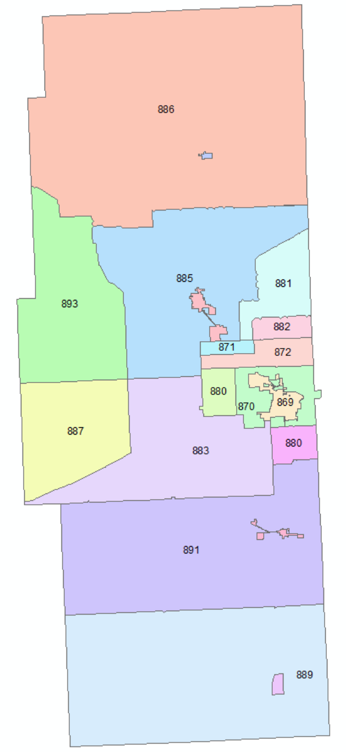
The 9-1-1 Database(s) - ESN
ESN | POLICE | FIRE | AMBULANCE
869 | HOBBS PD | HOBBS FD | HOBBS EMS
870 | LEA COUNTY SHERIFF | HOBBS FD | HOBBS EMS
870 | LEA COUNTY SHERIFF | HOBBS FD | HOBBS EMS
870 | LEA COUNTY SHERIFF | HOBBS FD | HOBBS EMS
870 | LEA COUNTY SHERIFF | HOBBS FD | HOBBS EMS
871 | LEA COUNTY SHERIFF | KNOWLES FD | LOVINGTON EMS
872 | LEA COUNTY SHERIFF | KNOWLES FD | HOBBS EMS
880 | LEA COUNTY SHERIFF | HOBBS FD | HOBBS EMS
880 | LEA COUNTY SHERIFF | HOBBS FD | HOBBS EMS
881 | LEA COUNTY SHERIFF | KNOWLES FD | LOVINGTON EMS
882 | LEA COUNTY SHERIFF | KNOWLES FD | HOBBS EMS
883 | LEA COUNTY SHERIFF | MONUMENT FD | HOBBS EMS
884 | LOVINGTON PD | LOVINGTON FD | LOVINGTON EMS
885 | LEA COUNTY SHERIFF | LOVINGTON FD | LOVINGTON EMS
886 | LEA COUNTY SHERIFF | TATUM FD | TATUM EMS
887 | LEA COUNTY SHERIFF | MALJAMAR FD | HOBBS EMS
888 | JAL PD | JAL FD | JAL EMS
889 | LEA COUNTY SHERIFF | JAL FD | JAL EMS
890 | EUNICE PD | EUNICE FD | EUNICE EMS
891 | LEA COUNTY SHERIFF | EUNICE FD | EUNICE EMS
892 | TATUM PD | TATUM FD | TATUM EMS
893 | LEA COUNTY SHERIFF | MALJAMAR FD | LOVINGTON EMS
ESNs for Lea County, NM
When a resident calls 9-1-1, the emergency providers dispatched are the same in a given ESN.
In 869, a resident is served by Hobbs Police Dept., Hobbs Fire Dept., and Hobbs EMS
A snapshot of ESNs for Lea County, NM (legacy)

Slide 38
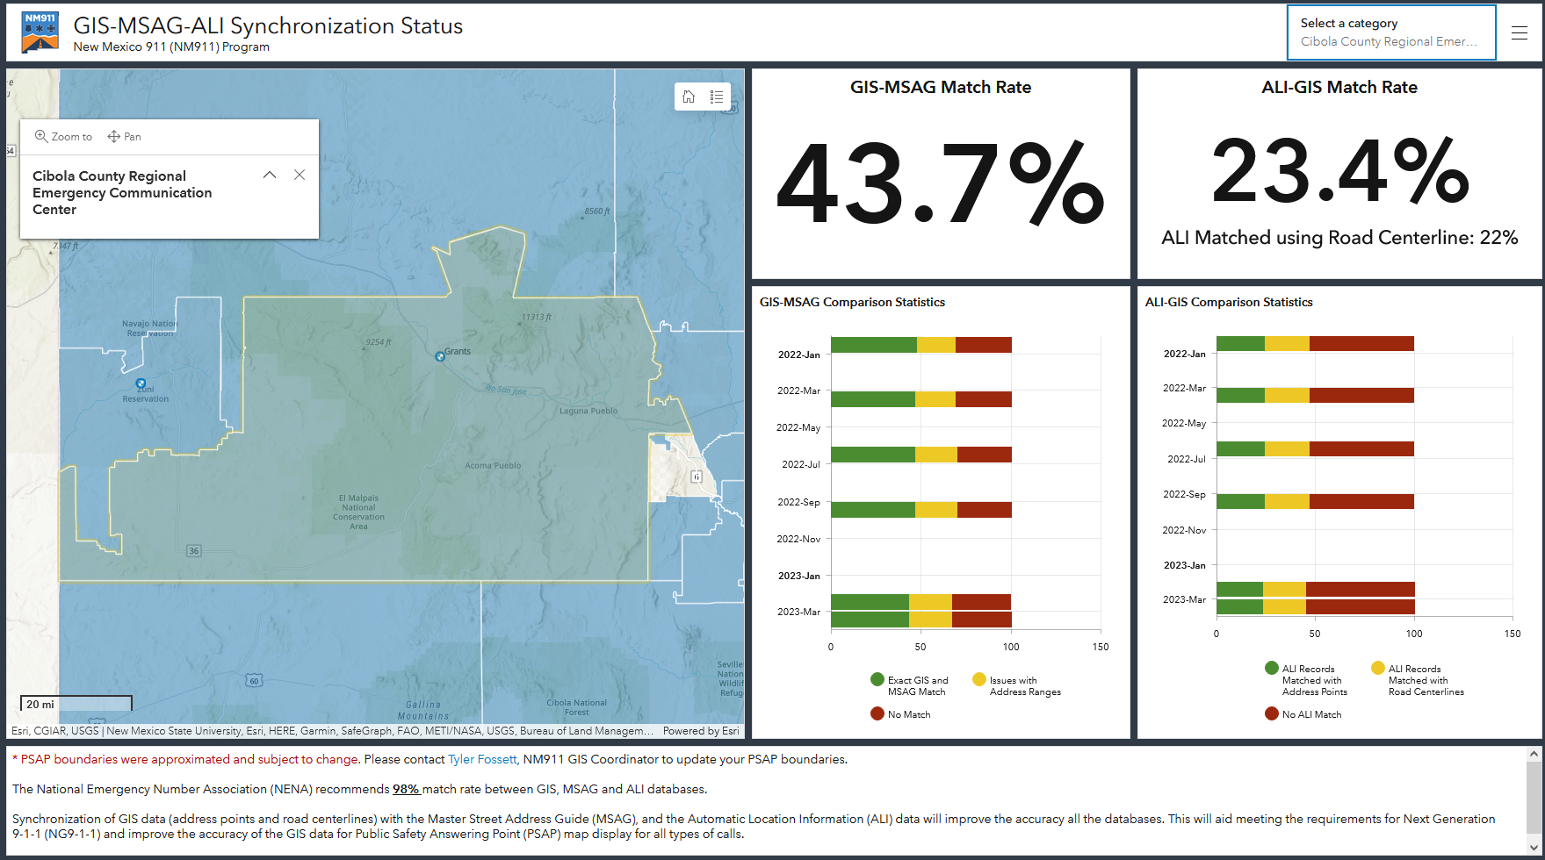
GIS-MSAG-ALI Comparison
NM911 GIS-MSAG-ALI Synchronization Status Dashboard https://nm911-hub.maps.arcgis.com

Slide 39
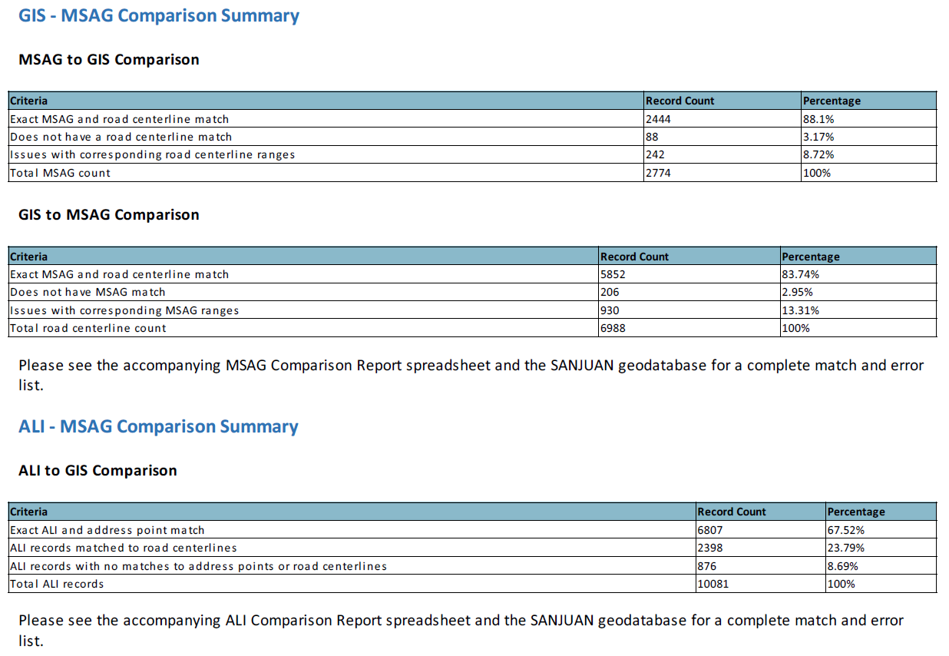
GIS-MSAG-ALI Comparison
MSAG and GIS Datasets used for Comparison
Snapshot of Quarterly GIS-MSAG-ALI Comparison Stats, San Juan County – March 2025
Notes:
MSAG Record count – Source Data: 509 and GIS: 506 – eliminated Wireless or VOIP calls rows

Slide 40
GIS-MSAG Comparison
Road Centerline data compared with MSAG records
Address columns, Community name, and ESN (Concatenated for left and right side of each segment to create unique identifier)
Results are generated in geodatabase and spreadsheet formats
Notes:
Address range comparisons were performed on entire road segments and are reported as such. For example, consider a road segment CENTRALAVE|ALBUQUERQUE|00111. In the MSAG, this segment has a low of 100 and a high of 249. In the road centerline file, there are two segments, one with a low of 100 and a high of 149, and another with a low of 200 and a high of 299. In this case, the MSAG segment will report that it does not have the range 250-299. In the road centerline, both segments will report that they are missing the range 150-199.

Slide 41
GIS-MSAG Comparison – Interpreting Results
REPORT | COMPARISON
Exact MSAG match | 13THMILERD|FORTSUMNER|00940
Does not have an MSAG match | ANTELOPERD|ROSWELL|00940
Does not have a road centerline match | LYNXRD|FORTSUMNER|00940
Not in NM911 road- Rng: 3466-3968 | BILLYTHEKIDDR|FORTSUMNER|00942
Not in NM911 road- Val: 3097 | CLAYFLATRD|FORTSUMNER|00940
Not in MSAG- Rng: 800-1299, Val: 1499 | EDUNNHL|FORTSUMNER|00943
Not in MSAG- Val: 1300 | EFOLEYAVE|FORTSUMNER|00943

Slide 42
MSAG Comparison Report

Slide 43
GIS-MSAG Comparison – Interpreting Results
BILLYTHEKIDDR|FORTSUMNER|00942 – Not in NM911 road- Rng: 3466-3968
Derived from GIS data (road centerlines)
Derived from MSAG from 911NET
In GIS data, address range 3466-3968 is part of ESN 943.
In MSAG data, address range 3466 – 3969 is duplicated for ESN 942 & 943
Fix: Data Providers & PSAPs must coordinate to establish the authoritative dataset and update the non-authoritative dataset!

Slide 44
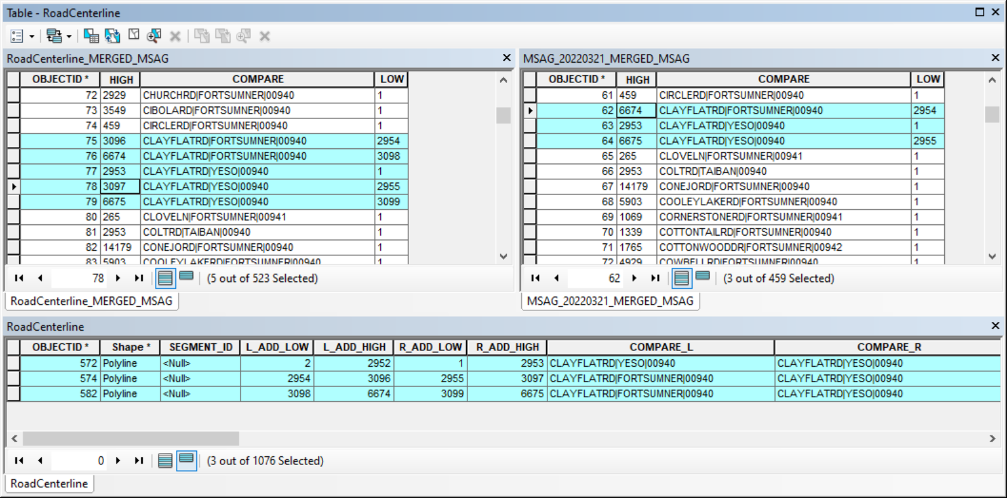
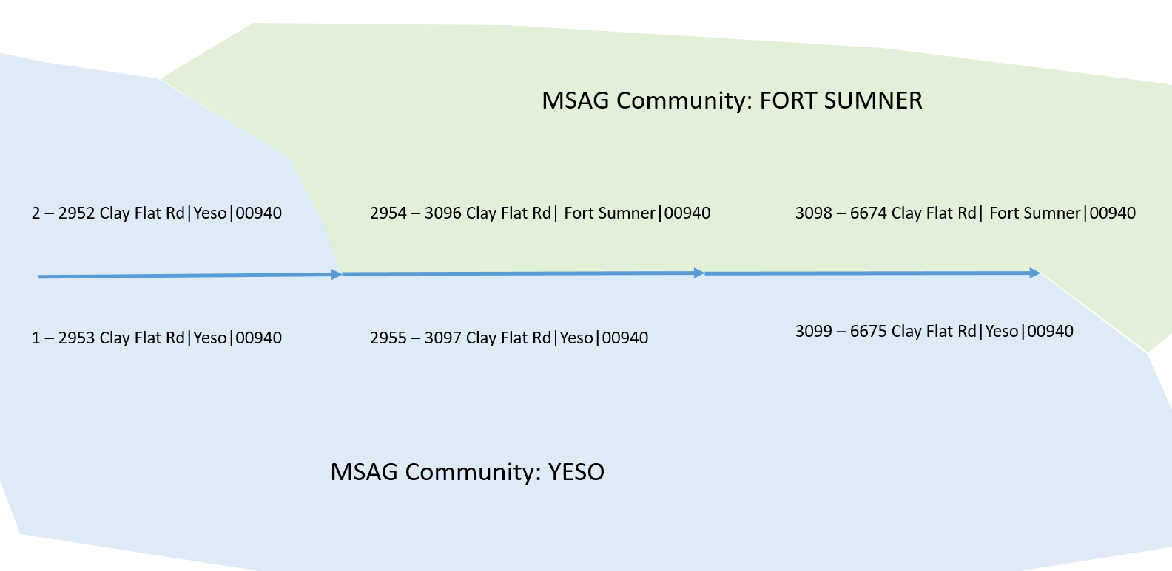
GIS-MSAG Comparison – Interpreting Results
CLAYFLATRD|FORTSUMNER|00940 – Not in NM911 road- Val: 3097
In GIS data, Value 3097 is part of YESO and not in FORT SUMNER. This is valid & No Correction Needed!

Slide 45
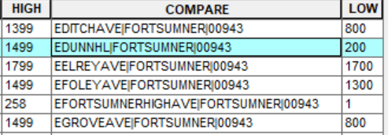
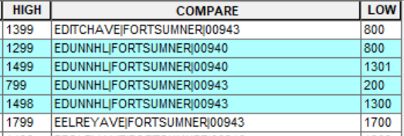
GIS-MSAG Comparison – Interpreting Results
EDUNNHL|FORTSUMNER|00943 – Not in MSAG- Rng: 800-1299, Val: 1499
EDUNNHL|FORTSUMNER|00940 – Does not have a road centerline match
Derived from GIS data (road centerlines)
Derived from MSAG from 911NET
Fix: Data Providers & PSAPs must coordinate to establish the authoritative dataset and update the non-authoritative dataset!

Slide 46
GIS-ALI Comparison
Tabular ALI data are compared with GIS address point data
If no exact matches found in the addresses then those records will be compared with Road Centerline data to see if the address fits within the address range of the corresponding segment
Address Number, Road Name columns (STR_DIR, STR_PRETYPE, STR_NAME, STR_SUFFIX, POST_DIR), MSAG Community, and ESN

Slide 47
ALI Comparison Report

Slide 48
GIS-ALI Comparison – Interpreting Results
Exact NM911 Address Point Match
Address Points Where Clause
ADD_NUMBER=1115 AND MSAG_COM='FORT SUMNER' AND (ADD_SUFFIX IS NULL or ADD_SUFFIX='') AND (STR_DIR IS NULL or STR_DIR='N') AND STR_NAME_1 = '10TH HL' and ( ESN = '943' OR ESN= '00943')
PHONE_NUMBER | ADD_NUMBER | ADD_SUFFIX | STR_DIR | STR_NAME_1 | COMMUNITY | ESN | DPID
5753552218 | 1115 |  | N | 10TH HL | FORT SUMNER | 00943 | DB_CO

Slide 49
GIS-ALI Comparison – Interpreting Results
No Match found in NM911 Address Points
Address Point Where Clause:
ADD_NUMBER=709 AND MSAG_COM='FORT SUMNER' AND (ADD_SUFFIX IS NULL or ADD_SUFFIX='') AND (STR_DIR IS NULL or STR_DIR='N') AND STR_NAME_1 = '2ND ST' and ( ESN = '943' OR ESN= '00943')
Road Centerline Where Clause:
COMPARE ='N2NDST|FORTSUMNER|00943' AND CAST(HIGH AS INTEGER) >= 709 AND CAST(LOW AS INTEGER) <=709
PHONE_NUMBER | ADD_NUMBER | ADD_SUFFIX | STR_DIR | STR_NAME_1 | COMMUNITY | ESN | DPID
5753557131 | 709 |  | N | 2ND ST | FORT SUMNER | 00943 | DB_CO

Slide 50
GIS-ALI Comparison – Interpreting Results
No Match found in NM911 Address Points or Road Centerlines
Address Point Where Clause:
ADD_NUMBER=339 AND MSAG_COM='FORT SUMNER' AND (ADD_SUFFIX IS NULL or ADD_SUFFIX='') AND (STR_DIR IS NULL or STR_DIR='S') AND STR_NAME_1 = '14TH ST' and ( ESN = '941' OR ESN= '00941')
Road Centerline Where Clause:
COMPARE ='S14THST|FORTSUMNER|00941' AND CAST(HIGH AS INTEGER) >= 339 AND CAST(LOW AS INTEGER) <=339
PRIORITY!!!
PHONE_NUMBER | ADD_NUMBER | ADD_SUFFIX | STR_DIR | STR_NAME_1 | COMMUNITY | ESN | DPID
5753556204 | 339 |  | S | 14TH ST | FORT SUMNER | 00941 | DB_CO

Slide 51
MSAG Updates: How?
Intrado Integrated User Portal (9-1-1 NET) Portal
You’re not changing the MSAG – you’re submitting a change which must be accepted by Intrado
Intrado then notifies you through the system if the change is accepted
Unaccepted edits may need additional review and verification
9-1-1net.intrado.com

Slide 52
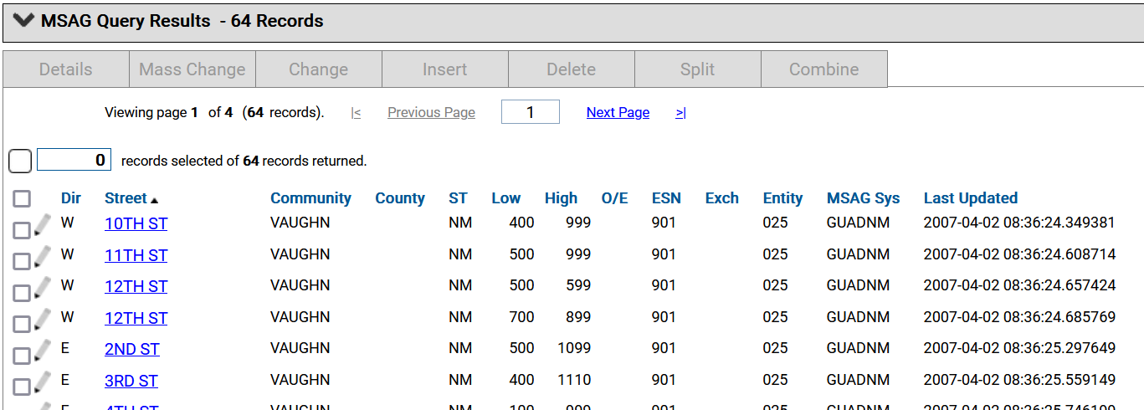
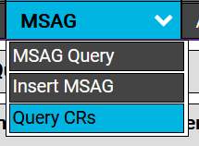
MSAG Updates: Tools/Functions
MSAG Tools
MSAG Query
MSAG Insert
Query CR
Notes:
Glenn – some info from your personal experience will be helpful.

Slide 53
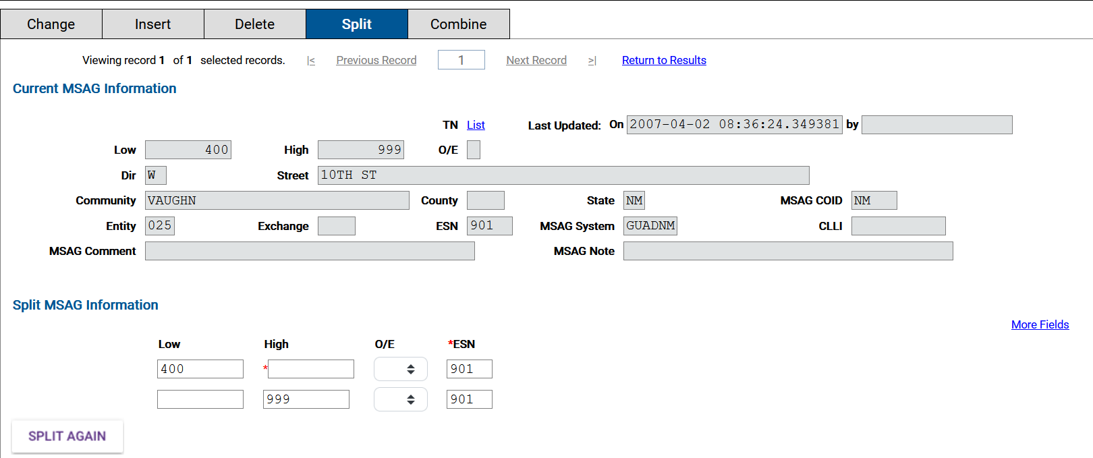
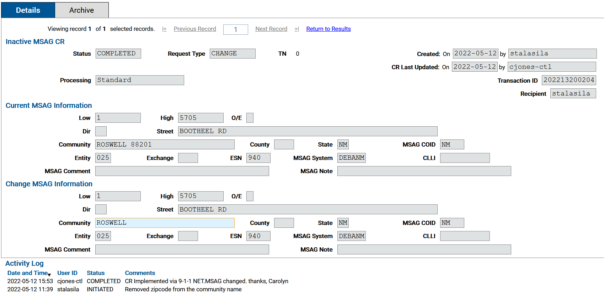
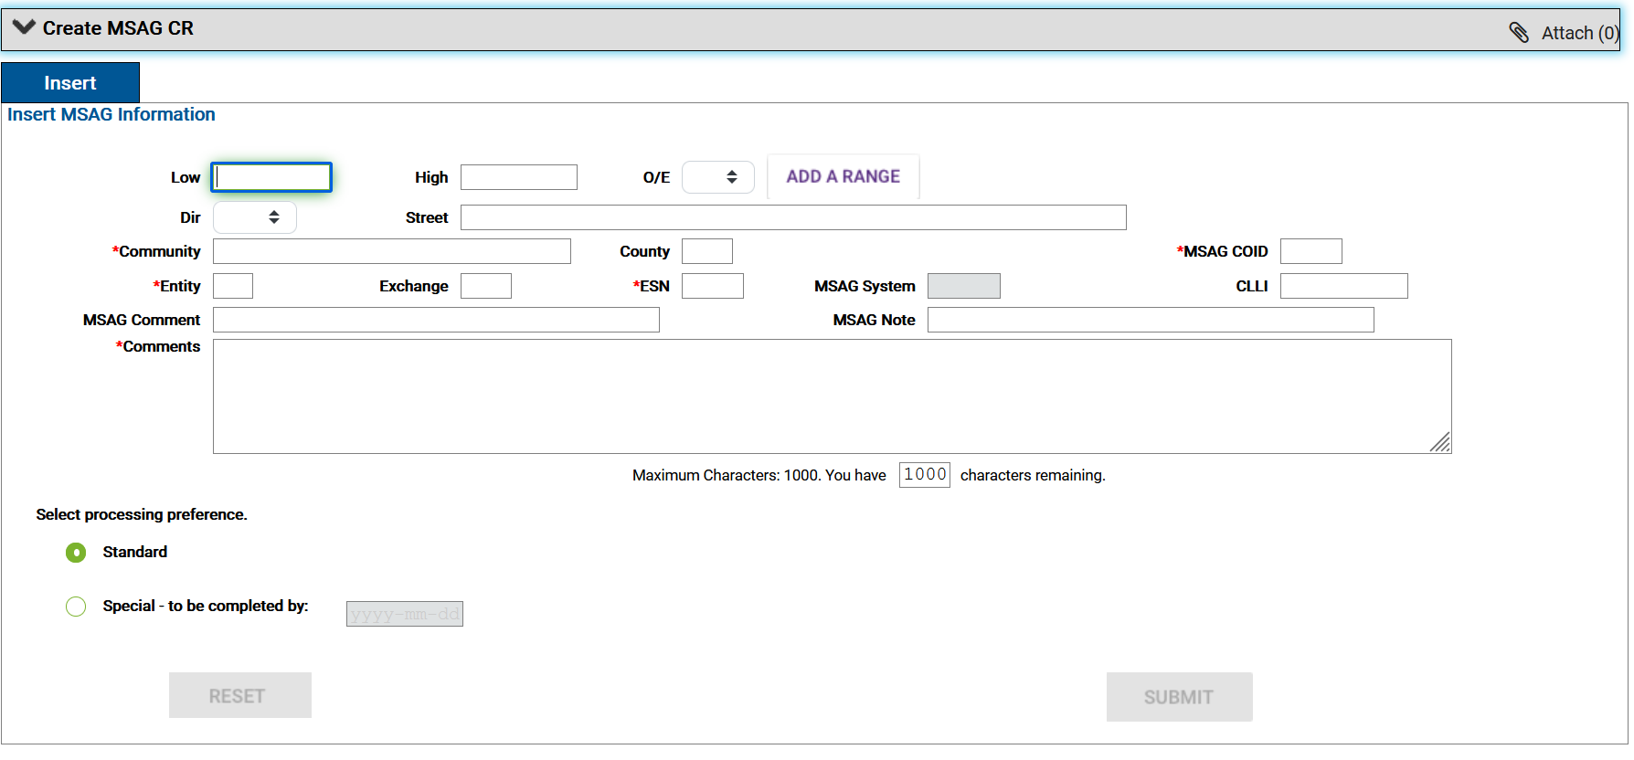
MSAG Split
Query Change Request
MSAG Insert

Slide 54
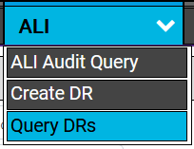
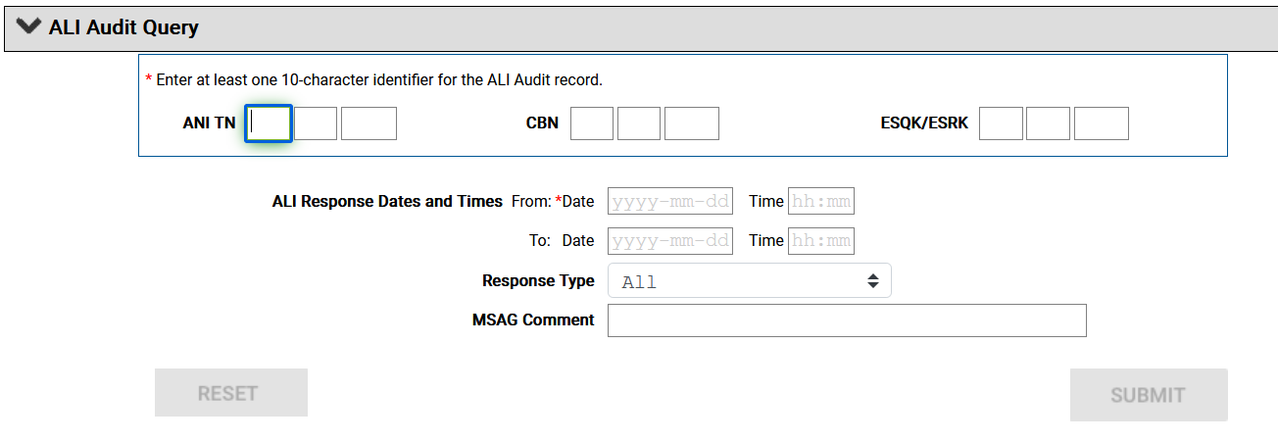
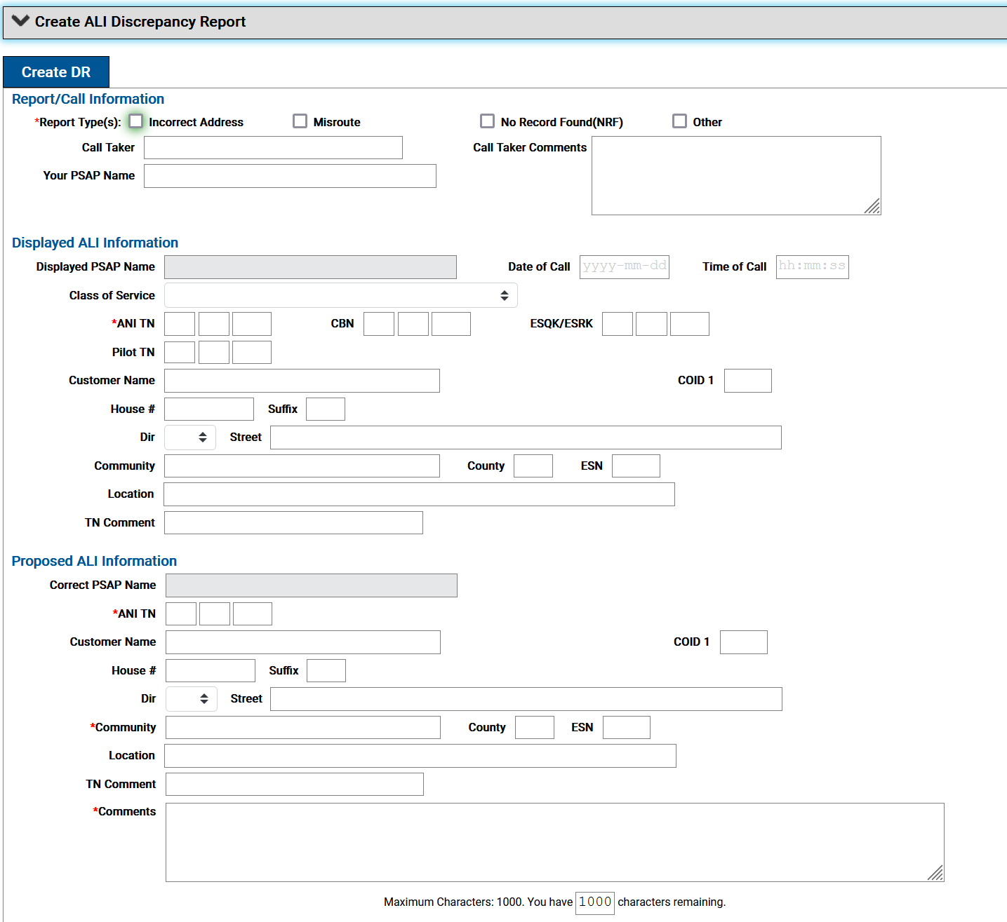

Slide 56
Local Exchange Carrier (LECs) & MSAG Updates
While Lumen (formerly CenturyLink) holds the 9-1-1 Database contract for the state, and contracts with Intrado, there are a dozen or more other phone companies in New Mexico
Each maintains customer service records with valid 9-1-1 addresses
Every time one of those records changes, the local phone company updates its records with Intrado through an SOI (Service Order Input)
These are done every day, and pass all adds/changes/deletes in their systems to Intrado for the 9-1-1 database
Making a change with Intrado does not make a change with the local phone company. And their data will overwrite what’s in the 9-1-1 database, so must be accurate too!

Slide 57
NM911 ArcGIS Hub
https://nm911-hub.maps.arcgis.com/

Slide 58
Contact Us
Data/Technical Questions
Sandeep Talasila
Earth Data Analysis Center, UNM
Email: nm911@edac.unm.edu
Phone: (505) 277-3622 x250
NM911 Data Portal: Submit a support request
General Questions
Tyler Fossett
NM911 GIS Coordinator
NM Department of Finance & Administration
Email: Tyler.Fossett@dfa.nm.gov
Phone: (505) 500-5587

