Slide 1
New Mexico’s RGIS Program: State Geospatial Data Clearinghouse
Laura Gleasner
Su Zhang
November 16, 2017

Slide 2
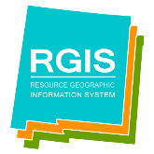
New Mexico RGIS: The State Digital Geospatial Data Clearinghouse
The Resource Geographic Information System (RGIS) is New Mexico’s statutorily designated (2013) State Digital Geospatial Data Clearinghouse. RGIS is the state’s primary source for geospatial data and information, technologies, and services.
Earth Data Analysis Center (EDAC) develops and enhances NM RGIS. The UNM Bureau of Business and Economic Research (BBER) provides Census and socioeconomic data. Numerous state and local agencies share their data and data services.
NM RGIS Data Portal rgis-data.unm.edu November 2017

Slide 3
RGIS History
1988 – New Mexico State agencies surveyed by four UNM units to assess the feasibility for developing a statewide computer mapping and geographic information system. (RGIS)
1989 – House Bill 218 requested funds for establishing a GIS clearinghouse
1990 – RGIS became a member of the New Mexico Geographic Information Systems Advisory Committee (GISAC
1992 – RGIS clearinghouse opened and provided digital data via 4mm and 8 mm tapes
1993 – Catalog of digital geographic data in New Mexico published. (cost $40.00)
1994 – EDAC received FGDC Cooperative Agreement Program award to develop FGDC compliant metadata
1996 – RGIS website inaugurated. Provided information on the program and metadata. Data not available yet via the website. CD-ROM set of clearinghouse data released. Cost per CD was $150.00.
1997 – RGIS Clearinghouse upgraded to a National Spatial Data Infrastructure (NSDI) compliant node. Metadata could be searched by keywords and/or geographic coordinates
1998 – Version 2 of the Resource Data CD released. First metadata training workshops supported by FGDC and RGIS were held.
2001 – RGIS website redesigned to provide online access to digital data. Data available at no cost!
2002 – Road centerline data collected by New Mexico Counties were made available
2008 – RGIS website redesigned
2013 - The RGIS website was redesigned to accommodate more sophisticated capabilities such as data discovery, access, and web mapping services.
2013 - RGIS designated State Digital Geospatial Data Clearinghouse by the NM Legislature and Governor (2013, HB493)
2015 – RGIS – ERDAS APOLLO released
NM RGIS Data Portal rgis-data.unm.edu November 2017

Slide 4
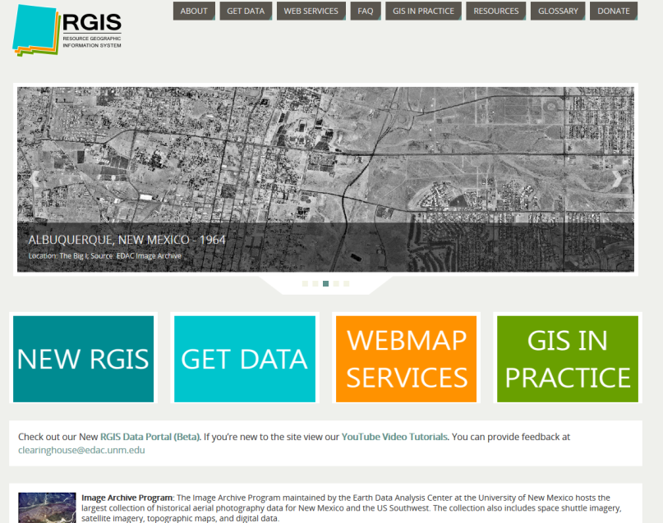
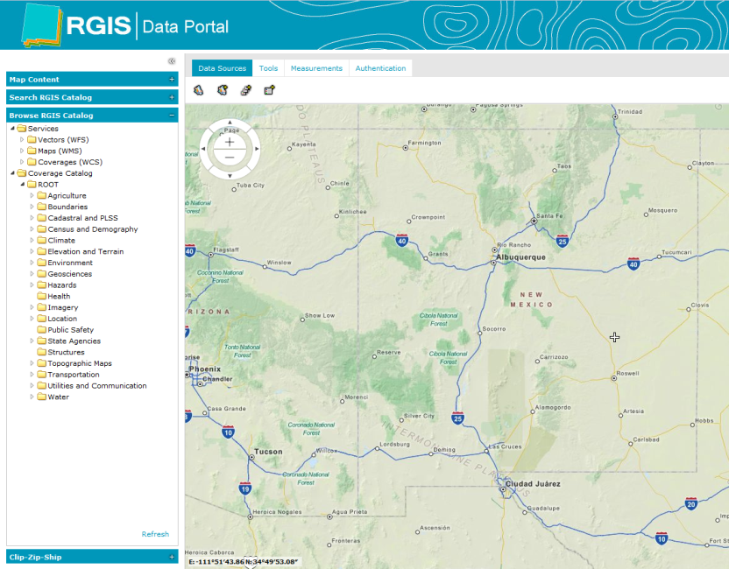
NM RGIS Data Portal
Popular datasets
LiDAR data (hillshade and DEM)
NAIP 2016 Mosaic and County Mosaics
State Imagery: Mosaics in addition to individual tiles
Historic Aerial Photo Indexes
Landsat Satellite Imagery 2014 County Mosaics
E-911 Roads and Address Points
Updated Boundaries
Wildfire Boundaries, Burn Severity
CASA (Community Anchor Site Assessment: Public Safety, Schools, Hospitals…)
USGS Earthquakes
FEMA National Flood Hazard Layer
FEMA Preliminary Maps
Updated USGS NHD
NM RGIS Data Portal http://rgis.unm.edu
NM RGIS Data Portal rgis-data.unm.edu November 2017

Slide 5
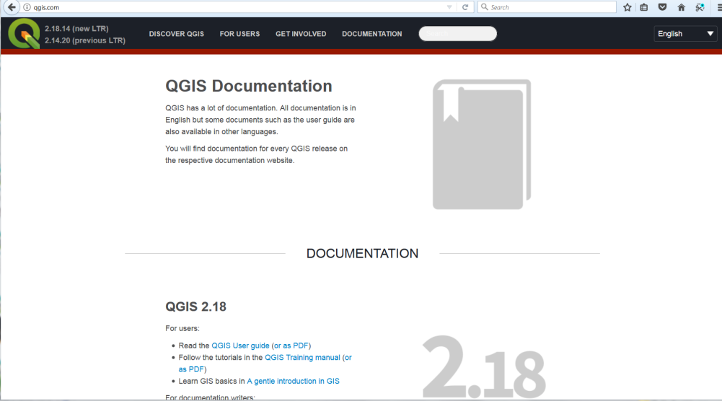
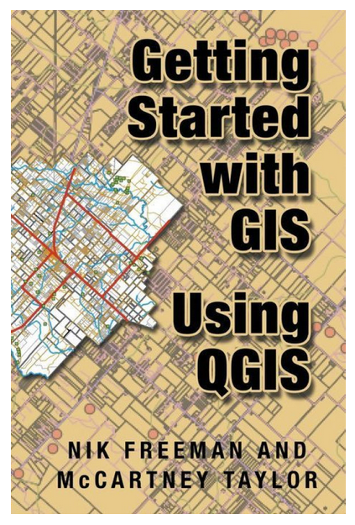
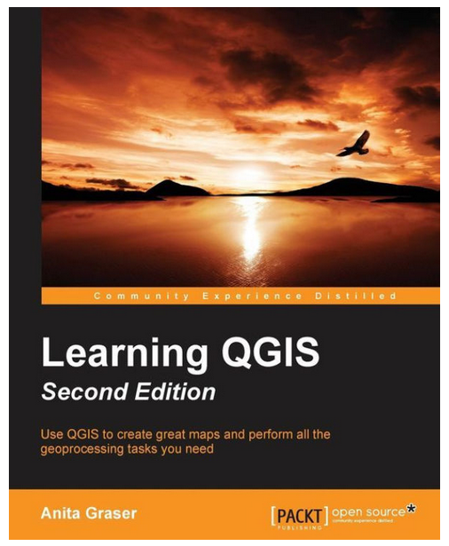
QGIS Help
NM RGIS Data Portal rgis-data.unm.edu November 2017

Slide 6
Laura Gleasner, Data Manager
505-277-3622 ext. 230
lgleasner@edac.unm.edu
Su Zhang, Sr. Research Engineer 1
szhang@edac.unm.edu
NM RGIS Data Portal rgis-data.unm.edu November 2017

