Slide 1
New Mexico’s RGIS Program: State Geospatial Data Clearinghouse
Laura Gleasner
November 10, 2016

Slide 2
New Mexico RGIS: The State Digital Geospatial Data Clearinghouse
The Resource Geographic Information System (RGIS) is New Mexico’s statutorily designated (2013) State Digital Geospatial Data Clearinghouse. RGIS is the state’s primary source for geospatial data and information, technologies, and services.
Earth Data Analysis Center (EDAC) develops and enhances NM RGIS. The UNM Bureau of Business and Economic Research (BBER) provides Census and socioeconomic data. Numerous state and local agencies share their data and data services.
NM RGIS Beta Data Portal rgis-data.unm.edu November 2016

Slide 3
RGIS History
1988 – New Mexico State agencies surveyed by four UNM units to assess the feasibility for developing a statewide computer mapping and geographic information system. (RGIS)
1989 – House Bill 218 requested funds for establishing a GIS clearinghouse
1990 – RGIS became a member of the New Mexico Geographic Information Systems Advisory Committee (GISAC
1992 – RGIS clearinghouse opened and provided digital data via 4mm and 8 mm tapes
1993 – Catalog of digital geographic data in New Mexico published. (cost $40.00)
1994 – EDAC received FGDC Cooperative Agreement Program award to develop FGDC compliant metadata
1996 – RGIS website inaugurated. Provided information on the program and metadata. Data not available yet via the website. CD-ROM set of clearinghouse data released. Cost per CD was $150.00.
1997 – RGIS Clearinghouse upgraded to a National Spatial Data Infrastructure (NSDI) compliant node. Metadata could be searched by keywords and/or geographic coordinates
1998 – Version 2 of the Resource Data CD released. First metadata training workshops supported by FGDC and RGIS were held.
2001 – RGIS website redesigned to provide online access to digital data. Data available at no cost!
2002 – Road centerline data collected by New Mexico Counties were made available
2008 – RGIS website redesigned
2013 - The RGIS website was redesigned to accommodate more sophisticated capabilities such as data discovery, access, and web mapping services.
2013 - RGIS designated State Digital Geospatial Data Clearinghouse by the NM Legislature and Governor (2013, HB493)
2015 – RGIS – ERDAS APOLLO released
NM RGIS Beta Data Portal rgis-data.unm.edu November 2016

Slide 4
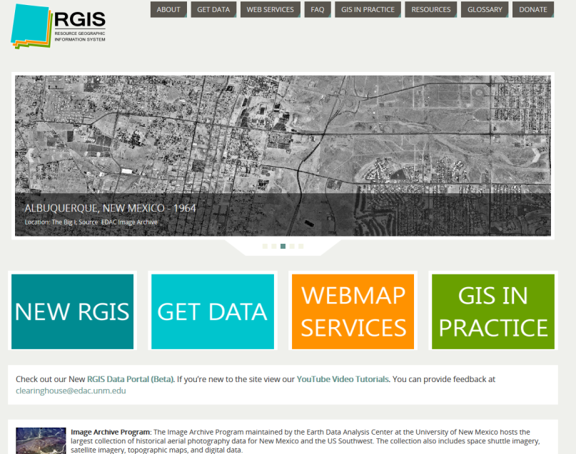
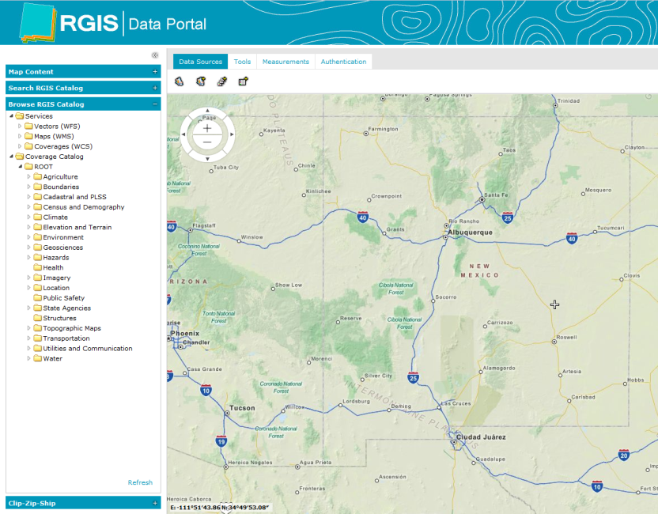
NM RGIS Data Portal
New and Updated Data
MRCoG 2016 Mosaic and County Mosaics
State Imagery: Mosaics in addition to individual tiles
Historic Aerial Photo Indexes
Landsat Satellite Imagery 2014 County Mosaics
E-911 Roads and Address Points
Updated Boundaries
Wildfire Boundaries, Burn Severity
Livestock, Range Management
CASA (Community Anchor Site Assessment: Public Safety, Schools, Hospitals…)
USGS Earthquakes
FEMA National Flood Hazard Layer
FEMA Preliminary Maps
Updated USGS NHD
NM RGIS Data Portal http://rgis.unm.edu
NM RGIS Beta Data Portal rgis-data.unm.edu November 2016

Slide 5
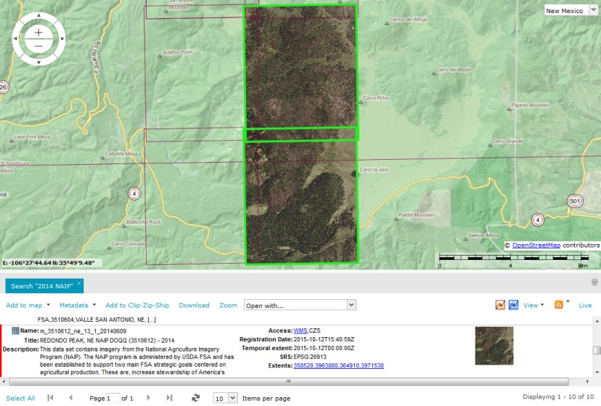
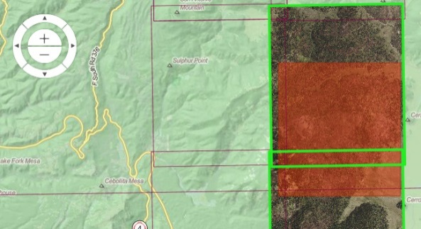
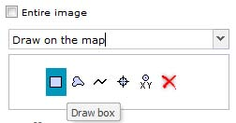
NM RGIS Data Portal
New Functions and Tools
Search RGIS Catalog: By Keywords, Type, Data Type, Spatial Filter, Availability, Date
Browse RGIS Catalog: By Web Service, Vector Category, Raster Category
Interactive Mapping: Show Extent, Add to Map, Zoom Options, Extent, Add Multiple Layers
Mapping Tools: Identify Features, Measure Distance/Area, Display Feature Classes and Queries, Set Map Scale, Print, Show Coordinates
Download Tools: OGC Web Services, Download (large files) via e-mailed link, Clip-Zip-Ship (for small subsets of raster/image data)
Metadata: Overview, Full Content, Download
NM RGIS Beta Data Portal rgis-data.unm.edu November 2016

Slide 6
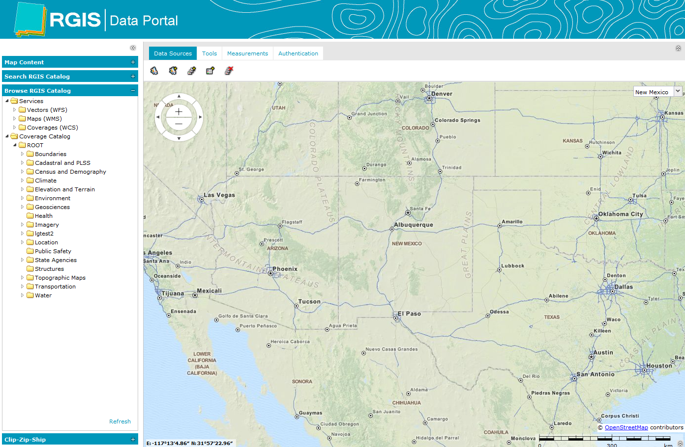
NM RGIS: Finding Data
Search RGIS Catalog
Browse RGIS Catalog
NM RGIS Beta Data Portal rgis-data.unm.edu November 2016

Slide 7
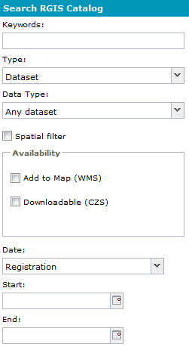
Search RGIS Catalog
Search by:
Keywords [free text]
Type: Data Set [default], Aggregates, Service Layers
Data Type: Any Data Set [default], Imagery, Vector, Point Cloud, Documents
Spatial Filter: Visible Map Area, Draw on Map, Select Feature from Map
Availability: Add to Map (WMS), Downloadable (CZS)
Date: Registration [default], Temporal Extent (Begin and End Dates)
NM RGIS Beta Data Portal rgis-data.unm.edu November 2016

Slide 8
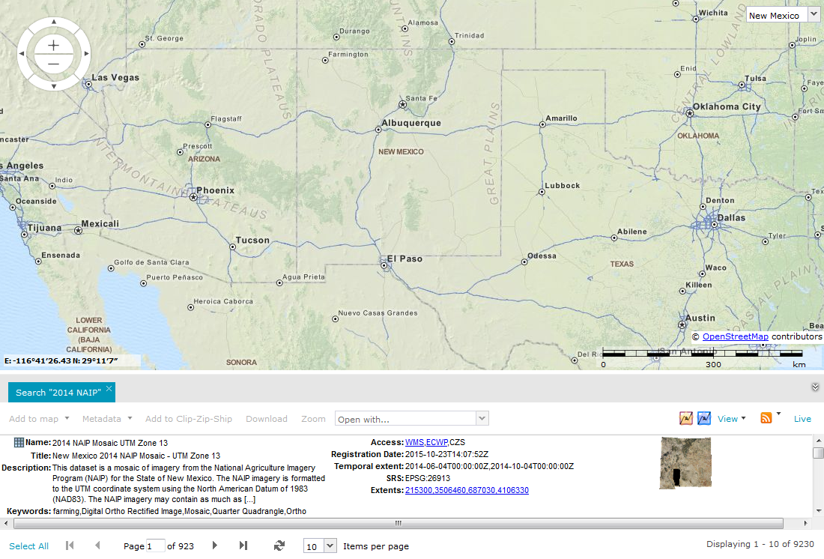
Search Catalog: Keywords
Data Results
NM RGIS Beta Data Portal rgis-data.unm.edu November 2016

Slide 9
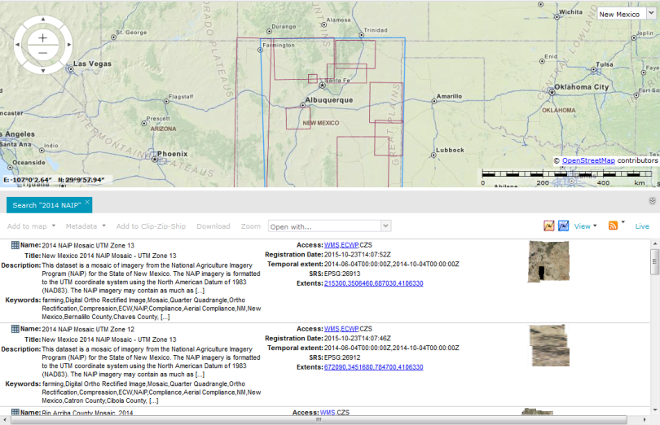
Data Results
Results Name/Category
NM RGIS Beta Data Portal rgis-data.unm.edu November 2016

Slide 10
Data Results
Results Name/Category
Thumbnail
Items per Page
NM RGIS Beta Data Portal rgis-data.unm.edu November 2016

Slide 11
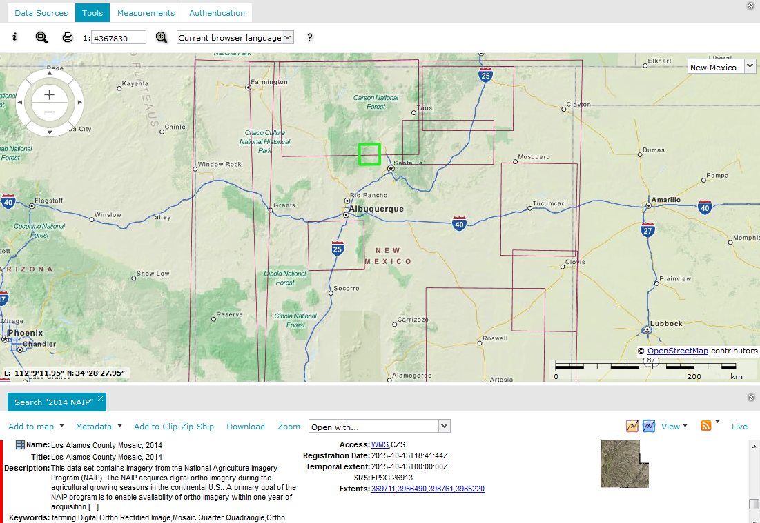
Select Dataset
Bounding Box
for Selected Data Set
Click Anywhere in Panel to Select Data Set (red identifies selection)
NM RGIS Beta Data Portal rgis-data.unm.edu November 2016

Slide 12
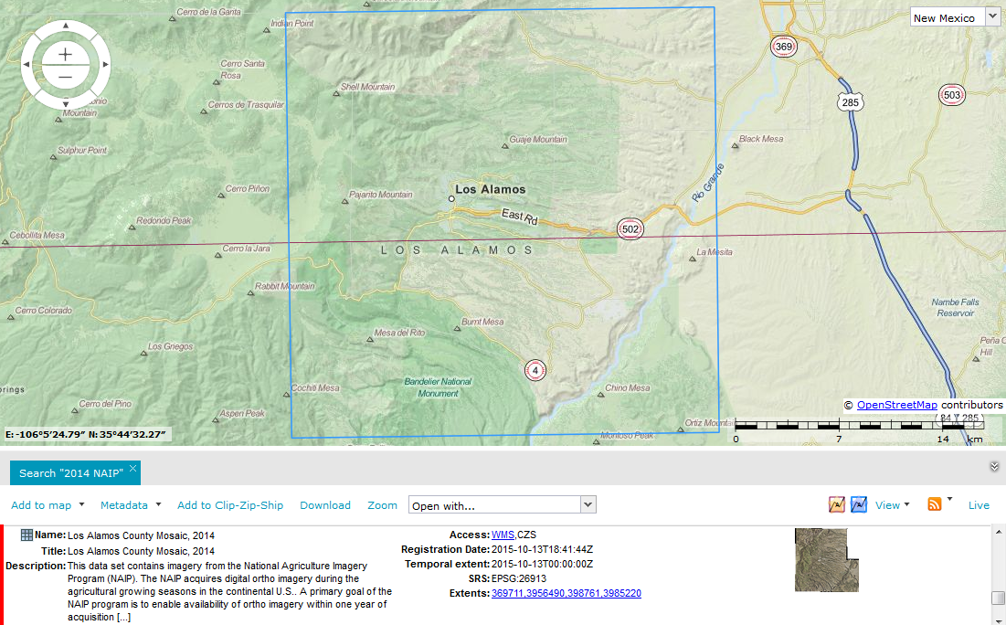
Data Results: Visualization
Map Extent
Map Extent
NM RGIS Beta Data Portal rgis-data.unm.edu November 2016

Slide 13
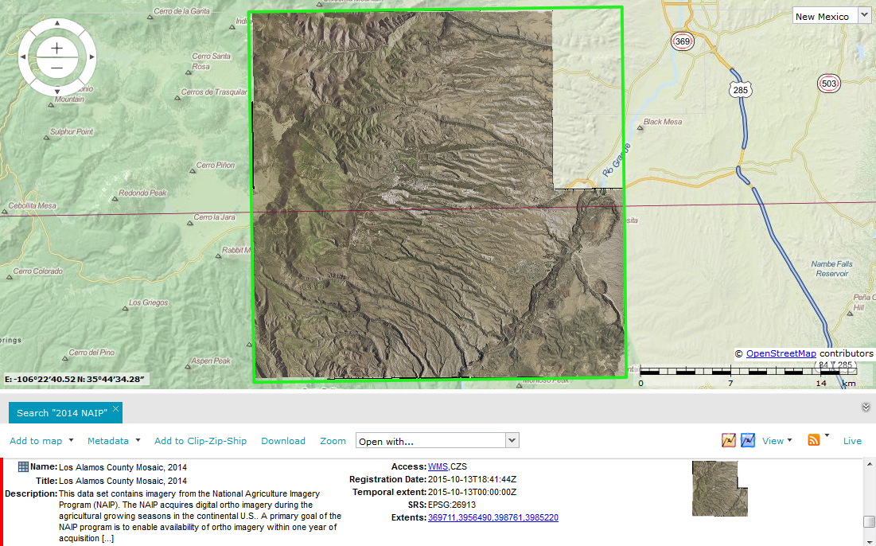
Data Results: Visualization
Add to Map
NM RGIS Beta Data Portal rgis-data.unm.edu November 2016

Slide 14
Data Results: Metadata, Download, Web Services
View/Download Metadata
NM RGIS Beta Data Portal rgis-data.unm.edu November 2016

Slide 15
Data Results: Download
Download Data Set (e-mailed link for large files)
NM RGIS Beta Data Portal rgis-data.unm.edu November 2016

Slide 16
Data Results: Web Services
Access Web Data Services
NM RGIS Beta Data Portal rgis-data.unm.edu November 2016

Slide 17
Data Results: Clip/Zip/Ship
Select Subset for Download (Raster only; e-mailed link)
NM RGIS Beta Data Portal rgis-data.unm.edu November 2016

Slide 18
Data Results: Open With
NM RGIS Beta Data Portal rgis-data.unm.edu November 2016

Slide 19
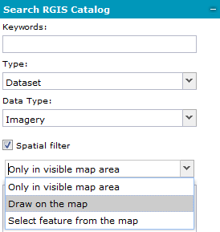
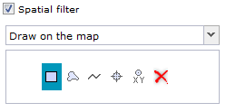
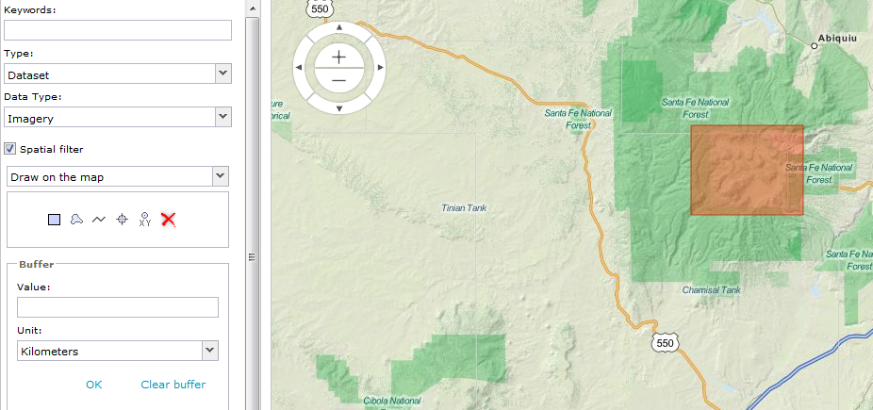
Search Catalog: Spatial Filter and Data Type
NM RGIS Beta Data Portal rgis-data.unm.edu November 2016
Click on map, release, and draw
Double-click to finish box

Slide 20
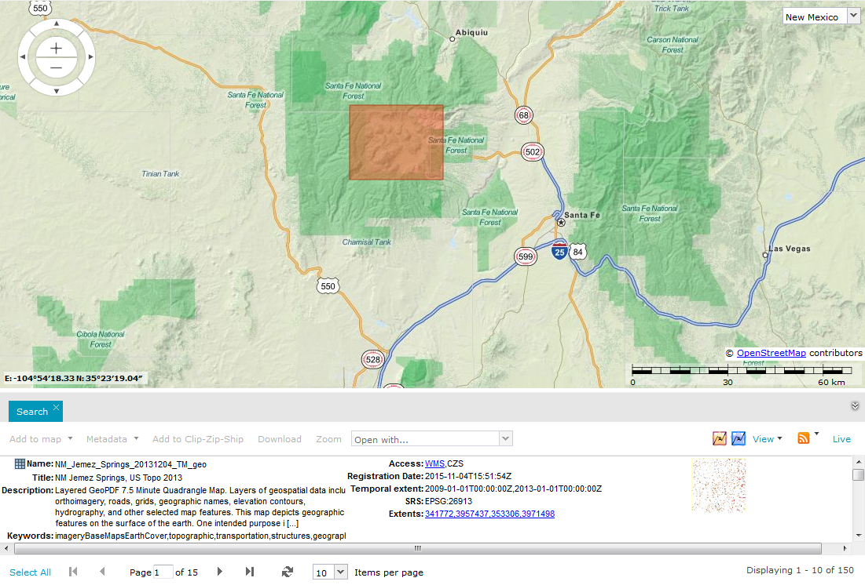
Search Catalog: Spatial Filter and Data Type
NM RGIS Beta Data Portal rgis-data.unm.edu November 2016

Slide 21
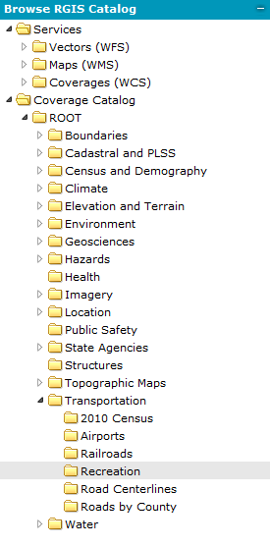
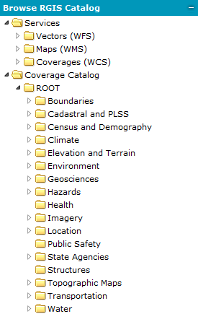
Browse RGIS Catalog
Expand Directories
to find data set
of interest
NM RGIS Beta Data Portal rgis-data.unm.edu November 2016

Slide 22
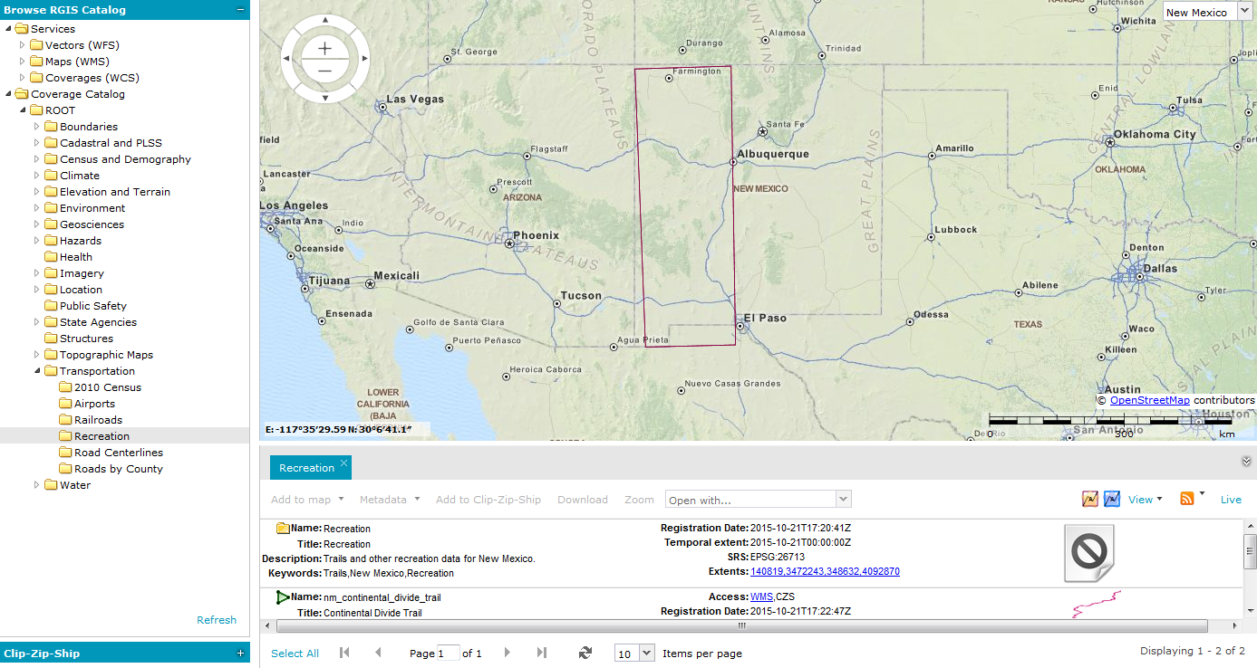
Browse Catalog:
Click on Directory for data results
NM RGIS Beta Data Portal rgis-data.unm.edu November 2016

Slide 23
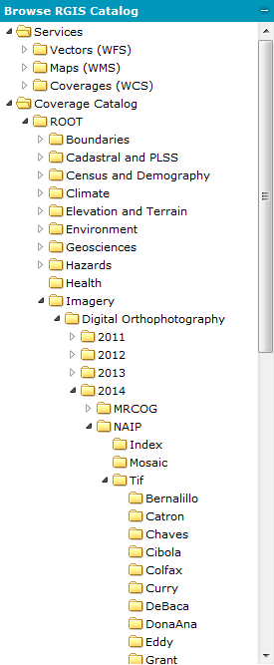
Browse Catalog: Another Example
Find DOQQs
under Imagery

Slide 24
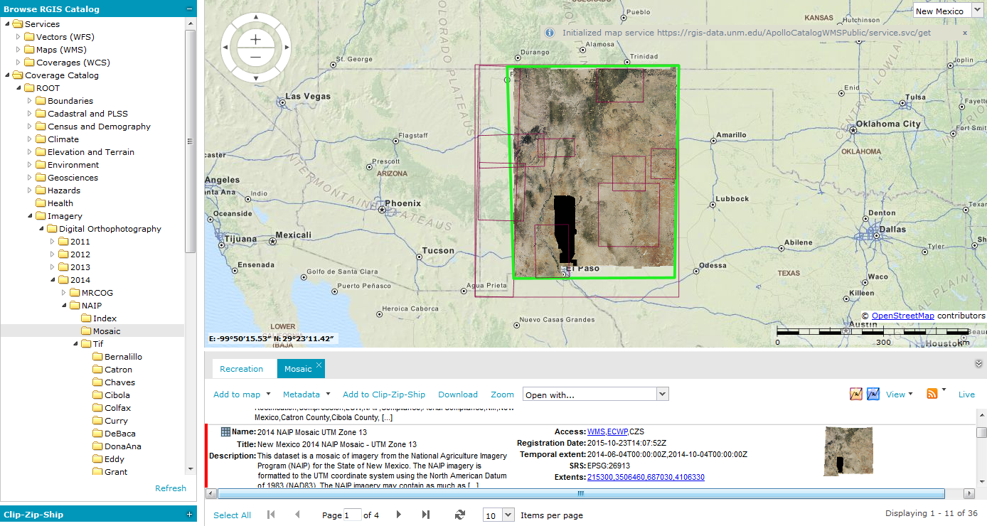
Web Services
Imagery > Digital Orthophotography > 2014 > NAIP > Mosaic
Select Data Set (also in this example, Show Extent and Add to Map)
NM RGIS Beta Data Portal rgis-data.unm.edu November 2016

Slide 25
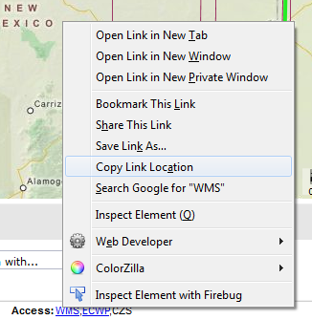
Web Services
Right-click on WMS link > select Copy Link Location
Add WMS Service to GIS Application
NM RGIS Beta Data Portal rgis-data.unm.edu November 2016

Slide 26
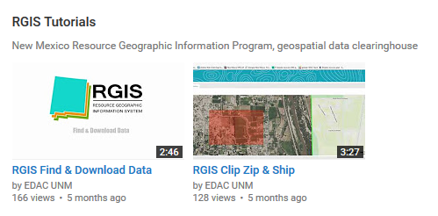
NM RGIS Quick Guides and Videos
Finding Data
Interactive Mapping
Downloading Data (includes the new Clip-Zip-Ship function)
access Quick Guides at rgis.unm.edu
You-Tube Videos
NM RGIS Beta Data Portal rgis-data.unm.edu November 2016

Slide 27
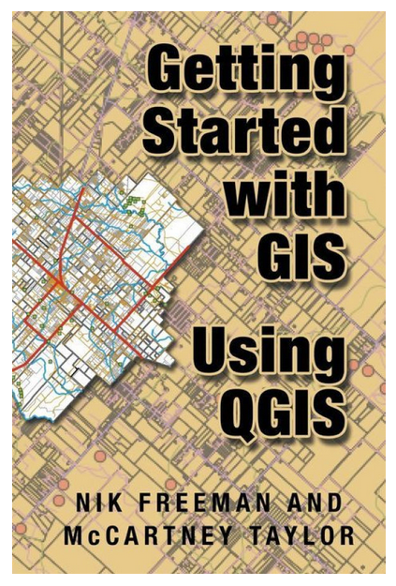
QGIS Demo
NM RGIS Beta Data Portal rgis-data.unm.edu November 2016

Slide 28
Laura Gleasner, Data Manager
505-277-3622 ext. 230
lgleasner@edac.unm.edu
Su Zhang, Research Assistant
szhang@edac.unm.edu
NM RGIS Beta Data Portal rgis-data.unm.edu November 2016

